Slide 1
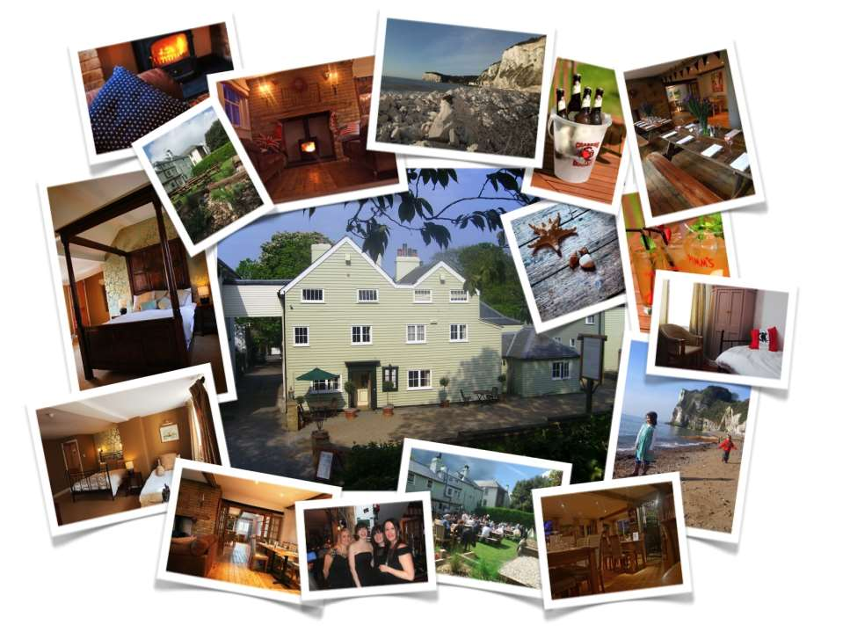
Hotel and Classification of Hotels

Slide 2
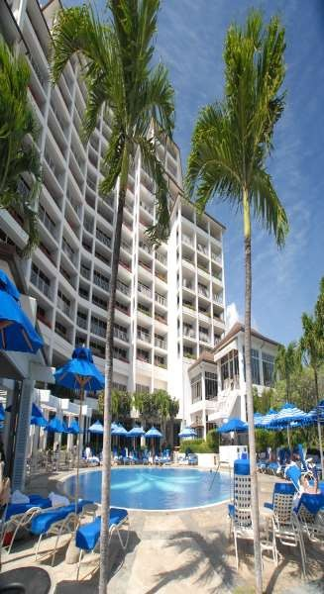
HOTEL
An establishment that provides lodging and usually meals and other services for travelers and other paying guests.
A hotel is a type of establishment that accommodates visitors for a short stay at a stated fee
a commercial establishment offering lodging to travelers and sometimes to permanent residents, and often having restaurants, meeting rooms, stores, etc., that are available to the general public.

Slide 3
CLASSIFICATION OF HOTELS
Based on Location
Based on Ownership
and Affiliation
Based on Target Market
TYPES OF
HOTEL
Based on size
Based on Star rating
Based on Theme
Based on Length of Stay
Based on Level of Service

Slide 4
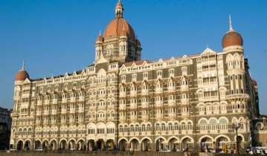
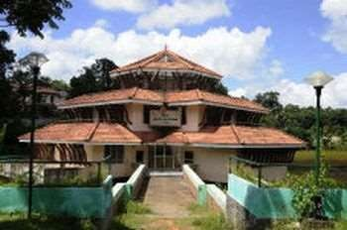
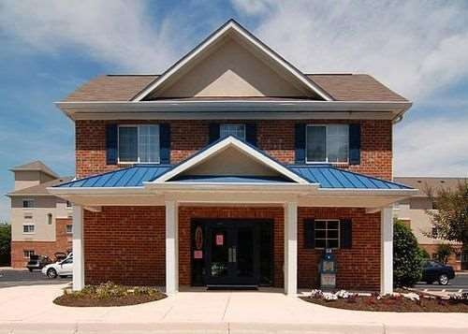
Based on Location
City center/Downtown : Generally located in the heart of city within a short distance from business center, shopping arcade. Rates are normally high due to their location advantages. They have high traffic on weekdays and the occupancy is generally high.
Example: Taj Mahal, Mumbai
Motels: They are located primarily on highways, they provide lodging to highway travelers and also provide ample parking space. The length of stay is usually overnight.
Example: KTDC, Kerala
Suburban hotels: They are located in suburban areas, it generally have high traffic on weekend. It is ideal for budget travelers. In this type of hotel rates are moderately low.

Slide 5

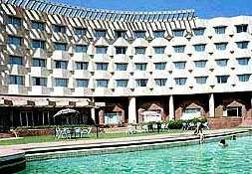


Airport hotels: These hotels are set up near by the airport. They have transit guest who stay over between flights.
Example: Centaur hotel , New Delhi
Resort hotels: They are also termed as health resort or beach hill resort and so depending on their position and location. They cater a person who wants to relax, enjoy themselves at hill station. Most resort work to full capacity during peak season. Sales and revenue fluctuate from season to season.
Example: Raj Vilas , Jaipur
Rotels: These novel variants are hotel on wheel. Our very own "palace on wheels" and "Deccan Odyssey" are trains providing a luxurious hotel atmosphere.Their interior is done like hotel room. They are normally used by small group of travelers.
Example: Palace on wheels

Slide 6
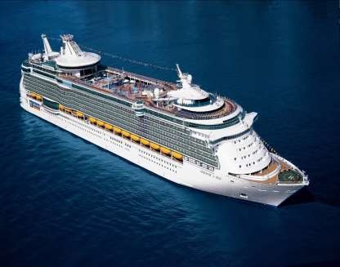
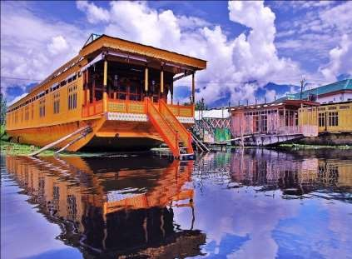
Floating hotels: As name implies these hotels are established on luxury liners or ship. It is located on river, sea or big lakes. In cruise ships, rooms are generally small and all furniture is fixed down. It has long stay guest. Example: Royal Caribbean cruise ships
Boatels: A house boat hotels is referred as boatels. The shikaras of Kashmir and Kettuvallam of Kerala are houseboats in India which offers luxurious accommodation to travelers.
Example: Shikaras , Kashmir

Slide 7
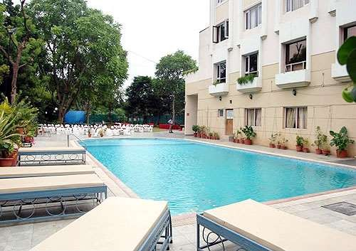
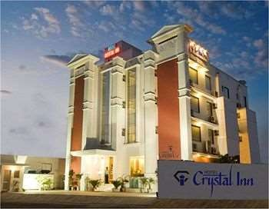
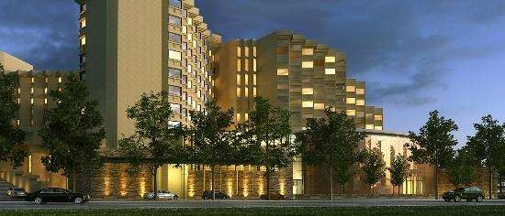
Based on the Level of Service
Economy/ Budget hotels: These hotels meet the basic need of the guest by providing comfortable and clean room for a comfortable stay.
Example: Central Park , Gwalior
Mid market hotels: It is suite hotel that offers small living room with appropriate furniture and small bed room with king sized bed.
Example: Crystal Inn , Agra
Luxury hotels: These offer world class service providing restaurant and lounges, concierge service, meeting rooms, dinning facilities. Bath linen is provided to the guest and is replaced accordingly. These guest rooms contains furnishing, artwork etc. prime market for these hotels are celebrities, business executives and high ranking political figures.
Example: Hyatt Regency, New Delhi.

Slide 8
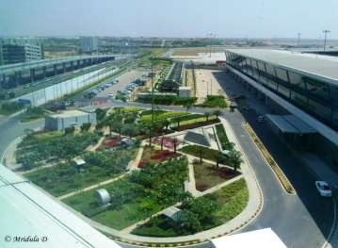
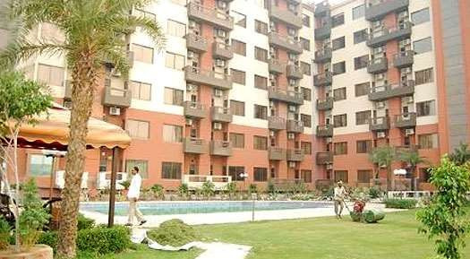
Based on the Length of Stay
Transit hotels : These are the hotel where guest stays for a day or even less, they are usually five star hotels. The occupancy rate is usually very high. These hotels are situated near airport.
Example: Eaton Smart Airport Transit Hotel at New Delhi
Residential hotels: These are the hotel where guest can stay for a minimum period of one month and up to a year. The rent can be paid on monthly or quarterly basis. They provide sitting room, bed room and kitchenette.
Example: Hare Krishna Orchid Residential Retreat, Mathura
Semi residential hotels: These hotels incorporate features of both transit and residential hotel.

Slide 9

Hotel Taj Wellington Mews- A residential hotel in Mumbai

Slide 10
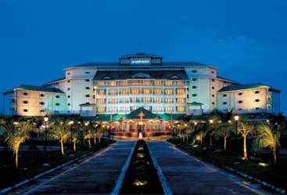
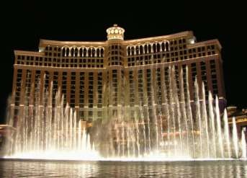
Based on Target Market
Commercial hotel: They are situated in the heart of the city in busy commercial areas so as to get good and high business. They cater mostly businessmen.
Convention hotels: These hotels have large convention complex and cater to people attending a convention, conference
Example: Le Meridian, cochin, JayPee Palace Agra
Suite hotels: These hotel offer rooms that may include compact kitchenette. They cater to people who are relocating act as like lawyers, executives who are away from home for a long business stay.
Casino hotels: Hotel with predominantly gambling facilities comes under this category, they have guest room and food and operation too. These hotels tend to cater leisure and vacation travelers. Gambling activities at some casino hotels operate 24 hours a day and 365 days a year.
Example: Las Vegas in United State

Slide 11
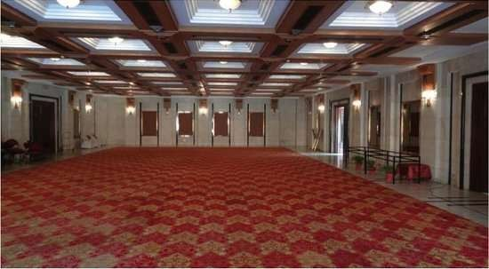

Slide 12
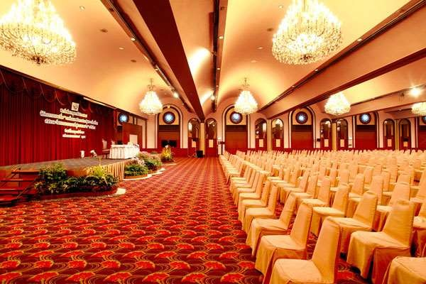
A Convention Hall in a Hotel

Slide 13

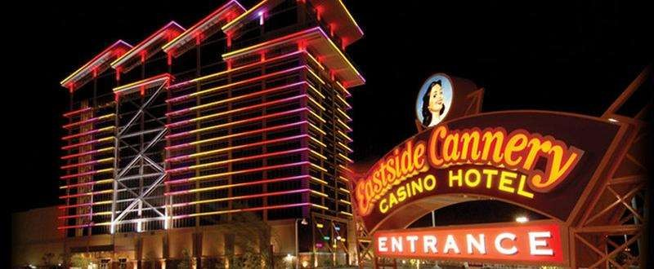

Slide 14
Based on size
Small – Less than 25 rooms Medium – 25-99
Large Mega
– 100-299
– More than 299 rooms
Based on Star rating
Single Star | 1*
Two Star | 2*
Three Star | 3*
Four Star | 4*
Five Star | 5*
Seven Star | 7*

Slide 15
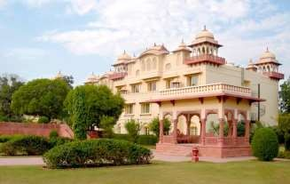
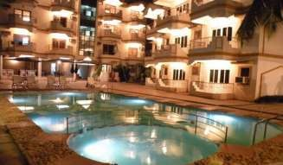
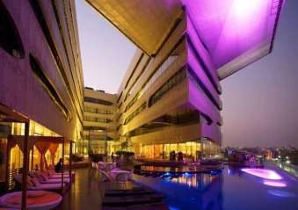
Based on Theme
Heritage hotel: In this hotel a guest is graciously welcomed, offered room that have their own history, serve traditional cuisine and are entertained by folk artist. These hotels put their best efforts to give the glimpse of their region’s history and culture.
Example: Jai Mahal palace in Jaipur.
Ecotels : these are environment friendly hotels these hotel use eco friendly items in the room. Example: Orchid Mumbai is Asia first and most popular five star Ecotels.
Boutique hotels: This hotel provides exceptional accommodation, furniture in a themed and stylish manner and caters to corporate travelers. Example: In India The Park Bangalore is a boutique hotel
Spas: is a resort which provide therapeutic bath and massage along with other features of luxury hotels in India. Ananda spa in Himalayas are the most popular Spa.

Slide 16



Slide 17
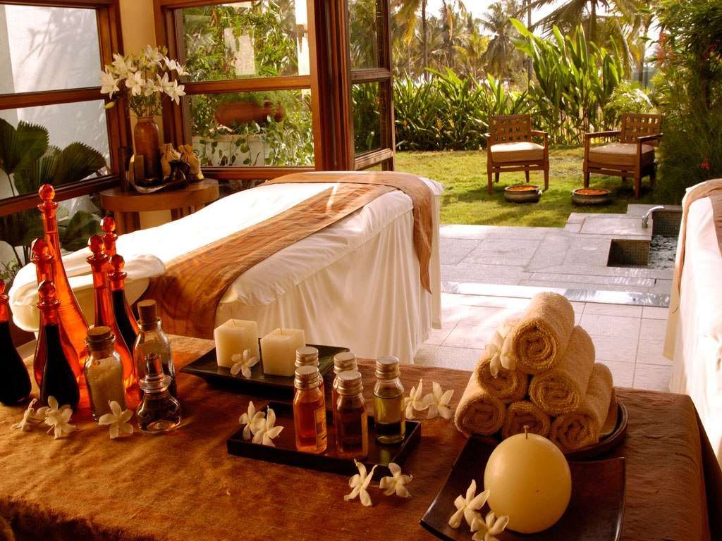

Slide 18
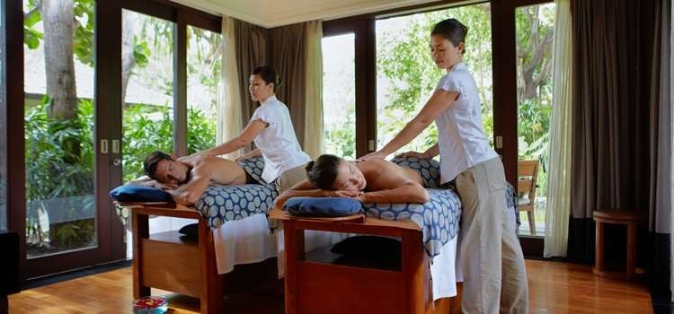
A Spa Hotel services

Slide 19
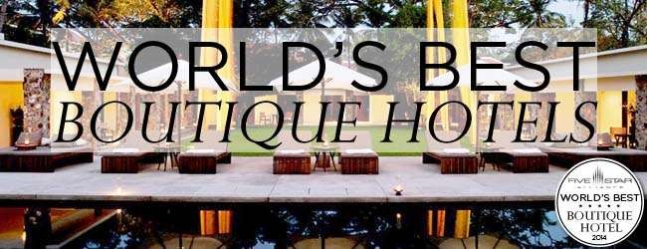
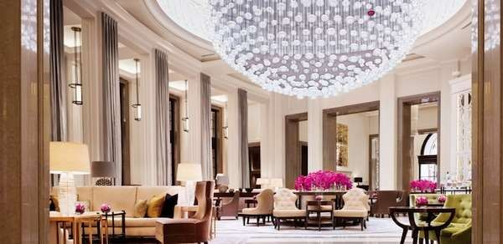
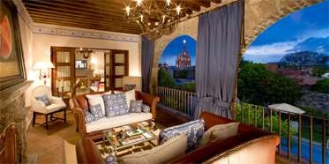

Slide 20
Based on Ownership and Affiliation
Independent Hotels :- They do not have identifiable ownership or management affiliation with other properties. That means these properties doesn't have any relationship to another hotel regarding policies , procedures , marketing or financial obligations . Example for the same would be family owned and operated hotel that is not following any corporate policies or procedures. The advantage of a individual property is its autonomy . An independent hotel however does not get the advantage of board advertising exposure or management insight and consultancy of an affiliated property .
Chain hotels :- These kind of ownership usually imposes certain minimum standards, rules , policies and procedures to restrict affiliate activities . In general the more centralized the organization the stronger the control over the individual property . Some chain have strong control over the architecture, management and standards of affiliate properties . Others concentrate only on marketing , advertising and central purchasing .

Slide 21
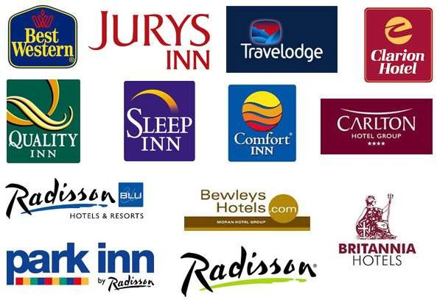

Slide 22
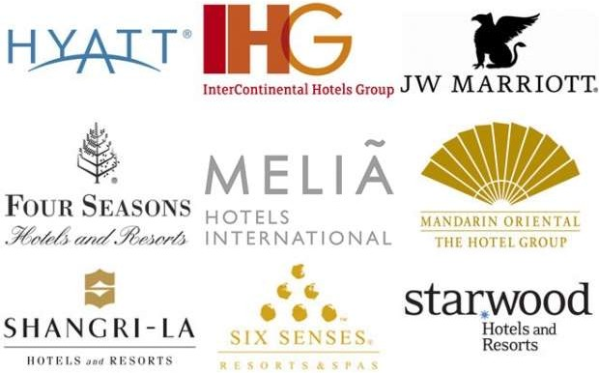

Slide 23
Timeshare and condominium Hotels: - Another new type or segment of the hospitality industry is the timeshare hotels. These are sometimes referred to as " Vacation-interval" hotels . Timeshare hotels are where the guests who purchase the ownership of accommodations for a specific period .These owners may also have the unit rented out by the management company that operates the hotel . Condominium are similar to timeshare but the difference between the two lies in the type of ownership. Units in condominium hotels only have one owner instead of multiple owners , each for a limited amount of time each year. In a condominium hotel, an owner informs the management company if when he/ she wants to occupy the unit.
Management Contract: Management companies are organizations that operate properties owned by others. Those other hotels may be owned by individual persons, partnerships or private limited companies . The individual hotel, under construction, may contract with a professional hotel management company to operate the proposed property . These contracts are normally on a long-term basis. Some management companies, when feel that they must have a hotel in a particular location then they approach prospective individuals to build a hotel and operate under their managements contract.

Slide 24
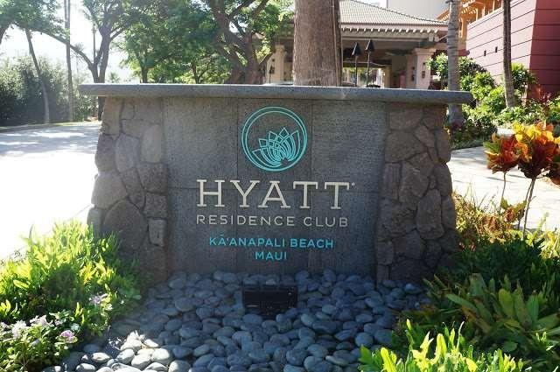

Slide 25
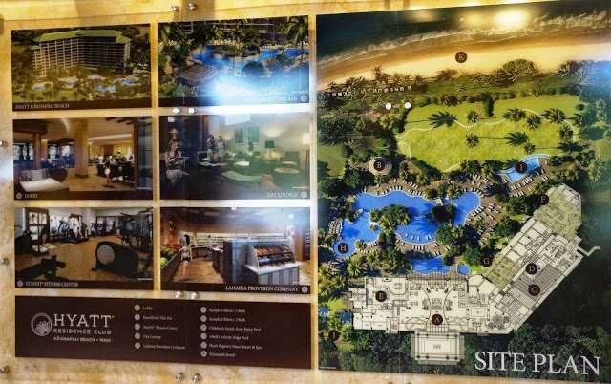

Slide 26




Slide 27


Slide 28
THANK YOU

