Slide 1
Introduction to customer service

Slide 2
Topics Covered
Customer service defined
A history of customer service
The role of customer service
  Unique characteristics of services
  Services marketing triangle
  The services marketing mix
The importance of customer service in the tourism and hospitality sector

Slide 3
Customer service
“Customer service is the practice of delivering products and services to both internal and external customers via the efforts of employees or through the provision of an appropriate servicescape.”
It acknowledges that customer service is more that interaction between employees and customers
It also relates to the physical infrastructure or the hospitality ‘servicescape’

Slide 4
History of customer service
1800s Craftsman economy
  Business owners also frontline employees
  Customized orders
20th century mass production
  Less individualized service
  Power of suppliers surpasses that of consumers
  1970s: Western manufacturers compete with Asia
  1990s: Suppliers more selective
Present day: Shift to service economy

Slide 5
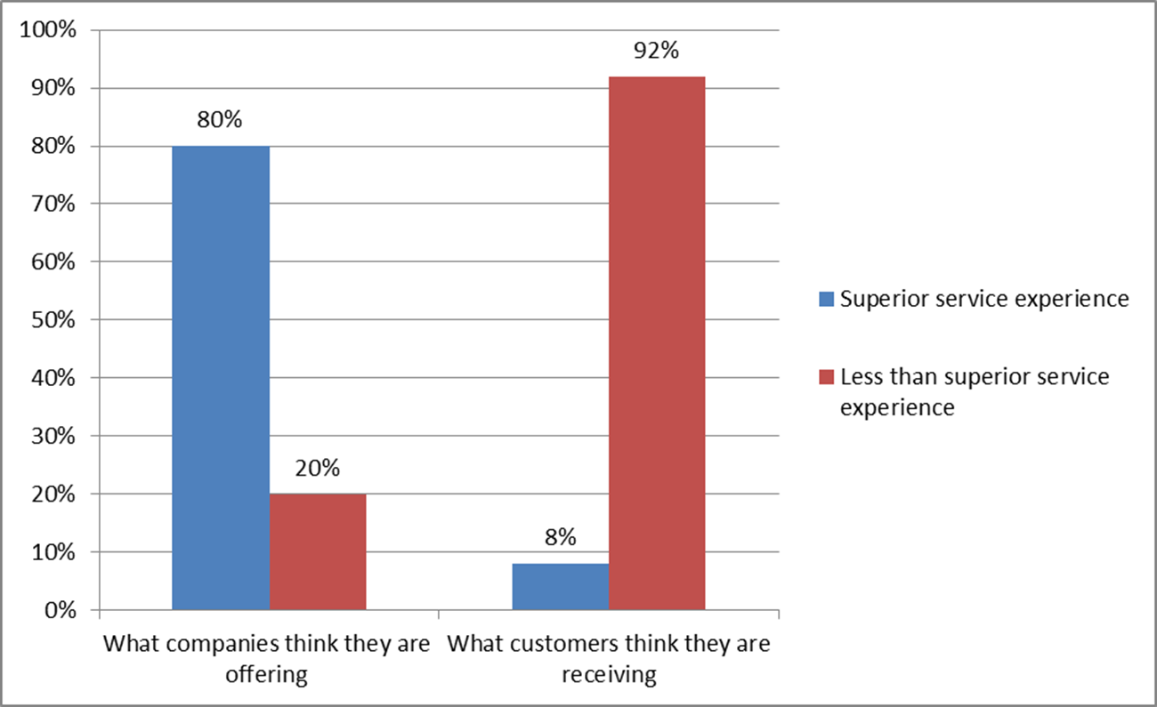
Reasons companies may not provide excellent customer service include….
Companies wrongly believe they are providing service excellence
Organizations don’t understand the significance of customer service
Companies don’t know how to deliver consistent, high quality customer service on an on-going basis

Slide 6
Role of customer service
Models to assist in services marketing and management decisions at the strategic and implementation levels:
Four unique characteristics of services
The services marketing triangle
The marketing mix for services

Slide 7
Unique characteristics of services

Slide 8
The services marketing triangle

Slide 9
Tourism and hospitality market
The World Tourism Organization is the United Nations specialized agency entrusted with the promotion of responsible, sustainable and universally accessible tourism.
As the leading international organization in the field of tourism, UNWTO promotes tourism as a driver of economic growth, inclusive development and environmental sustainability and offers leadership and support to the sector in advancing knowledge and tourism policies worldwide.
Demand for a wide range of travel and hospitality products
Total market now serviced by the world’s largest industry
    International tourism represents 7% of total world exports and 30% of services exports.
    In 2015, the total export value from international tourism amounted to $1.4 trillion, with the sector being responsible for 10% of the world’s GDP.

Slide 10
Western markets
Hospitality and Tourism markets
  Severe competition
  Limited promotional cost
  Customer service increasingly important as market differentiator
Actual customer satisfaction
  Heightened customer expectations
  Lagging satisfaction rates for tourism and hospitality

Slide 11
Customer service superstars

Slide 12
Asian markets
  Knowing our guests and their preferences helps us to understand their needs, and in turn, we are able to anticipate their requests before they even ask for assistance - The Ritz-Carlton director of sales and marketing
High levels of service in tourism and hospitality
  Customer satisfaction study in Singapore
  Satisfaction index across eight economic sectors, 102 organizations.
  Top five spots: The Ritz-Carlton, Singapore Airlines, Swissotel The Stamford, Shangri-La and Grand Hyatt

Slide 13
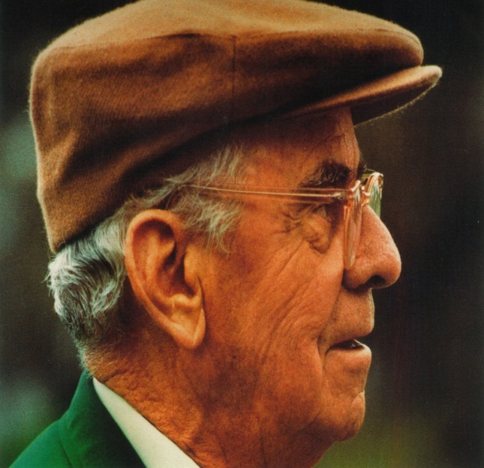
Snapshot: Customer service at the Augusta Masters
‘In the race for excellence, there is no finishing line’.
Many key features of professional golf tournaments introduced in Augusta
Focus on serving ‘Patrons’ and was the ‘first’ in many areas:
  Bleachers, rope galleries, closed circuit TV, on-course scoreboards
  Picnicking grounds, plenty of lavatories
  Great value food –
Still the competition by which others are judged
  3,500 staff employed every year
  They look for ‘a special kind of person’
  Clifford’s principles are guiding philosophy

Slide 14
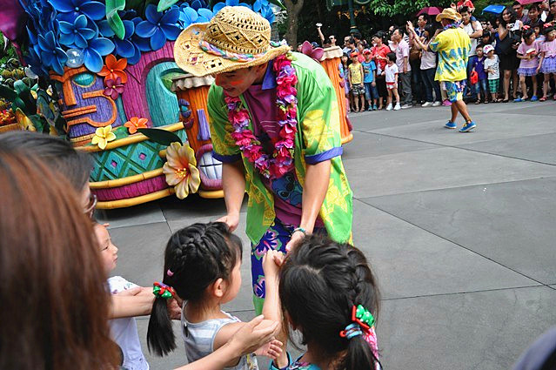
‘At Your Service Spotlight’: Walt Disney – a legacy of customer service
Disneyland is a work of love. We didn’t go into Disneyland just with the idea of making money’.
Walt’s personal philosophy (values, morals, religious beliefs, creative goals, innate psychographic awareness)
The company still holds true to his basic beliefs – and has diversified to incorporate cruises, TV channels, film studios and a training institute
Commitment to customers - a focus on the guest experience rather than traditional business efficiencies
‘Imagineering’
  ‘what ifs’
  positive alternative to saying ‘no’
‘Guestology’
Disney Institute

Slide 15
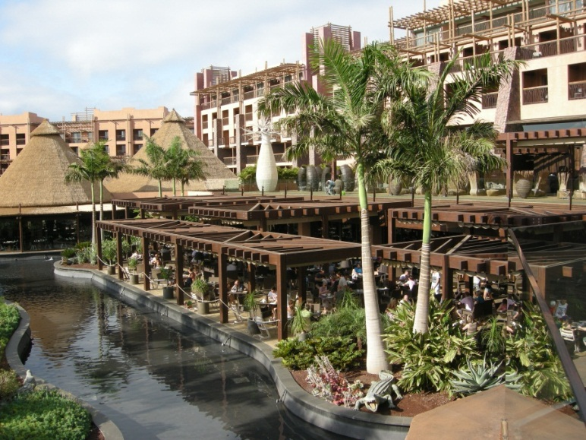
Case Study: The Lopesan Group, Gran Canaria, Spain
‘There’s no second chance for a first impression’
Five-star hotels, beach, restaurants, shopping malls, golf course
African-themed: Jungle foliage, calls, scents
40 % repeat customers
Attention to detail
  Cocktails at check-in
  Televisions on guest’s language channel
  Staff track personal preferences
  Complementary drinks and fruit
  Investments in staff training
  Well-compensated, career opportunities

Slide 16
Hotel Industry @ Destination Marketing

Slide 17
Learning Objectives
To understand the principles of marketing
To consider the marketing mix
To evaluate the importance of technology in services marketing.

Slide 18
What is Marketing?
Marketing is the management process responsible for identifying, anticipating and satisfying customers’ requirements profitably.
A set of decisions and processes that every organization uses to carry out an exchange with others
The process of planning and executing the conception, pricing, promotion and distribution of ideas, goods and services to create exchanges that satisfy organizational objectives

Slide 19
The Marketing Mix
The 4 Ps (Product, Place, Promotion, Price) and
Services industry 7 Ps in the Extended Marketing Mix (adding People, Physical Evidence and Process)

Slide 20
Product
‘A product is a complex mix of tangible and intangible attributes including packaging, colour, price, manufacturers prestige, retailers prestige, and manufacturers and retailers services which the buyer may accept as offering satisfaction of wants or needs’
(Stanton, 1981)

Slide 21
People (Internal Marketing)
The people element includes all human actors [internal audiences*] who play a part in service delivery and thus influence the buyers perceptions (Hudson, 2008)
The people part of the marketing mix relates to all stakeholders involved in the product or service during its lifecycle. They portray [internal audiences*] and benefit [consumers] from the brand values (Wale, 2008)
Internal marketing programme is adopted consisting of establishing a service culture; developing a marketing approach to HRM (e.g. teamwork) and dissemination of marketing information to employees – the aim to enable employees to deliver satisfying products and services to customers (Kotler et al., 2009)
People need to be recruited, trained, provided with tools and appropriate internal systems, and rewarded for good service to deliver and retain the brand image

Slide 22
Place (1)
‘Place decisions refer to the ease of access which potential customers have to a service. Place decisions can therefore involve physical location decisions…, decisions about which intermediaries to use in making a service accessible to customers … and non-locational decisions which are used to make services available.’
(Palmer, 2001, pp. 11–12)
‘In the four Ps of the marketing mix, it is place which represents distribution and access to the product.’
(Seaton and Bennett, 1996, p. 152)

Slide 23
Place (2)
‘The way in which the goods and services are made available or accessible to the market constitutes the place element of the mix, also referred to as distribution. The importance of careful management of product distribution is sometimes undervalued. The ways in which consumers can book … hotel accommodation … will depend on the place element of the hotel’s marketing mix. Booking may be possible at travel agencies or at other hotels in the same chain, for example.’
(Pender, 1999, p. 36)

Slide 24
Promotion
Promotion is the part of the marketing mix, which uses marketing communication methods to sell products and services to targeted consumers

Slide 25
Promotional Methods
Personal selling
Telemarketing
Direct mail
Trade fairs and exhibitions
Commercial television
Newspapers and magazines
Also (Radio, Cinema, Point of sale displays, Packaging).

Slide 26
Price
Components of cost
Price, cost and value
Price elasticity
Costing and setting prices
Pricing policies
Pricing strategies

Slide 27
Price, Cost and Value
Price
  The actual prices of the product set by the supplier
Cost
  The end cost (financial or otherwise) to the consumer
Value
  The evaluation made by the consumer of the price and cost set against the features and benefits of the product

Slide 28
People
Recruiting the right staff and training them appropriately in the delivery of their service is essential if the organization wants to obtain a form of competitive advantage
Consumers make judgements and deliver perceptions of the service based on the employees with whom they interact
Staff should have the appropriate interpersonal skills, aptitude and service knowledge to provide the service for which consumers are paying

Slide 29
Physical Evidence (PE)
The environment in which the service is offered and consumed
Physical evidence encompasses the tangible face of service products including; premises, vehicles, company websites and appearance and behaviour of staff (Wale, 2009)
An important part of the augmented product is the physical environment. They include all aspects of the servicescape that affect customers, including both exterior attributes (such as parking and landscape) and interior attributes (such as design, layout, equipment, and décor. Signage and atmospherics are also part of the servicescape (Hudson, 2008).

Slide 30
Process (1)
The process relates to the processes involved in the life cycle of a product or service from conception to after sales, it is the key to Brand Management. Brand management is standardization of a product, service or brand
The process part of this involves producing a product or service that reflects the mission, vision and values of a company (Wale, 2009)
Operationalizing the product or service through documented standard operational procedures (which clearly describe the operational process of products and services)
Standardized processes are audited through internal and external audits. Internal audits include operational checklists, external mystery guest audits

Slide 31
Process (2)
These in turn are linked to bonus related Key Performance Indicators (KPIs) of a company (linking back to values) adding an incentivized reason for conforming. Is there a complaints procedure; are there auditing systems in place to alert you of customer problems before dissatisfaction sets in? (Wale, 2009)
Process is the service encounter: how customers are treated at the place of purchasing and consuming
e.g. anything that affects the customers perception of the service product on offer e.g: friendliness and helpfulness of staff, speed with which customers are served

Slide 32
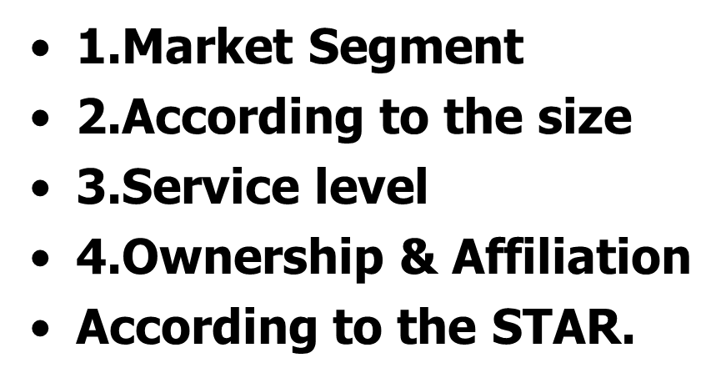
Hotel Industry
Classification

Slide 33
Assignment - 1
Services Industry:
  A Hotel company of your choice
  A Restaurant of your choice or
  A Theme park
  OR
  Any Service Industry
Select one of the above @ your choice write down marketing mix application (implementation) part.
Minimum of 4 to 5 pages and last date for your submission is 1/10/2022.

Slide 34
Marketing Communications
Marketing communications forms a key aspect of the delivery of tourism and hospitality services. The sector is dependent on marketing because of the industries’ special characteristics as services
These sectors are said to be intangible because it is not possible to experience the service prior to purchase
Theodore Levitt (1981) suggested that ‘instead of talking of “goods” and of “services”, it is better to talk of “tangibles” and “intangibles”’ (McCabe, 2009)

Slide 35
Advertising
Advertising communicates the brand image and personality to the consumer. Memorable adverts have used characters, typology, colours, personalities and music
(Wale and Phoenix, 2009)
Advertising must appeal to market segment, hit the target market and achieve the desired effects of positioning, e.g. make the customer feel and think the positioning, high-quality high-cost such as first-class travel
(Wale, 2009)

Slide 36
Public Relations
Public relations (PR) is the practice of managing the flow of information between an organization and its public. The practice of PR is planned around the core business activities of an organization (in line with its mission, vision and values). In practice the PR role is a balancing act of providing ‘good image’ information and managing ‘bad news’ stories. It involves making sure that all activities carried out by the organization, its intermediaries and stakeholders maintain the reputation of the business.
(Wale and Phoenix, 2009)

Slide 37
The Promotional Message
AIDA: effective promotional messages should:
Grab ATTENTION
Maintain INTEREST
Create DESIRE
Lead to ACTION

Slide 38
Activity: Promotional Methods
Select a product or service in your industry, e.g. budget airline/restaurant ‘chain’ meal/ music event/football match
What promotional methods are used and for what purpose?
Which are most effective and why?

Slide 39
e-Distribution
Electronic distribution is evolving very rapidly and accommodation managers face the following challenges:
Increasing number of distribution channel networks that must be managed daily
Complexity of electronic distribution
Need to be more responsive to the market
Increase exponentially comments on hotels over Internet, Web 2.0, blogs and social networks
Need to keep the rate integrity in all distribution systems (Rate Parity)
Turnover in reception, lack of human resources and therefore difficult management and training
World markets in a crisis economy, unstable and uncertain, which determines a vision of your planning in the very short term
The electronic distribution requires a dual effort to manage the distribution of bookings and consistent messages and pictures in the electronic world
Adapting to a changing global environment where customers, players, actors, producers need to find new working places and new ways to work together
(Hotel iTour, 2010)

Slide 40
e-Marketing
The last decade has seen an explosion of e-marketing spurred by a rapid revolution in the development of communications technology. The economic downturn in 2008 resulted in marketing departments scaling down and consolidating their marketing activity. When marketing budgets are tight, companies will use the cheapest most effective forms of communications to reach consumers. E-marketing can be very cost effective, as packaging and distribution costs may be avoided.
(Wale and Phoenix, 2009)

Slide 41
e-Communications
e-Communication, electronic communication or virtual communication is effectively the standard communication tools deployed electronically. Email, instant messaging, voice mail, conference calls, web conferences and video conferences are all types of e-communication
(Benson, 2004)

Slide 42
Search Engine Marketing
Search (engine) marketing is a technique used by brands looking to help customers find their products and services online faster and with less effort. The Internet is used by businesses to motivate customers and maintain consumer interest in their brands. The aim is to be top of the list when a user searches. Companies will pay a premium for this service, as it relates to increased sales and the ability to analyse consumer behaviour data.
(Fernandez, 2008)

Slide 43
Viral Marketing and Web 2.0
Based on the concept of word of mouth marketing (person to person communication), viral marketing involves spreading a message across multiple media making it reach more people. It relies on people using various elements of social media to forward the message
(Charlesworth, 2009)
Web 2.0 is a term that encompasses a certain type of online application often labelled as User-Generated Content or UGC, as the consumer is the main content contributor. Web 2.0 can be split into five categories: blogs, social networks, content communities, forums/bulletin boards and content aggregators
(Constantinides and Fountain, 2008)

Slide 44

Encompasses the management, marketing and operations of restaurants and other food services, lodging, attractions, recreation events and travel related services.

Slide 45
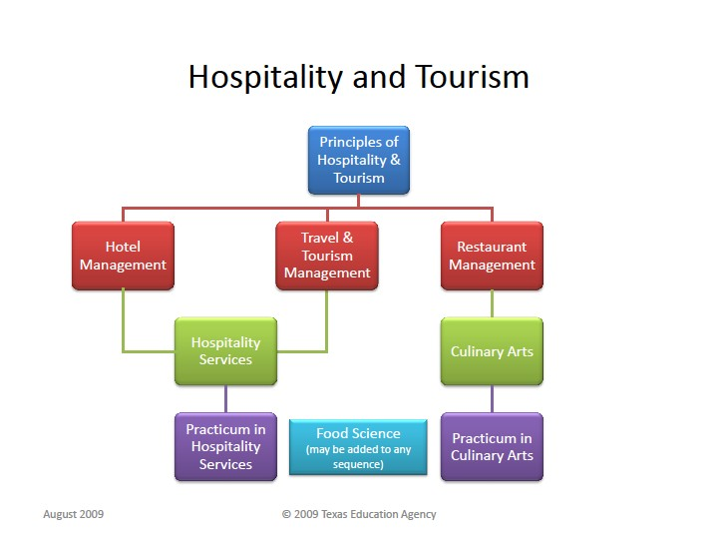

Slide 46
References
Benson, L.K. (2004) Power of E-Communication. HRD Press, Amherst, Massachusetts.
Charlesworth, A. (2009) Internet Marketing, A Practical Approach. Butterworth-Heinemann, Elsevier, Oxford, UK.
Constantinides, E. and Fountain, S.J. (2008) Web 2.0: Conceptual foundations and marketing issues. Journal of Direct, Data and Digital Marketing Practise 9(3), 231−244.
Fernandez, J. (2008) Click to Refresh. Marketing week, 23 October 2008.
Hudson, S. (2008) Tourism and Hospitality Marketing: A Global Perspective. Sage Publications, London.
McCabe, S. Marketing Communications in Tourism & Hospitality. Butterworth Heinemann, Oxford, UK.
Pender, L. (1999) Marketing Management for Travel and Tourism. Stanley Thrones, Cheltenham, UK.
Wale, D. (2009) Marketing. In: Robinson, P. (ed.) Managing Operations in the Travel Industry. CAB International, Wallingford, UK.
Wale, D. and Phoenix, F. (2009) Sports Marketing. In Bill, K. (ed.) Sport Management. Learning Matters, Exeter, UK.

