Slide 1
Hospitality Management

Slide 2
Hospitality
Hospitality is the relationship between guest and host, or the act or practice of being hospitable. Specifically, this includes the reception and entertainment of guests, visitors, or strangers, resorts, membership clubs, conventions, attractions, special events, and other services for travellers and tourists.
"Hospitality" can also mean generously providing care and kindness to whoever is in need.

Slide 3
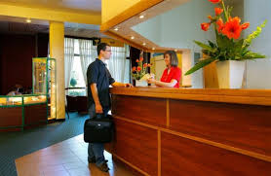
Objectives of Hospitality
Understand the hospitality industry
Understand the national and international employment opportunities available in the hospitality industry
The industry employs 2 million people
The restaurant industry is the largest in terms of jobs, employing half a million people
The industry employs a young workforce – just over a third of the staff are under 25

Slide 4
Hospitality and Tourism
Largest and fastest growing industries
Common dynamics:
  Delivery of services and products
  Customer and guest impressions are critical

Slide 5
Scope of Hospitality and Tourism Industry
Travel
  Air
  Cruise
  Rail
  Coach
  Auto
  Ecotourism
Lodging
  Hotels
  Motels
Meetings, Conventions, and Expositions
Restaurants
Managed services
Recreation
  Attractions
  Gaming
  Parks
  Recreation

Slide 6
Components of Hospitality Industry
1. Lodging Operations
-such as hotels, resorts, motels etc.
2. Transportation Services
-such as taxi, train, cruise ships, etc.
3. Food and Beverage Operations
-such as restaurants, bars, etc.
4. Retail Stores
-such as souvenir shops, etc.
5. Activities
-such as recreations, festivals, etc.

Slide 7
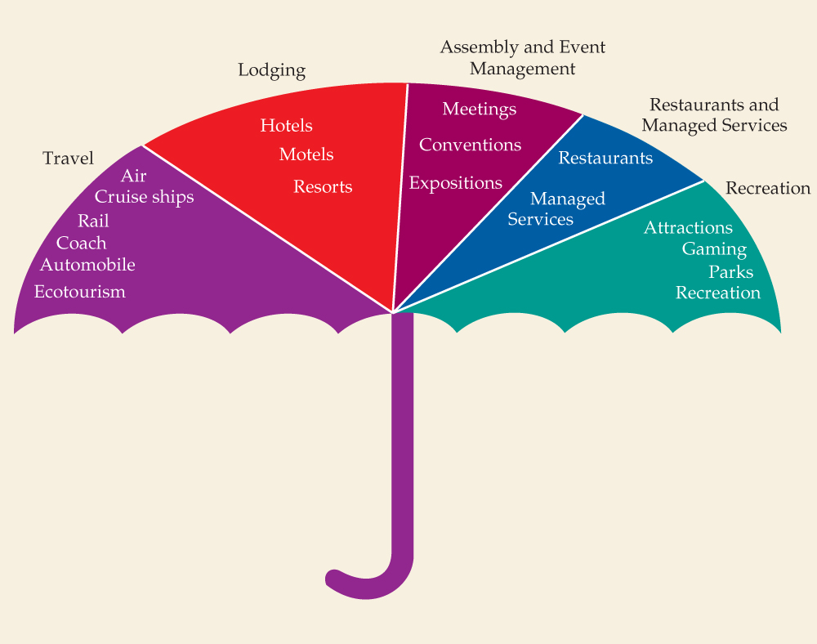
Scope of the Hospitality-Tourism Industry

Slide 8
Types in hospitality industry
NATIONAL –All the outlets look the same, with the same style of furnishing, menus and pricing.
LOCAL – One can find a wide variety of specialised and interesting menus, accommodation and prices.

Slide 9
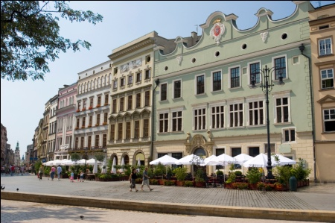
Overview of Hospitality Industry
Characteristics of Hospitality Industry
Inseparability
Perishability
Labor-intensive
Repetitive
Intangibility

Slide 10
Characteristic of Services

Slide 11
Characteristics of the Hospitality Industry
Product is intangible and perishable
No such thing as business hours
Hospitality operations run on a 24-hour basis all year round
Characterized by shift work

Slide 12
Corporate Philosophy
Philosophy:
  Shift toward greater employee empowerment
  Strong links to TQM
  Service philosophy is a way of life

Slide 13
Corporate Culture
Culture:
  Overall style and feel of the company
Mission statement:
  Central purposes, strategies, and values

Slide 14
Corporate Culture (cont.)
Goal:
  Broad statement geared toward accomplishment
Strategy/tactics:
  Actions needed to reach goals

Slide 15
According to Levels of Service
a. World-Class Service
b. Medium-Range Service
c. Economy / Limited Service

Slide 16
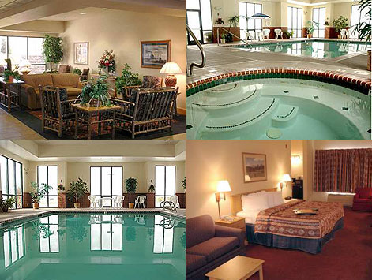
Lodging careers
Entry level
Housekeeper
Mid level
Upper management
Front desk clerk
Reservations clerk
Food service staff
Reservations manager
Executive housekeeper
Front office manager
Catering sales manager
Sales manager
Personnel director
Senior sales manager
Controller
Food & beverage director
Director of sales & marketing
General manager

Slide 17

Food service careers
Entry level
Crew person
Crew supervisor
Lead positions
Mid level
Manager trainee
Chef
Unit manager
Controller
Kitchen manager
Catering manager
Upper management
Executive chef
General manager District manager
Regional manager
Operations director
Other directors
CFO
President/CEO

Slide 18
The hospitality industry consists of broad category of fields within the service industry that includes lodging, restaurants, event planning, theme parks, transportation, cruise line, and additional fields within the tourism industry.
The hospitality industry is a several billion dollar industry that mostly depends on the availability of leisure time and disposable income.
A hospitality unit such as a restaurant, hotel, or even an amusement park consists of multiple groups such as facility maintenance, direct operations (servers, housekeepers, porters, kitchen workers, bartenders, etc.), management, marketing, and human resources.

Slide 19
Sectors in hospitality industry
COMMERCIAL SECTOR
It includes any businesses where the sale of food and drink or accommodation is the main source of income.
The commercial sector includes hotels, restaurants and clubs etc.
CATERING SERVICES SECTOR
It includes situations where food and drink services are provided within other organisations whose main focus is not hospitality.

Slide 20
Front-of-the-house vs. Back-of-the-house
Front-of-the-house : areas that involves guest and employee interaction (front office, restaurants, and lounges).
Back-of-the-house : areas where interaction between guests and employees is less common (housekeeping, engineering and maintenance, accounting, and human resources).

Slide 21
For Success in Service We Need to:
Focus on the guest
Understand the role of the guest-contact employee
Weave a service culture into education and training systems
Thrive on change

Slide 22
Thank You..!

