Slide 1
CONSUMER BEHAVIOUR AND ENVIRONMENT
SIX MAJOR FACTORS INFLUENCE ARE
DEMOGRAPHIC
ECONOMIC
NATURAL
TECHNOLOGICAL
POLITICAL & LEGAL
SOCIAL CULTURAL

Slide 2
CONSUMER BEHAVIOUR AND ENVIRONMENT
STORE ENVIRONMENT – The entrance of the store creates the story by creating expectations by containing and giving promises.
Objectives of a good store design
Should be consistent with the image and strategies of the store.
Should positively influence consumer behaviour
should be flexible
Should recognize the needs of the disabled, ie., reasonable access

Slide 3
CONSUMER BEHAVIOUR AND ENVIRONMENT
STORE LAYOUT
Grid Layout – long rows of shelves for different types of merchandise
Race Track Layout, also known as LOOP, - is type of store design that provides easy customer traffic, which facilitating impulse purchase.
Free form type layout, Boutique layout – which arranges fixtures and fittings unsystematically

Slide 4
CONSUMER BEHAVIOUR AND ENVIRONMENT
STORE AMBIENCE – has got four important elements
Store’s Exterior – store front, Marques (Display Board), Entrance, etc.
General interior of the store – Flooring, Colour Schemes, etc.
Interior Display – is the Point-of-purchase which provides shoppers with information, also known as “Merchandise Presentation Techniques”
Store layout
Notes:
ise

Slide 5
CONSUMER BEHAVIOUR AND ENVIRONMENT
Organizational Buying Behaviour
Characteristics
Group based Decision Making
Technical Knowledge
Rational Motivation
Buying Motivation –
NEW TASK BUYING
Straight Rebuy
Modified Rebuy

Slide 6
CONSUMER BEHAVIOUR AND ENVIRONMENT
Factors Affecting Organizational Buying Behaviour
Organizational Factors – Task, structure, Technology, & people
Environmental factors – Technological, Political, physical, Legal, cultural & Ethical
Interpersonal factors – Reference Groups, Power Relationships, Family Members.

Slide 7
CONSUMER BEHAVIOUR AND ENVIRONMENT
Organizational Buying Process
Problem Recognition
Product Specification
Product and vendor search
Product and vendor evaluation
Outlet Evaluation, selection and purchase
Post purchase Evaluation

Slide 8
Organizational Buying Behaviour
Organisational buying, according to Webster and Wind (1972), is ‘the decision making process by which formal organisations establish the need for purchased products and services and identify, evaluate and choose among alternative brands and suppliers’.
One of the important aspects of this definition is that organisational buying behaviour is a process rather than a static, one-off event. There are a number of stages, or phases, associated with product and service procurement, each one often requiring a key decision to be made.

Slide 9
Organizational Buying Behaviour
Decision Making Units
Reference has been made on a number of occasions to organisational buyers, as if such people are the only representatives of an organisation to be involved with the purchase decision process. Very often a large number of people are involved in a purchase decision. This group is referred to as either the decision making unit (DMU) or the buying centre.

Slide 10
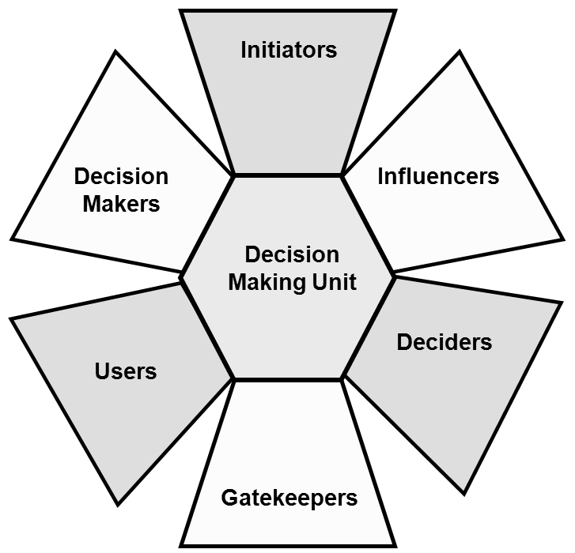
Organizational Buying Behaviour

Slide 11
Organizational Buying Behaviour
Initiators.. request the purchase of an item and propel the purchase decision process. They may be other members of the DMU or others in the organisation.
Users.. may not only initiate the purchase process but are sometimes involved in the specification process. They will use the product once it has been acquired and subsequently evaluate its performance. Their role is continuous, although it may vary from the peripheral to highly involved.
Influencers.. very often help set the technical specifications for the proposed purchase and assist the evaluation of alternative offerings by potential suppliers. These may be consultants hired to complete a particular project. This is quite common in high-technology purchases where the customer has little relevant expertise.ecision Making Units

Slide 12
Organizational Buying Behaviour
Deciders.. are those who make purchasing decisions and they are the most difficult to identify. This is because they may not have formal authority to make a purchase decision yet are sufficiently influential internally that their decision carries most weight. In repeat buying activities the buyer may well also be the decider. However, it is normal practice to require that expenditure decisions involving sums over a certain financial limit be authorised by other, often senior, managers.

Slide 13
Organizational Buying Behaviour
Buyers.. (purchasing managers) select suppliers and manage the process whereby the required products are procured. As suggested previously, buyers may not decide which product is to be purchased but they influence the framework within which the decision is made.
Gatekeepers.. have the potential to control the type and flow of information to the organisation and the members of the DMU. These gatekeepers may be assistants, technical personnel, secretaries or telephone switchboard operatorsng Units

Slide 14
Consumerism
Consumerism is a word with two meanings.
First, consumerism is a movement to promote the rights and powers of consumers in relation to sellers of products and services.
Second, consumerism is a powerful ideology, in which the pursuit of material goods beyond subsistence shapes social conduct.

Slide 15
Consumerism
Consumerism is a global phenomenon that rises everywhere when its necessary social and economic conditions come together in developing countries.
The rise of consumer ideology is paralleled by a movement to protect consumers from fraud, deception, and greed using government power.

Slide 16
CONSUMERISM
Consumer Protection Act
Laws designed to protect consumers from unfair and unjust marketing practices. Specifically, these laws protect
The right to be informed
The right to safety
The right to redress
The right to choose
The right to a healthful environment
The right to privacy

Slide 17
CONSUMERISM
The right to be informed
This right states that businesses should always provide consumers with enough appropriate information to make intelligent and informed product choices. Product information provided by a business should always be complete and truthful. Aiming to achieve protection against misleading information in the areas of financing, advertising, labeling, and packaging, the right to be informed is protected by several pieces of legislation passed between 1960 and 1980.

Slide 18
CONSUMERISM
The right to safety
The assertion of this right is aimed at the defense of consumers against injuries caused by products other than automobile vehicles, and implies that products should cause no harm to their users if such use is executed as prescribed.

Slide 19
CONSUMERISM
The right to redress
The consumer’s right to complain and express grievances about product failure.
The right to redress provides for consumers to receive a fair settlement of just claims, including compensation for misrepresentation, shoddy goods, or unsatisfactory services.

Slide 20
CONSUMERISM
The right to choose
The right to free choice among product offerings states that consumers should have a variety of options provided by different companies from which to choose.

Slide 21
CONSUMERISM
The right to a healthful environment
This is the right to live and work in an environment that is non-threatening to the well-being of present and future generations.

Slide 22
CONSUMERISM
The right to privacy
The consumer’s right to be left alone. Business does not have the right to collect information about consumers to establish detailed profiles about their lives and shopping habits.

Slide 23
COMMUNICATION
Communication is central to marketing.
Successful companies design superior products, price them favourably, distribute them effectively.
And also communicate with all present and prospective consumers about the benefits of the products and services and convince them to buy a company’s products in preference to those of competitors.
Communication is the voice of the product and effective medium between producers and consumers

Slide 24
COMMUNICATION
Emerging trends in communication
Proliferation of communication channels
the range and variety of media for getting messages across to the target market has widened.
Media fragmentation
specialized channels for kids, ladies, sports lovers, business man, health care, etc.
Shifts in channel power
technology has put consumer in control. Consumers decide which message to see

Slide 25
COMMUNICATION
Content and Audience Decisions
Marketers rely heavily on consumer research in to decision process, consumer involvement and other aspects of marketing environment that can be influenced by a message.
Message Content
The message is the central component of any piece of marketing communications. An effective message tells a great deal not only about the brand advertised but also about its target audience, competitors and the marketer’s brand strategy.

Slide 26
COMMUNICATION
Message Content
The message can communicate a number of important pieces of information to target consumers including product benefits, price, and availability.
Message contents flows directly from product positioning. Through positioning research marketers able to decide exactly which aspects of brand are most likely to persuade target consumers to buy.

Slide 27
COMMUNICATION
Elements of the Communications Process
The Message Initiator (the Source)
The Sender
The Receiver
The Medium
The Message
The Target Audience (the Receivers)
Feedback - the Receiver’s Response

Slide 28
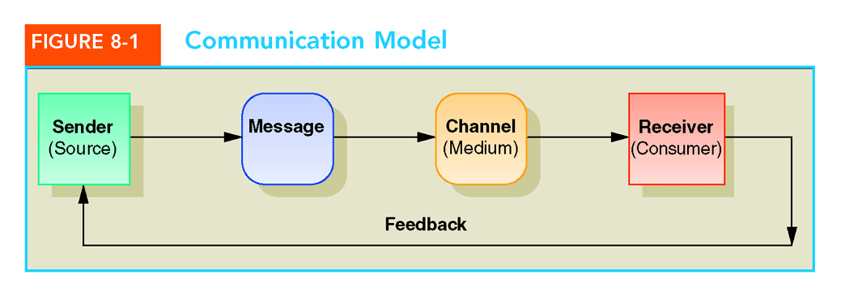
COMMUNICATION
Medium can be:
  Impersonal (mass media)
  Interpersonal (with salesperson or a friend)
  Interactive (direct feedback possibility exists)

Slide 29
COMMUNICATION
Factors That Affect The Communication Process
Characteristics of the source
Message characteristics
Characteristics of the receiver
Characteristics of the medium

Slide 30
COMMUNICATION
Credibility of Informal Sources
  Opinion leaders
Credibility of Impersonal, Neutral Sources
Credibility of Marketer-Related Sources
Credibility of Spokespersons and Endorsers
Sleeper Effect - The idea that both positive and negative credibility effects tend to disappear after a period of time.Differential decay: memory of negative cues disappear faster than the message itself. Source is forgotten before the message

Slide 31
COMMUNICATION
Barriers to Communication
Selective Perception
  Wandering, Zapping, Zipping, and Channel Surfing
  Combat with Roadblocking
Psychological Noise
  Combat with repeated exposures, contrast in the copy, and teasers

Slide 32
COMMUNICATION
Communication and Marketing Strategy
Establish communication objectives
Select target audience
Choose the best media
Develop suitable message strategies
  Match message with audience characteristics
  Develop suitable message structure, presentation
  Develop suitable message appeals
Reduce barriers to effective communication
Measure effectiveness of marketing communications

Slide 33
CONSUMER PROTECTION ACT
THE LAW RELATING TO CONSUMER PROTECTION IS CONTAINED IN THE CONSUMER PROTECTION ACT,1986. THE ACT APPLIES TO ALL GOODS & SERVICES
Any person who buys or hires any goods or service is A consumer
  Except if he uses such goods or service for commercial purpose.
  Or if the goods/service provided is free of cost, the person shall not be considered a consumer

Slide 34
CONSUMER PROTECTION ACT
Two kinds of consumer under the Act
  Consumer of goods
    buys or agrees to buy goods
    any user of such goods
  Consumer of services
    hires or avails any services
    any beneficiary of such service

Slide 35
CONSUMER PROTECTION ACT
On 24 December 1986 Govt. of India enacted the Consumer Protection Act 1986 to:
Ensure Rights of Consumers
Provide Remedies for deceived Consumers

Slide 36
CONSUMER PROTECTION ACT
Exclusive courts for consumer disputes in all districts, state and national capitals.
Consumer Protection Councils from national to state and district levels.
Covers private, public, cooperative sectors.
Unfair trade practice
Restrictive trade practice
Defects

Slide 37
CONSUMER PROTECTION ACT
    UNFAIR TRADE PRACTICE
    Adopting unfair methods or deception to promote sale, use or supply of goods or services
    Misleading public about price (e.g. bargain price when it is not so).
    Charging above MRP printed.
    Misleading public about another’s goods or services.
    Falsely claiming a sponsorship, approval or affiliation.
    Offering misleading warranty or guarantee.

Slide 38
CONSUMER PROTECTION ACT
RESTRICTIVE TRADE PRACTICE
    Price fixing or output restraint re: delivery/flow of supplies to impose unjustified costs/restrictions on consumers.
    Collusive tendering; market fixing territorially among competing suppliers, depriving consumers of free choice, fair competition.
    Supplying only to particular distributors or on condition of sale only within a territory.
    Delaying in supplying goods/services leading to rise in price.
    Requiring a consumer to buy/hire any goods or services as a pre-condition for buying/hiring other goods or services.

Slide 39
CONSUMER PROTECTION ACT
DEFECTS
  Any fault, imperfection or shortcoming in the quality, quantity, potency, purity or standard which is required to be maintained by or under any law for the time being in force or under any contract express or implied or as is claimed by the trader in any manner whatsoever in relation to any goods.
DEFICIENCY
  Any fault, imperfection, shortcoming or inadequacy in the quality, nature and manner of performance which is required to be maintained by or under any law for the time being in force or has been undertaken to be performed by a person in pursuance of a contract or otherwise in relation to any service.

Slide 40
CONSUMER PROTECTION ACT
Right to SAFETY against hazardous goods and services.
Right to be INFORMED about quality, quantity, purity, standard, price.
Right to CHOOSE from a variety at competitive prices.
Right to BE HEARD.
Right to seek REDRESSAL.
Right to CONSUMER EDUCATION.

Slide 41
CONSUMER PROTECTION ACT
BEFORE BUYING ANY GOODS OR SERVICE, BE SATISFIED ABOUT THE QUALITY OR QUANTITY.
MAKE IT CLEAR THAT ISSUE OF RECEIPT IS MANDATORY FOR ANY PURCHASE OF Rs.200 AND ABOVE.
IN ANY PACKAGED MATERIAL, THE MONTH & YEAR OF MANUFACTURE, NET QUANTITY or WEIGHT & M.R.P is MUST.
If IMPORTED, it must carry the NAME & ADDRESS OF IMPORTER WITH VALID REGISTRATION
DON’T PAY MORE THAN THE M.R.P.
ALWAYS LOOK FOR THE DATE OF MANUFACTURE AND DATE OF EXPIRY / BEST BEFORE IN CASE OF EDIBLE AND MEDICINES.

Slide 42
CONSUMER PROTECTION ACT
Central Consumer Protection Council.
State Consumer Protection Council.
District Consumer Protection Council (only W.B. has constituted Kolkata CPC for a metropolis).
District Consumer Information Centre (so far 2 in Kolkata, 1 each in Hooghly, Nadia, Paschim Medinipur, South 24 Parganas & Bankura).
Jagriti Shivir Yojana for Antyodaya & Annapurna Yojanas (BPL category 12 districts).
Markets till GP level on GIS (unique to W.B.).
Consumer Complaint Cells of Business Chambers & Traders’ Associations.

Slide 43
CONSUMER PROTECTION ACT
File in triplicate on plain paper to the District Consumer Disputes Redressal Forum where the seller has his business or residence or where the cause of action arises.
File complaint within 2 years from the date of the cause of action.
Name and full address of complainant
Name and full address of opposite party
Description of goods and services
Quality and quantity
Price
Date & proof of purchase
Nature of deception
Type of redressal prayed for

Slide 44
CONSUMER PROTECTION ACT
No lawyer or agent is necessary for filing complaint or to make submission. If due to lawyer’s conduct consumer suffers, it is a deficiency in service open to redress.
Nominal fees payable as per table below. No charges for dispatching notices to opposite parties etc.
Every complaint shall be heard and disposed of within 90 days (150 days in case of lab test) from the date of receipt of notice by the opposite party.
No adjournment shall ordinarily be granted. If granted, reasons to be recorded.

Slide 45
CONSUMER PROTECTION ACT
Removal of defects in goods or deficiency in services.
Replacement of defective goods.
Refund against defective goods or deficient services.
Compensation.
Prohibition on sale of hazardous goods.

Slide 46





CONSUMER PROTECTION ACT
Standardization mark is a mark or symbol given to a product, which meets certain standards with respect to the quality in terms of material used, methods of manufacturing, labeling, packaging and performance.

Slide 47
CONSUMER PROTECTION ACT

Slide 48
CONSUMER PROTECTION ACT

Slide 49
CONSUMER PROTECTION ACT

Slide 50
CONSUMER PROTECTION ACT

