Slide 1
CONSUMER BEHAVIOUR

Slide 2
Why do we need study CB
No longer we can take the Customer/Consumer for granted.
Recent study says: (2015)
In the last 5 years 11,000 new products are launched by 77 companies, but only 56% are now available in the market.

Slide 3
CONSUMER BEHAVIOUR
What is Marketing???
What does it do??
Marketing is ‘Meeting Human Needs’

Slide 4
CONSUMER BEHAVIOUR
Customer Satisfaction is the core concept of marketing
Satisfaction- fulfillment or gratification of need, desire or appetite.
Customer satisfaction or dissatisfaction is the feeling derived by the consumer when he compares the product’s actual performance with the performance that he expects of it.
Customer satisfaction is achieved by understanding customer requirements and delivering superior quality goods and services.

Slide 5
CONSUMER BEHAVIOUR
WHAT IS MARKETING?
Marketing is the business function
that identifies, current unfulfilled needs and wants,
defines and measures its magnitude,
Determines which target markets
the organization can best serve and
decides on appropriate products, services, programmes to serve their markets

Slide 6
CONSUMER BEHAVIOUR
CORE CONCEPTS OF MARKETING
NEEDS
WANTS
DEMAND
PRODUCT
VALUE & SATISFACTION – COST & UTILITY
MARKET
MARKETER- BUYER/SELLER
MARKETING

Slide 7
CB based on -
Psychology
Sociology
Anthropology
Marketing
Economics

Slide 8
CB
Can Marketing be Standardized ?
“NO”
Bcos cross cultural styles, habit, tastes, prevents such Standardization.

Slide 9
Language Problem
“Please leave your values at the desk”.(Paris-hotel)
“Drop your trousers here for the best results”(Bangkok laundry)
“The Manager has personally passed all water served here” .( Acapulco restaurant )
“Because of the impropriety of entertaining guests of the opposite sex in the bed room ,it is suggested that the lobby be used for the purpose”.(Zurich Hotel).
“Ladies are requested not to have children in the bar”.(Norway Hotel).
Notes:
gue

Slide 10
CONSUMER BEHAVIOUR
Needs – a state of felt deprivation of some basic satisfiers.
Basic human requirements.
1.Stated Needs 2. Real Needs 3.Unstated Needs 4. Delight Needs 5. Secret Needs.
Wants – desires for specific objects/ satisfiers of deeper needs.

Slide 11
CONSUMER BEHAVIOUR
Demand – wants for specific products/brands that are back up by ability and willingness to buy them.
Product – anything that can be offered to someone to satisfy need/want.
(goods, services, people, properties, events, etc.)

Slide 12
CONSUMER BEHAVIOUR
Value and satisfaction – Cost and Utility.
Value is the perceived tangible and intangible benefits and costs to customers. Basically a combination of ‘qsp’ (quality, service and price), is called the ‘Customer Value Triad’

Slide 13
CONSUMER BEHAVIOUR
Utility – the functional satisfaction
Satisfaction is a person’s judgment of a products perceived performance in relationship to expectations
Exchange/ transaction – the act of obtaining a derived product from someone by offering something in return.

Slide 14
CONSUMER BEHAVIOUR
Market- a common place where exchange is taking place or where buyers and sellers are coming in contact
Marketer –buyer (prospects)/seller. Is an individual or an institution who is engaged in making available the goods. A prospect is a person or organization which is willing to buy and pay for the goods and services
Marketing – human activity related to the market.
”Marketing is a social and managerial process by which individuals and groups obtain what they need and want through creating and exchanging of products and value with others”.
Philip Kotler

Slide 15
CONSUMER BEHAVIOUR
Market- a common place where exchange is taking place or where buyers and sellers are coming in contact.

Slide 16
CONSUMER BEHAVIOUR
Marketer –buyer (prospects)/seller.
Seller is an individual or an institution who is engaged in making available the goods. Someone who seeks a response from another person called the prospect.
A prospect is a person or organization which is willing to buy and pay for the goods and services.
Marketers are skilled in stimulating demand.

Slide 17
CONSUMER BEHAVIOUR
People do not buy products or services, they buy benefits. Tangible benefits are those that are in some sense measurable, whereas Intangible Benefits are based on the feelings experienced.
People make purchases not for the products themselves, but for the problems they solve or the opportunities they offer.

Slide 18
CONSUMER BEHAVIOUR
The term Consumer Behaviour is defined as the behaviour that consumers display in searching for, purchasing, using, evaluating and disposing of products and services that they expect will satisfy their needs.

Slide 19
CONSUMER BEHAVIOUR
Consumer behavior focuses on how individuals make decisions to spend their available resources (money, time, effort) on consumption related items.
(What,When,Why,Where,Whom,&How)
5W & 1H

Slide 20
CONSUMER DECISION MAKING
Include:-
What they buy
Why they buy
Where they buy it
How often they buy it, Use it, Evaluate it, (post-purchase)
After purchase, the impact of such evaluations reflect on future purchases and how they dispose it.

Slide 21
CB denotes two kind of consumers
CB denotes two kinds of consumers
All are consumers the pattern of consumption may differ
Personal consumers- who buys goods/ services for him.
Organizational consumers/
non-profit organizations/govt.agencies/ institutions.
This study of CB deals with both the categories of consumers.

Slide 22
The product philosophy was the dominant marketing philosophy prior to the Industrial Revolution and continued to the 1920s.
The selling era has the shortest period of dominance of the three philosophies. It began to be dominant around 1930 and stayed in widespread use until about 1950. The selling philosophy holds that an organization can sell any product it produces with the use of marketing techniques, such as advertising and personal selling. Organizations could create marketing departments that would be concerned with selling the goods, and the rest of the organization could be left to concentrate on producing the goods.

Slide 23
MARKETING CONCEPT
The marketing era started to dominate around 1950, and it continues to the present. The marketing concept recognizes that the company's knowledge and skill in designing products may not always be meeting the needs of customers. It also recognizes that even a good sales department cannot sell every product that does not meet consumers' needs. When customers have many choices, they will choose the one that best meets their needs.
More Products
More Sizes
More Models
More Versions and
More Packages
Most Important is SMALLER VERSIONS OF MARKETS
SMALLER MARKETS CALLS FOR STRONG CUSTOMER
RELATIONSHIPS

Slide 24
Consumer Buying Process
Problem recognition: Recognizes the need for a service or product
Information search: Gathers information
Alternatives evaluation: Weighs choices against comparable alternatives
Purchase decision: Makes actual purchase
Post-purchase evaluation: Reflects on the purchase they made

Slide 25
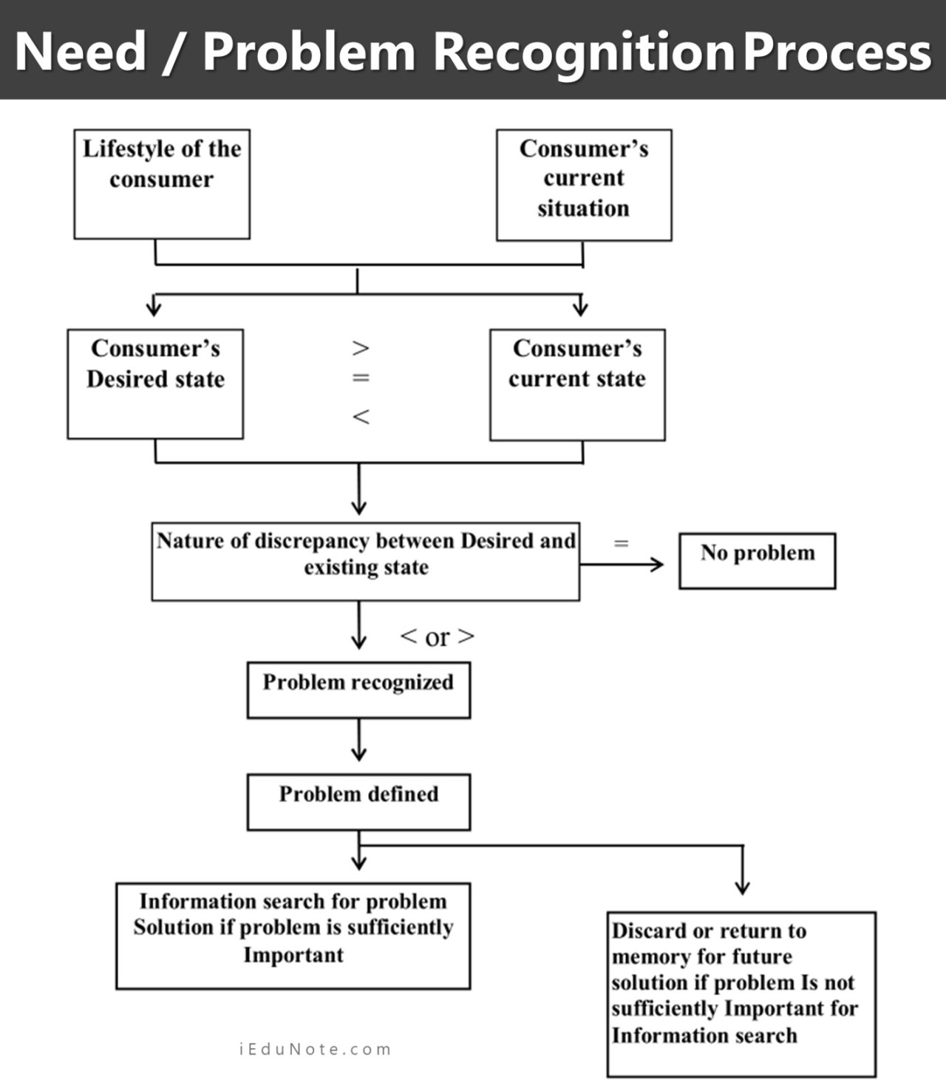

Slide 26
Situations Leading to Problem Recognition
Insufficient Stock of Goods
Dissatisfaction or Discontentment with the Stock
Changes in the Environmental Characteristics
Changes in the Financial Status
Promotional Activities
Consumer’s Previous Decisions
Individual Development
Efforts of Consumer Groups and Governmental Agencies
Availability of Products

Slide 27
A SUCCESSFUL CUSTOMER RELATIONSHIP IS :
CUSTOMER VALUE
CUSTOMER SATISFACTION
CUSTOMER RETENTION

Slide 28
CUSTOMER VALUE
CUSTOMER VALUE is defined as the ratio between the customer’s perceived benefits (economic, functional and psychological) and the resources (monetary, time, effort, psychic) used to obtain those benefits .
Perceived value is a relative concept and subjective.
Develop a value proposition instead of USP is the basic of successful positioning. (Quality, Zero Defects in Manufacturing and superior professional post-purchase service).

Slide 29
CUSTOMER SATISFACTION
Customer Satisfaction is the individuals perception of the performance of the product or service in relation to his/her expectations.
CLASSIFICATION
LOYALISTS – Who keep on purchasing
APOSTLES - whose experiences their expectation
promotes +ve towards the Product & Company , (& word-of-mouth advertising)
DEFECTORS – Who is neutral / merely satisfied and likely to stop buying the company products.
TERRORISTS - negative experience with Company & the Products. (‘-’ ve promotion against the company)

Slide 30
CUSTOMER SATISFACTION
Hostages – Unhappy Customers who stay with the company only because of Monopolistic Conditions.
Mercenaries – Very Satisfied Customers but have no loyalty to the Company. (lower price, discounts, other offers or benefits).

Slide 31
CUSTOMER RETENTION
PROVIDING VALUE TO CUSTOMERS CONTINOUSLY AND MORE EFFECTIVE THAN THE COMPETITORS IS TO RETAIN HIGHLY SATISFIED CUSTOMERS.
THE STRATEGY OF RETAINING THE CUSTOMERS WITH THE COMPANY IS KNOWN AS CUSTOMER RETENTION

Slide 32
CUSTOMER RETENTION
Small reductions in customer detentions produce more increases in profits.
BECAUSE, LOYAL CUSTOMERS
.
1. BUY MORE PRODUCTS
2. ARE LESS PRICE SENSITIVE & PAY LESS ATTENTION TO COMPETITORS ADS
3. SERVICING EXISTING CUSTOMER IS CHEAPER.
4. LOYAL CUSTOMERS SPREAD +VE W-O-M ADs

Slide 33
CUSTOMER RETENTION
Modern promotional tools (Internet, Electronic Media)
-( marketer- customer interactions – are used for tailoring products and services for specific needs of the customers).
This is called One- to – One marketing or Customized Marketing.
Or offering more value through “CUSTOMER INTIMACY”

Slide 34
CUSTOMER CLASSIFICATIONS
In CUSTOMER RETENTION Customers are classified on basis of PROFITABILITY
Selective Customer Relationships are maintained on the basis of Customer Ranks in terms of profitability
Consumption Volume and patterns establish ‘tiers’/different levels of customers on profitability basis and develop distinct strategies for each customer groups.
Customer Profitability-focused marketing considers costs and revenues of Individual customers and then categorizes them in to ‘tiers’

Slide 35
CATEGORIES
PLATINUM TIER –heavy users, not price sensitive and willing to try new offerings.
GOLD TIER – heavy users but price sensitive, asks for discounts, rebates, etc. Are not profitable compared to Platinum Tier
IRON TIER – Consists of customers when spending volume and profitability are considered do not require special attention.
LEAD TIER – they cost company money because they claim more attention, tie-up company resources, and spreads – ve word –of-mouth ads.

Slide 36
MARKETING CONCEPT
CUSTOMER VALUE, SATISFACTION AND RETENTION EVOLVES FROM THE MARKETING CONCEPT .

Slide 37
CONSUMER DECISION MAKING
SIMPLIFIED MODEL
THREE STAGE MODEL
THE INPUT STAGE
THE PROCESS STAGE
THE OUT PUT STAGE

Slide 38
SIMPLIFIED MODEL
THE INPUT STAGE
Recognition of the product need
two sources of information
THE FIRMS MARKETING INFORMATION
PRODUCT, PRICE, PLACE, PROMOTION
EXTERNAL SOCILOGICAL INFLUENCES ON CUSTOMER
FAMILY, FRIENDS, OTHER INFORMAL NON-COMMERCIAL SOURCES

Slide 39
SIMPLIFIED MODEL
PROCESS STAGE
PSYCHOLOGICAL FACTORS
MOTIVATION,PERCEPTION,LEARNING,PERSONALITY AND ATTITUDES
THIS ALSO AFFECT THE EXTERNAL INPUTS ON INPUT STAGE
THE RECOGNITION OF A NEED
PRE-PURCHASE SEARCH FOR INFORMATION
EVALUATION OF ALTERNATIVES

Slide 40
SIMPLIFIED MODEL
OUT PUT STAGE
CLOSELY RELATED TO POST-DECISION ACTIVITIES
1. PURCHASE BAHAVIOUR
2. POST-PURCHASE BAHAVIOUR

Slide 41
MODELS OF DECISION MAKING
ALL CONSUMER DECISIONS DOES NOT REQUIRE THE SAME DEGREE OF INFORMATION RESEARCH.IF ALL PURCHASE DECISIONS REQUIRE EXTENSIVE EFFORTS (DECISION MAKING PROCESS) THEN THE DECISION MAKING BECOME EXHAUSTIVE THE ENTIRE TIME MAY BE ENGAGED IN PURCHASES.
ON A CONTINUM, EFFORTS MAY RANGE FROM VERY HIGH TO VERY LOW. THESE ARE
EPS, LPS & RRB

Slide 42
EXTENSIVE PROBLEM SOLVING (EPS)
EPS HAPPENS WHEN
NO ESTABLISHED CRITERIA TO EVALUATE A PRODUCT CATEGORY
CONSUMER NEEDS A GREAT DEAL OF INFORMATION
LIMITED BRANDS

Slide 43
LIMITED PROBLEM SOLVING
(LPS)
HAVE ESTABLISHED CRITERIA TO EVALUATE THE PRODUCT
VARIOUS BRANDS IN THAT CATEGORY
THE CONSUMER MAY HAVE FULLY ESTABLISHED PREFERENCES
THEY NEED ADDITIONAL INFORMATION ONLY TO DESCRIMINATE THE PRODUCT AMONG VARIOUS BRANDS

Slide 44
ROUTINIZED RESPONSE BEHAVIOUR
(RRB)
CONSUMERS HAVE EXPERIENCE WITH PRODUCT CATEGORY
HAVE WELL ESTABLISHED CRITERIA TO EVALUATE THE PRODUCT
ADDITIONAL INFORMATION ONLY TO REVIEW WHAT THEY KNOW ALREADY

Slide 45
MODELS OF CONSUMER BEHAVIOUR
VIEWS OF CONSUMER DECISION MAKING
FOUR MODELS OR FOUR VIEWS

Slide 46
1. ECONOMIC VIEW
ALSO CALLED ECONOMIC MAN THEORY
BASED ON RATIONAL APPROACH TO PURCHASES
TO MAKE RATIONAL DECISIONS OR TO BEHAVE RATIONALLY THE CONSUMER SHOULD HAVE
1. AWARE OF ALL AVAILABLE PRODUCT ALTERNATIVES
2. BE CAPABLE OF CORRECTLY RANKING EACH
ALTERNATIVE IN TERMS OF ITS BENEFITS AND
DISADVANTAGES.
3. BE ABLE TO IDENTIFY THE BEST ALTERNATIVE
SUCH DECISION CAN BE A ‘PERFECT DECISION’

Slide 47
2. A PASSIVE VIEW
OPPOSITE TO ECONOMIC VIEW
IMPULSIVE/IRRATIONAL PURCHASES
SOMETIMES CUSTOMERS ARE PASSIVE
SOMETIMES THEY SEARCH FOR INFORMATION

Slide 48
3. A COGNITIVE VIEW
CONSUMER IS A THINKING PROBLEM SOLVER
CONTINOUSLY SEARCHING FOR INFORMATION TO FULFILL THEIR NEEDS AND ENRICH THEIR LIVES
CONSUMERS ARE CONSIDERED AS INFORMATION PROCESSORS AND INFORMATION PROCESSING LEADS TO FORMATION OF PREFERENCES AND ULTIMATELY TO PURCHASE INTENTIONS.

Slide 49
COGNITIVE VIEW
THIS MAY LEAD TO TWO CONDITIONS
THEY MAY THINK THAT THEY HAVE SUFFICIENT INFORMATION AND MAY DEVELOP A SHORTCUT TO DECISION MAKING (TO FACILITATE DECISION MAKING) CALLED HEURISTICS
THEY MAY HAVE TOO MUCH INFORMATION AND MAY GET CONFUSED, IS CALLED INFORMATION OVERLOAD

Slide 50
4.AN EMOTIONAL VIEW (IMPULSIVE)
SOME FEELINGS/EMOTIONS (JOY, FEAR, LOVE, HOPE, SEXUALITY, FANTASY) WITH CERTAIN PURCHASES
THESE EMOTIONS ARE HIGHLY INVOLVING
WHEN CONSUMER IS MAKING AN EMOTIONAL PURCHASE DECISION, LESS EMPHASIS ON
PRE-PURCHASE INFORMATION.
CONSUMERS MOODS ARE ALSO INFLUENCING
(Mood – a feeling state/state of mind)
MOOD IS IMPORANT BECAUSE IT IS HAVING AN IMPACT ON WHEN, WHERE AND WHETHER THEY SHOP ALONE OR WITH OTHERS.
WHEN CONSUMERS ARE IN +VE MOOD THEY RECALL INFORMATION ABOUT THE PRODUCT.

Slide 51
CONSUMER DECISION RULES
They are:
1.Heuristic
2.Decision Strategies
3.Information Processing Strategies
(Heuristic: They may think that they have sufficient information and may develop a shortcut to decision making (to facilitate decision making) called heuristics.

Slide 52
CONSUMER DECISION RULES
Consumer Decision Rules are categorized in two,
1.Compensatory – in which a consumer evaluate the product in terms of each attribute. A decision rule designed to allow for trade-offs among the strengths and weaknesses of alternatives being evaluated.
2.Non-compensatory are
Conjunctive decision rule
Disjunctive decision rule
Lexicographic decision rule
Affect Referral decision rule
Elimination-by-Aspects rule

Slide 53
Non-compensatory Decision Rules
A Decision Rule that does not allow for weaknesses in an alternative to be offset by its strengths. Such a rule is used to reduce the alternatives to be further evaluated.

Slide 54
Non-compensatory Decision Rules
Conjunctive Decision Rule
The customer establish a separate, minimally acceptable level as a cut-off point for each attribute
If any particular model falls below, the cut-off point is eliminated

Slide 55
Non-compensatory Decision Rules
Disjunctive Decision Rule
( a mirror image of Conjunctive decision rule)
The consumer establishes a separate minimally acceptable cut-off level for each attribute when option meets/excess the cut-off level is accepted

Slide 56
Non-compensatory Decision Rules
Lexicographic Decision Rules
The consumer ranks the attribute in terms of perceived relevance and importance.
Then compares the various alternatives
Top ranking ones are selected

Slide 57
Non-compensatory Decision Rules
Lexicographic Decision Rules
With Lexicographic Decision Rules the highest ranked attribute may be connected to the consumers basic orientation,
1.Quality Oriented
2.Status Oriented
3.Economy Oriented
Infrequently purchased items have Specific Decision Rules,
1.Practical Loyalists – they look for the same on the brand they would buy anyway.
2. Bottom Line Price Shoppers – Buy the lowest priced items. No brand preference.
3. Opportunistic switchers – who use coupons/discount sales to decide among brands in their Evoked sets
4. Deal Hunters – look for best bargain, not brand loyal

Slide 58
Non-compensatory Decision Rules
Affect Referral Decision Rules
For many decisions consumer maintain long-term memory in overall evaluations of the brands in their Evoked sets. This would make assessment by individual attributes unnecessary. Instead, consumer may simply select the Brand with highest overall ranking.
This decision rule is known as Affect Referral Decision Rules

Slide 59
Non-compensatory Decision Rules
The consumer ranks the evaluative criteria and also sets minimum scores that must be met on each of them. The each minimum on one or more of the evaluative criteria are eliminated.

Slide 60
POST-PURCHASE EVALUATION
THREE POSSIBLE OUTCOMES OF THIS EVALUATION
1. ACTUAL PERFORMANCE MATCHES EXPECTATION –
this leads to Neutral feeling
2. PERFORMANCE EXCEEDS EXPECTATION - + ve disconfirmation of expectation - satisfaction
3. PERFORMANCE BELOW EXPECTATION - -ve disconfirmation of expectation – dissatisfaction. Post-purchase Cognitive Dissonance.
Post-purchase evaluation is a Feed back as an experience to Consumers Psychological Field
Notes:
e

Slide 61
CONSUMER BEHAVIOUR MODELS
MARKETING EXPERTS HAVE DEVELOPED DIFFERENT MODELS. THESE MODELS ANALYSE,
STIMULI AS INPUT AND BEHAVIOUR AS OUTPUT

Slide 62
I. NICOSIA MODEL
DEVELOPED BY FRANCESCO NICOSIA IN 1966
AN EXPERT IN CB
IT IS USING COMPUTER FLOW CHARTING TO ILLUSTRATE ELEMENTS AND THEIR RELATIONSHIPS
IT CONSISTS OF FOUR FIELDS

Slide 63
I. NICOSIA MODEL
INPUT ➔PROCESS ➔ OUTPUT
EXTERNAL INFLUENCES
INPUT
SOCIO-CULTURAL ENVIRONMENT
1. FAMILY
2.INFORMAL SOURCES
3.NON-COMMERCIAL
4.SOCIAL CLASS
5.CUTURE AND SUB-CULTURE
FIRMS MARKETING EFFORTS
PRODUCT
PRICE
PLACE
PROMOTION

Slide 64
I. NICOSIA MODEL
CONSUMER DECISION MAKING
PROCESS
1.NEED RECOGNITION
2.PRE-PURCHASE SEARCH
3.EVALUATION OF ALTERNATIVES
PSYCHOLOGICAL FIELD
MOTIVATION
PERCEPTION
LEARNING
PERSONALITY
ATTITUDES

Slide 65
I. NICOSIA MODEL
POST DECISION BEHAVIOUR
OUT PUT
PURCHASE
TRIAL
REPEAT PURCHASE
POST-PURCHASE EVALUATION
EXPERIENCE

Slide 66
. NICOSIA MODEL
INPUT
Inputs are external influences that serves as sources of information about a particular product and influence consumer’s product related values, attitudes and behaviour.
These are
1. Marketing Mix – Product,(Package, Size and Guarantees) Mass Media Ads., Direct Marketing, Personal Selling, Pricing Policies, Distribution Channels
2. Socio-cultural Influences –
Non-commercial Influences, Friends, News, Family members, Consumer Magazines, experienced consumers.

Slide 67
NICOSIA MODEL
Social class, culture, sub-culture, etc.
These factors affect how consumers evaluate and ultimately adopt (or reject) the products

Slide 68
NICOSIA MODEL
PROCES : How consumers make decisions?
Psychological concepts (motivation, perception, learning, personality, attitudes) affect consumer’s decision making processes (what they need, awareness of various product choices, information gathering, and evaluation of alternatives).
The act of Decision Making consists of Three Stages
1. Need recognition
2. Pre-purchase Search

Slide 69
NICOSIA MODEL
Need Recognition
When a consumer is faced with a problem, two different need/problem recognition styles
1. Actual State – who perceive that they have a problem
when a product fails to perform.
2.Desired state – Desire for something new.
Pre-purchase Search
Pre-purchase search begin when a consumer perceives a need that might be satisfied by the purchase and consumption of product.
Prior experience may provide adequate information OR
engage in extensive search for information.
Past Experience- is an internal source for information.
Many purchases are based on internal and external sources

Slide 70
NICOSIA MODEL
Evaluation of Alternatives
Evoked Set-Specific Brands a consumer considers in making purchases, Also called Consideration Set.
Evoked set consists of a small number of brands which the consumer is aware of.
Inept set – consists of brands the consumer excludes from the purchase because they are unacceptable.
Inert set – the brands consumer is indifferent, because of perception that they may not serve the need.

Slide 71
NICOSIA MODEL
Brands may be unknown because of selective exposure and selective perception of ads.
Brands may be unacceptable because of poor qualities and attributes.
Brands may be perceived having no special benefits regarded as indifferently.
Brands may be overlooked because of vague positioning.
Brands that are perceived as unable to satisfy the needs

Slide 72
NICOSIA MODEL
Criteria to Evaluate Brands
Product attributes
Price
Service
Positioning
Promotion

Slide 73
NICOSIA MODEL
FIELD NO. 1
ATTRIBUTES OF THE FIRM & CONSUMER
Has two Sub-fields
1. FIRMS ATTRIBUTES
2. CONSUMER ATTRIBUTES
The communication flow from the marketer to consumer is interpreted by the consumer on the basis of various Socio-environmental factors like, awareness, motivation, attention, and perception.
This becomes an input for Field Two

Slide 74
NICOSIA MODEL
FIELD TWO
SEARCH AND EVALUATION
The consumer will search and evaluate the product/brand, especially if other alternatives are available.
This evaluation can lead to motivation to make purchase decision

Slide 75
NICOSIA MODEL
FIELD THREE PURCHASE DECISION
Consumer’s purchase intention leads to final purchase decision with respect to the particular product/brand

Slide 76
NICOSIA MODEL
FIELD FOUR CONSUMPTION AND FEED BACK
THE CONSUMPTION WHICH WILL GENERATE CONSUMER FEED BACK
THE USAGE AND STORAGE OF THE PRODUCT
THE CONSUMPTION WILL ADD TO HIS OWN EXPERIENCE
THIS MODEL SUGGESTS THAT PURCHASE IS NOT THE ONLY ASPECT OF CONSUMER DECISION MAKING AND THERE IS MORE TO IT

Slide 77
HOWARD – SHETH MODEL
by JOHN HOWARD & JAGADISH SETH in 1969
More comprehensive than Nicosia Model
Based on the following assumptions:-
Consumer Behaviour is a rational exercise in purchase problem solving .
CB (output) is a systematic and orderly approach caused by inputs ie., stimulational results.
Satisfaction leads to brand loyalty
Dissatisfaction leads to switching to other brands
This model is based on
- what happens between the receipt of stimuli ie., input and its action, which is buyer behaviour,ie., output.

Slide 78
HOWARD – SHETH MODEL
INPUT
The stimuli which attend the potential customers
these are information cues.
3 types of cues which affect consumer decision making process:-
1. Cues related to physical appearance of the product
(Significative Cues)
2. Verbal and Non – verbal elements of product/brand
marketing messages (Symbolic Cues)
3. The information provided by the consumers social
circle (Social Cues)

Slide 79
HOWARD – SHETH MODEL
Perceptual Constraints
These variables are concerned with processing done by the potential consumers with respect to all the information available to them.
- they mentally register all information available
(Attention)
- Consumers may actively search for information (Overt
Search)
- All information may not be clear to them (Stimulus
Ambiguity)
- consumers may process the information with their own reference point leading to bias (Perceptual Bias)

Slide 80
HOWARD – SHETH MODEL
Learning Constraints
- the perceptual constraints may influence learning constraints
learning constraints are,
1. Objectives of purchase (Motives)
2. Criteria for evaluation of product/brand (Choice
Criteria)
3. awareness of product/brand attributes (brand
apprehension)
4. Attitude towards product/brand
5. consumers confidence in his ability to make a choice
6. consumers buying intention
7. purchase
8. post-purchase feed back (satisfaction)

Slide 81
HOWARD – SHETH MODEL
OUT PUT
FINAL DECISION MAKING FOLLOWED BY THE PROCESSING OF INFORMATION
Howard-Sheth Model is helpful in understanding CB but it fails to explain all aspects of CB

Slide 82
Engel, Blackwell and Kollat’s Model
The Engel, Kollat and Blackwell Model, also referred to as the EKB model was proposed to organize and describe the growing body of knowledge concerning consumer behavior.
A comprehensive model, it shows the various components of consumer decision making and the relationships/interactions among them.

Slide 83
Engel, Blackwell and Kollat’s Model
The model went through many revisions and modifications, with attempts to elaborate upon the interrelationship between the various components and sub-components; and, finally another model was proposed in the 1990s which came to be known as the Engel, Blackwell and Miniard Model (EBM).

Slide 84
Engel, Blackwell and Kollat’s Model
The EKM model went through many revisions and modifications, with attempts to elaborate upon the interrelationship between the various components and sub-components; and, finally another model was proposed in the 1990s which came to be known as the Engel, Blackwell and Miniard Model (EBM).
The model consists of five parts, information input, information processing, decision process stage, decision process variables, and external influences.

Slide 85
Engel, Blackwell and Kollat’s Model
Information input: The information input includes all kinds of stimuli that a consumer is exposed to and triggers a kind of behavior. The consumer is exposed to a large number of stimuli both marketing (advertising, publicity, personal selling, demonstrations, store display, point of purchase stimuli) as well as non-marketing sources (family, friends, peers); thus the various stimuli compete for consumer’s attention. These stimuli provide information to the consumer and trigger off the decision making process.

Slide 86
Engel, Blackwell and Kollat’s Model
Information processing: Stimuli received in the first stage provide information; the information is processed into meaningful information.
The stage comprises consumer’s exposure, attention, perception/comprehension, acceptance, and retention of information. The consumer is exposed to stimuli ; attention determines which of the stimuli he will focus upon; thereafter he would interpret and comprehend it, accepts it in his short term memory and retains it by transferring the input to long-term memory.

Slide 87
Engel, Blackwell and Kollat’s Model
Decision-process stage: At any time during the information processing, the consumer could enter into this stage. The model focuses on the five basic decision-process stages, viz., problem recognition, search, alternative evaluation, choice, and outcomes (post-purchase evaluation and behavior).
EKB proposed that it is not necessary for every consumer to go through all the five stages; it would depend on whether the problem is an extensive or a routine problem-solving behavior.

Slide 88
Engel, Blackwell and Kollat’s Model
Decision process variables: The model proposes individual influences that affect the various stages of the decision making process. Individual characteristics include constructs like demographics, motives, beliefs, attitude, personality, values, lifestyle, normative compliance, etc.

Slide 89
Engel, Blackwell and Kollat’s Model
External influences: The model also proposes certain environmental and situational influences that affect the decision making process. The environmental influences include “Circles of Social Influence,” like culture, sub-culture, social class, reference groups, family and other normative influences; situational influences include consumer’s financial condition

Slide 90
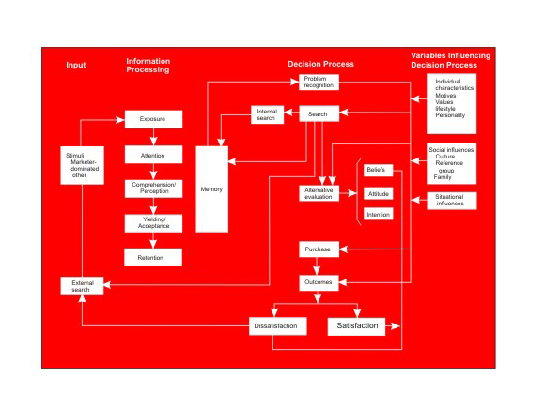
Engel, Blackwell and Kollat’s Model

Slide 91
Engel, Blackwell and Kollat’s Model
The model incorporates many constructs that impact consumer decision making. It tries to explain clearly the interrelationships between stages in the decision process and the various variables. The model fails to adequately explain as to how each of these influences consumer decision making. The model was revised in the 1990s and proposed again as the Engel, Blackwell and Miniard (EBM) model

Slide 92
ENGEL-BLACKWELL-MINIARD MODEL
The model consists of four sections information input; information processing; decision process and variables influencing the decision process.
Information received from marketing and non-marketing stimuli feeds into the information-processing section of the model. The information section of the model comprises various stages like exposure, attention, comprehension, acceptance and retention.

Slide 93
ENGEL-BLACKWELL-MINIARD MODEL (EBM)
THIS PROBLEM SUGGESTS THAT CONSUMERS TAKE A PROBLEM SOLVING APPROACH.THE PROCESS STARTS WITH CONSUMERS NEED/PROBLEM
EBM MODEL HAS 4 SECTIONS.
INPUT – the information received by consumer from internal source (memory, experience) and external source (family, Ads., internet, etc.).
INFORMATION PROCESSING – the input information from various sources are processed for pre-purchase evaluation.
Notes:
IONS

Slide 94
ENGEL-BLACKWELL-MINIARD MODEL
DECISION PROCESS –
Decision process has 7 steps
          Need Recognition
          Information search (processing)
          Pre-purchase Evaluation of Alternatives
          Purchase
          Consumption
          Post-consumption evaluation
          Divestment

Slide 95
ENGEL-BLACKWELL-MINIARD MODEL
VARIABLES INFLUENCING DECISION PROCESS
PERSONAL – Resources, motivation, product
Involvement, knowledge, attitude,
personality, values and life style.
ENVIRONMENTAL – Culture, Social Class, Personal Influences, family and situation.
This Model takes many factors but it is criticized for lack of clarity.

