Slide 1

2
+
THE MICRO, SMALL AND MEDIUM ENTERPRISES
(MSME)
By Abhishek Arthur

Slide 2


What is MSME
MSME stands for Micro, Small and Medium Enterprise (MSME), introduced by Government of India in agreement with Micro, Small & Medium Enterprises Development (MSMED) Act, 2006 are entities engaged in the production, manufacturing, processing or preservation of goods and commodities.

Slide 3

MSME SECTOR
Financial Management of MSMEs in India
Financial management is one of the most important aspects of running a business successfully. However, MSME entrepreneurs often ignore their financial strategy and pass the burden on the accounting departments.
Now, the accounting department can file your taxes, make salaries, manage your accounts, but a larger process like budgeting, forecasting, creating financial strategies.

Slide 4
The Medium, Small and Micro Enterprises (MSMEs) are the backbone of India’s economy. The country’s growth of 7.3% for F.Y. 2020-21 means this backbone is severely dented and needs to realign and re-engage its efforts towards smarter and economical ways of undergoing business processes. Here is where the role of technology comes into play.
With the pandemic, a large number of MSMEs in India are battling for survival and their credit requirements are compounded from a year ago. In addition, MSMEs now have to adopt digitization. Although this can be considered as the silver lining to the cloud of despair brought by covid-19 induced lockdowns and restrictions, unfortunately, MSMEs are gripped with the lack of technological knowledge and awareness.
In the present scenario, there is no denying that MSMEs facing liquidity crisis along with other major issues need whatever help they can get. So, here are the top five ways in which MSMEs can manage their finances better and focus on rebuilding their business.

Slide 5



Five financial management strategies for SMEs/MSMEs
manage finances better and focus on rebuilding the business.

Slide 6

Meeting Credit Needs Via Alternate Routes
As MSMEs prepare to bounce back from a coronavirus-induced economic scenario, they will once again have to think about meeting their working capital requirements.
MSMEs can approach structured finance companies who offer strategies such as;
Off-balance sheet accounting,
legal and corporate restructuring or
the use of financial instruments for credit, both working capital and loans.

Slide 7

Planning Insurance Support
Insurance is a critical financial tool to help MSMEs reduce their risk and recover after experiencing tough times. It makes MSMEs resilient to shocks, making them more financially sound.
Tailor-made regulation on insurance products that specifically target SMEs will contribute to increased uptake.

Slide 8

Adopting Suitable Software
The use of technology helps MSMEs to mitigate reliability on additional resources and consequently cut costs,
It enables easy accounting and book-keeping for MSMEs,
This will help them establish a transparent accounts system,
Cloud technologies and services make digitization convenient and cost-effective,
Technology provides ease of business,
Digital technologies can scale up manufacturing & revenues in no time.

Slide 9
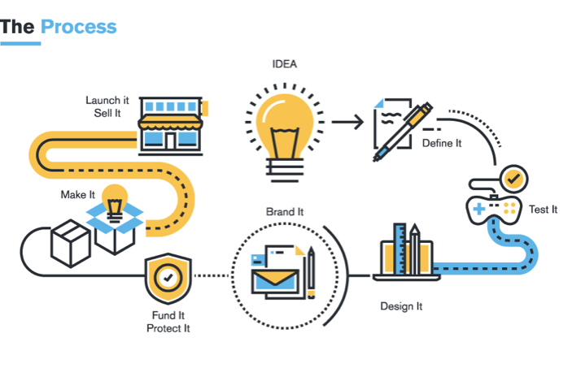
Automating Daily Processes
Simple basics like an online catalog to detail products and services,
using technology platforms to register pending orders, and
producing automated bills and payment slips instead of manual entries, etc. can be adopted.
This will not only save time but improve the efficiency of the business and ensure transparency, as well as, precision. Automating the everyday processes that may not require high acumen and skills is a crucial requirement in times of labor shortage and credit conservativeness.

Slide 10

Collaborating for Technical Support
One of the ways for MSMEs to build their network and garner support from peers is by collaborating with others for technical support.
Listing your business on a marketplace and allowing orders to be taken digitally via an alternate business that acts as an enabler is a classic example of collaborating for technical support.

Slide 11

Tips for financial management OF MSMEs

Slide 12

BUSINESS FINANCE VS PERSONAL FINANCE
Entrepreneurs handling a smaller industry generally mix their business finance and personal finance with the aid of one single bank account for all transactions. However, this dependency is incredibly unhealthy for business and personal finance of the entrepreneur.
So separate trade and personal banking account. This will not just help you monitor your financial go with the flow but additionally aid you in elevating business loans from banks and replacement lenders.

Slide 13

Maintain Planning
Financial planning is as foremost as business planning or advertising methods and entrepreneurs have got to pay attention to this aspect of financial management.
Entrepreneurs must work out a quarterly financial plan and evaluation each month to have an understanding of the economic pulse of what you are promoting and plan a bigger cost.

Slide 14
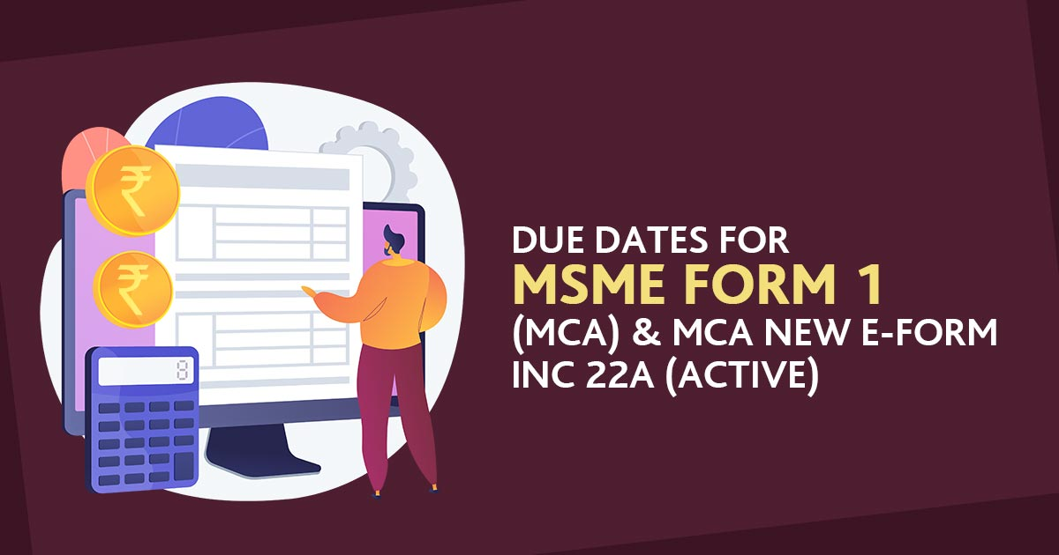
Follow deadlines
Never miss your tax dues or payments or loan compensation deadline. Arrears are inclined to expect fines, which additionally adds to your expense and raise the price.
Additionally, regularly missing a payment will combine a red mark on your credit score, which will produce problems while you require to increment funds for your business development plans.

Slide 15
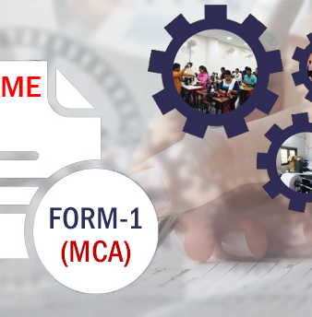
COMPLIANCES FOR MSME
MSME FORM - 1
Every specified company has to submit the yearly return on a half-yearly basis to the Registrar concerning the outstanding payments to the Micro, small and medium enterprises

Slide 16

DUE DATES FOR MSME FORM - 1
Due Dates:-
The Ministry Of Corporate Affairs states that the date of filing the MSME Form 1 will be calculated from the time the form is deployed on the MCA 21 Portal.
Period of Return | Date of Filing
April to September | 31st October
October to March | 30th April

Slide 17


HERE ARE A FEW IMMEDIATE THINGS MSME OWNERS SHOULD LOOK AT
Be Tax Compliant
Keeping good accounts shall help keep your tax returns clean and mostly you shall be looking at a very fair tax level.
Keep Single Accounts
One for business and management accounting, and one for tax filing.
Move to digital channels – Like using smartphone apps, mobile payments, UPI and other electronic means
Be Digital

Slide 18
Financial Management continues….
Proper accounting- have qualified acct.staff
Better lAIsOnINg WITH all depts…
Proper budgeting & control
Capital budgeting
Working capital mgmnt..
Ensuring smooth fund flow…
Legal compliance- timely return filing, availing itc, it refund, avoiding fine etc…

Slide 19
India has approximately 6.3 crore MSMEs. As per the MSME Ministry data, as of May 16, 2021, the Udyam Registration portal registered 30,00,822 MSMEs, which replaced the former process of filing for Udyog Aadhaar Memorandum (UAM). Registered micro-enterprises stood at 28 lakh (93%), followed by small enterprises at 1.78 lakh (6%) and midsized enterprises at 24,657 (1%). The Indian MSMEs sector contributes about 29% towards the GDP through its national and international trade.
Estimated Number of MSMEs (Activity Wise)
Activity Category | Estimated Number of Enterprises (in lakh) |  |  | Share (%)
 | Rural | Urban | Total
(1) | (2) | (3) | (4) | (5)
Manufacturing | 114.14 | 82.50 | 196.65 | 31
Electricity | 0.03 | 0.01 | 0.03 | 0
Trade | 108.71 | 121.64 | 230.35 | 36
Other Services | 102.00 | 104.85 | 206.85 | 33
All | 324.88 | 309.00 | 633.88 | 100

Slide 20
MSME Classification
Micro
Small
Medium
MANUFACTURING AND SERVICES SECTORS
Investment <= Rs. 50 crore
and Turnover <= Rs.250 crore
Investment <= Rs. 10 crore
and Turnover <= Rs.50 crore
Investment <= Rs. 1 crore
and Turnover < =Rs.5 crore

Slide 21
Old MSME Classifications
Manufacturing Enterprises
Service Enterprises
Micro
Investment < Rs. 25 Lakhs
Small
Investment < Rs. 5 Crore
Medium
Investment < Rs. 10 crore
Micro
Investment < Rs. 10 Lakhs
Small
Investment < Rs. 2 crore
Medium
Investment < Rs. 5 crore

Slide 22
New MSME Classifications
Composite Criteria : Investment and Turnover
Micro
Investment < Rs. 1 Crore and Turnover < Rs. 5 Crore
Small
Investment < Rs. 10 Crore and Turnover < Rs. 50 Crore
Medium
Investment < Rs. 50 Crore and Turnover < Rs. 250 Crore

Slide 23


MSME Schemes
MSME SCHEMES

Slide 24
Udyog Aadhaar Memorandum
Aadhaar card is a 12 digit number given to all individuals by the government. The benefit of registering in this scheme is the ease in availing credit, loans, and subsidies from the government.

Slide 25
Prime Minister’s Employment Generation Programme
The scheme aims to generate employment opportunities in rural as well
as urban areas of the country through setting up of new self-employment.
The scheme also seeks to provide continuous and sustainable employment to all segment of traditional and prospective artisans and rural / urban unemployed youth in the country, so as to help arrest migration of rural youth to urban areas.

Slide 26

CREDIT GUARANTEE TRUST FUND FOR MSEs (CGTMSE) - Provision of Collateral Free Credit for MSMEs
Guarantees are provided for extending collateral free lending to Micro and Small Enterprises through banks and financial institutions (including NBFCs).
The Scheme covers collateral free credit facility (term loan and /or working capital) extended by eligible lending institutions to new and existing micro and small enterprises up to Rs. 200 lakh per borrowing unit

Slide 27
INTEREST SUBVENTION SCHEME FOR INCREMENTAL CREDIT TO MSMES
As a part of the initiative on support and outreach for MSMEs Hon'ble Prime Minister announced the "Interest Subvention Scheme for Incremental credit to MSMEs.
The Scheme offers 2% interest subvention for all Udyog Aadhar Number (UAN) and GST registered MSMEs on fresh or incremental loans to the extent of Rs. 100 lakh.

Slide 28
Credit Linked Capital Subsidy Scheme
Under this scheme, new technology is provided to the business owners to replace their old and obsolete technology. The capital subsidy is given to the business to upgrade and have better means to do their business. These small, micro and medium enterprises can directly approach the banks for these subsidies.

Slide 29
Quality Management Standards & Quality Technology Tools
Registering in this scheme will help the micro, small and medium enterprises to understand and implement the quality standards that are required to be maintained along with the new technology.

Slide 30
Emergency Credit Line Guarantee Scheme (ECLGS)
Government has operationalized Rs. 3,00,000 crore collateral free loan scheme which is likely to benefit 45 lakh MSMEs.
It seeks to provide much needed relief to the MSME sector by incentivizing Member Lending Institutes (MLIs) to provide additional credit at low cost, thereby enabling MSMEs to meet their operational liabilities and restart their businesses.

Slide 31
Women Entrepreneurship
This scheme is especially started for women who want to start their own business. The government provides capital, counselling, training and delivery techniques to these women so that they manage their business and expand it.

Slide 32


IMPACT OF
BUDGET 2021-22
ON MSME SECTOR

Slide 33























INCREASE IN BUDGETARY OUTLAY
The Budget estimates for the MSME sector in FY 20-21 stood at Rs. 7,572 crore. However, for this fiscal year, the Finance Ministry allocated Rs. 15,700 crore, which is more than double the previous year’s allotment.
Provisions for earlier announced Atma Nirbhar schemes to provide much needed financial succour and accessibility.
ENHANCING COMPETITIVENESS OF MSME PRODUCTS:
Rationalization and Reduction of custom duties on, alloys and stainless steel and reduction of duty on steel and copper scraps will be of great help to the MSME sector;
Rationalization of duties on raw materials for textile production
Rationalization of Customs Duty in Gold and Silver would provide required impetus to MSMEs working in this sector.

Slide 34

RESOLUTION OF INSOLVENCY
The National Company Law Tribunal (NCLT) infrastructure has not been greatly successful in providing effective solutions; insolvency cases are still pending. To combat this issue, the Finance Minister announced the following measures:
Introduction of changes to reinforce the framework of NCLT
Implementation of new ecosystems, for instance, e-courts to conduct virtual hearings to resolve and close cases efficiently
Besides these, the Indian government shall also introduce effective debt resolution methods and special guidelines for MSMEs soon

Slide 35

ONE PERSON COMPANY (OPC) AMENDMENTS
The government announced reforms concerning OPCs to boost the growth of both start-ups and MSMEs.
The Finance Ministry took measures to lift restrictions on paid-up capital and turnover. Hence, the process of setting up of One Person Companies has now become exceedingly convenient for start-ups.
The current measures allow OPCs to convert into other forms of business as per their convenience.

Slide 36

























Other initiatives:
Further, Post Covid-19, Government has taken a number of initiatives under Aatma Nirbhar Bharat Abhiyan to support the MSME Sector in the country especially in Covid-19 pandemic. Some of them are:-
Rs 20,000 crore Subordinate Debt for MSMEs.
Rs 3 lakh crores Collateral free Automatic Loans for business,including MSMEs.
New revised criteria for classification of MSMEs.
New Registration of MSMEs through ‘Udyam Registration’ for Ease of Dong Business.

Slide 37
  RECENT DEVELOPMENTS
REVIVAL AND REHABILITATION OF MSMES
In order to provide a simpler and faster mechanism to address the stress in the accounts of MSMEs and to facilitate the promotion and development of MSMEs.
The Ministry of Micro, Small and Medium Enterprises ,Government of India, vide its Gazette Notification notified a ‘Framework for Revival and Rehabilitation of Micro, Small and Medium Enterprises.
Reserve Bank of India has also issued guidelines to the Banks, Under these guidelines, Banks have created mechanism for finalising corrective action plan for revival & rehabilitation of MSMEs.

Slide 38
    MSME DATA BANK
For facilitating the promotion and development and enhancing the competitiveness of MSMEs, the Ministry of MSME vide Gazette had notified the MSME Development under which all MSMEs are to furnish information relating to their enterprises online to the Central Government in the data bank maintained by it at www.msmedatabank.in. This data bank will enable Ministry of MSME to streamline and monitor the schemes and pass on the benefits directly to MSMEs.

Slide 39

    My MSME
To facilitate the enterprises to take benefits of various schemes, the Office of Development Commissioner (MSME) has launched a web-based application module, namely, My MSME. This can also access through a mobile app. Entrepreneurs can make their applications and track it as well on their mobile itself.

Slide 40
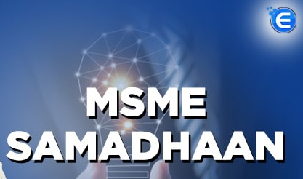
MSME SAMADHAAN
Deals with the issues relating to the Delayed Payments to Micro and Small Enterprises (MSEs) by the buyers to the MSE supplier. In the case of delay in payment beyond 45days, MSEs suppliers may approach the Micro and Small Enterprises Facilitation Council(MSEFC) constituted under the Act in all State/UTs. Under Section 16 of the MSMED Act, delayed payment to supplier units, attracts compound interest with monthly interests at three times of the bank rate notified by the Reserve Bank.

Slide 41

Champions Portal
Creation and Harmonious Application of Modern Processes for Increasing the Output and National Strength (CHAMPIONS) portal launched by Hon’ble Prime Minister on 1st June, 2020, is an ICT based technology system for making the smaller units big by helping and handholding them. The portal is not only helping MSMEs in the present situation, but also providing guidance to grab the new business opportunities.

Slide 42
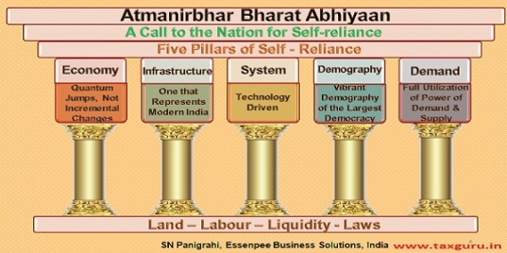
SPECIAL MEASURE UNDER ATMANIRBHAR BHARAT ABHIYAAN
In the aftermath of COVID-19 pandemic, Hon'ble Prime Minister was quick to recognize the role of MSMEs in building the Nation. As such, MSMEs formed a very prominent part of the announcements made under the Atmanirbhar Bharat Abhiyaan. Under this package, the MSME sector has not only been given substantial allocation but has also been accorded priority in implementation of the measures to revive the economy. To provide immediate relief to MSME sector, various announcements have been made under the Package.

Slide 43

    Skill Training Eco-system of Ministry of MSME
      Ministry of Micro, Small & Medium Enterprises (MSME) in its endeavor to provide the right stimulus for the growth of the industry in the country – particularly with the objective of helping micro, small and medium enterprises, has developed a robust skilling eco-system to meet the demands of skilled workforce in the various emerging and traditional sectors in different segments of enterprises.

Slide 44


Slide 45
      ENCOURAGING THE PRODUCTION OF COVID-19 RELATED MEDICAL AND AUXILIARY ITEMS BY TECHNOLOGY CENTERS(TCs):
Technology Centers(TCs) have developed innovative products to fight against COVID-19 like Box to sanitize office files and other articles using UV lights, plasma based sanitizers, accurate IR thermometer, non-contact dispensers, etc. and are manufacturing indigenous components for Corona Testing Equipment, hot tape sealing (critical operation for PPE coveralls), masks, WHO quality alcohol based sanitizers, sanitizer pumps face shields, etc.
They have been funded by the Ministry to undertake these activities and be helpful to the MSMEs in producing these items and benefit from this opportunity.

Slide 46

Loans for MSMEs
There are multiple private sector banks that offer MSME loan at competitive interest rates. Some key banks and NBFCs that offer MSME loans with added benefits are:-

Slide 47

MSME Loans from Lendingkart Finance
Lendingkart has special MSME loans and SME loans for businesses looking for quick finance in India. These loans are approved through an online process which helps in speeding up the financial vehicle delivery
Interest Rate | 15.35%
Max. Loan Amount | Up to 2 crore
Min. Loan Amount | Rs.50,000

Slide 48

MSME Loans from ICICI Bank
Considered as the second-largest bank in India in terms of assets and market capitalisation, ICICI Bank offers a wide range of finance products to different segments of its customer base. As of now, the bank has three MSME loans listed on it’s website. ICICI Bank also offers non-funded facilities to help small businesses run business operations smoothly.
Interest Rate | 15%
Max. Loan Amount | Up to 15 crore

Slide 49

MSME Loans from Bajaj Finserv
MSME refers to micro, small and medium enterprises. Convenient and quick, the Bajaj Finserv MSME Loan/SME Loan is designed to help growing businesses meet their financial requirements in a timely, easy way with funds up to Rs. 45 lakh.
Interest Rate | 17%
Max. Loan Amount | Up to 45 lakh

Slide 50
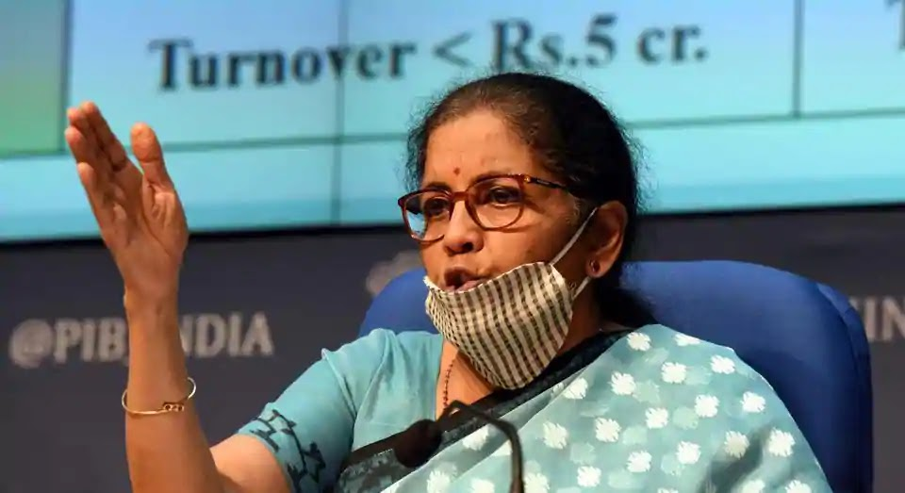
ATMNIRBHAR BHARATH ABHIYAN

Slide 51

INCREASE IN BORROWING LIMITS
All businesses (including MSMEs) will be provided with collateral free automatic loans of up to three lakh crore rupees
Borrowers with up to Rs 25 crore outstanding and Rs 100 crore turnover will be eligible for such loans and can avail the scheme. (October 31, 2020). Last year.
Interest on the loan will be capped and 100% credit guarantee on principal and interest will be given to banks and NBFCs.
MSMEs can borrow up to 20% of their entire outstanding credit as on February 29, 2020 from banks and Non-Banking Financial Companies (NBFCs).

Slide 52

Corpus for MSMEs
A fund of funds with a corpus of Rs 10,000 crore will be set up for MSMEs. This will provide equity funding for MSMEs with growth potential and viability. Rs 50,000 crore is expected to be leveraged through this fund structure.

Slide 53
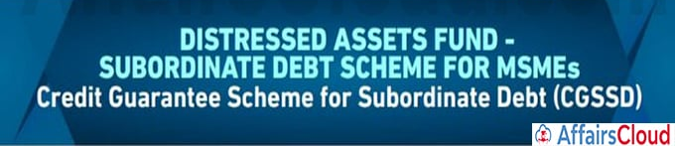
Subordinate debt for MSMEs
This scheme aims to support to stressed MSMEs which have Non-Performing Assets (NPAs). Under the scheme, promoters of MSMEs will be given debt from banks, which will be infused into the MSMEs as equity.
The government will facilitate Rs 20,000 crore of subordinate debt to MSMEs. For this purpose, it will provide Rs 4,000 crore to the Credit Guarantee Fund Trust for Micro and Small Enterprises, which will provide partial credit guarantee support to banks providing credit under the scheme

Slide 54
Schemes for NBFCs
A Special Liquidity Scheme was announced under which Rs 30,000 crore of investment will be made by the government in both primary and secondary market transactions in investment grade debt paper of Non-Banking Financial Companies (NBFCs)/Housing Finance Companies (HFCs)/Micro Finance Institutions (MFIs).
The central government will provide 100% guarantee for these securities. The existing Partial Credit Guarantee Scheme (PCGS) will be extended to partially safeguard NBFCs against borrowings of such entities (such as primary issuance of bonds or commercial papers (liability side of balance sheets)).
The first 20% of loss will be borne by the central government. The PCGS scheme will facilitate liquidity worth Rs 45,000 crores for NBFCs.

Slide 55

Employee Provident Fund (EPF)
Under the PM Garib Kalyan Yojana, the government paid 12% of employer and 12% of employee contribution into the EPF accounts of eligible establishments for the months of March, April and May. This will be continued for three more months (June, July and August). This is estimated to provide liquidity relief of Rs 2,500 crore to businesses and workers.

Slide 56

Statutory PF contribution
Statutory PF contribution of both the employer and employee will be reduced from 12% to 10% each for all establishments covered by EPFO for next three months. This scheme will apply to workers who are not eligible for the 24% EPF support under PM Garib Kalyan Package and its extension. However, Central Public Sector Enterprises (CPSEs) and State Public Sector Units (PSUs) will continue to contribute 12% as employer contribution

Slide 57
Other Highlights
Expediting payment of dues to MSMEs:
Payments due to MSMEs from the government and CPSEs will be released within 45 days.
Insolvency resolution:
A special insolvency resolution framework for MSMEs under the Insolvency and Bankruptcy Code, 2016 will be notified.
Nirmala Sitharaman introduces IBC (Amendment) Bill 2021 in Lok Sabha
The ordinance to amend the Insolvency and Bankruptcy Code (IBC) was promulgated on April 4, whereby a pre-packaged resolution process for stressed micro, small and medium enterprises (MSMEs) was introduced under the Code.
( An excerpt from The Hindu Business Line published on Tuesday, July 27th 2021 )

Slide 58


Slide 59


