Slide 1
Rural Entrepreneurship

Slide 2
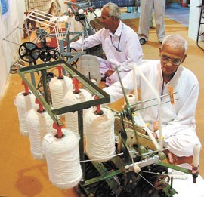

Small ideas grow to an enterprise

Slide 3
Rural Entrepreneurship
Rural entrepreneurship is defined as entrepreneurship whose roots lie in the rural areas but has a lot of potential to drive various endeavors in business, industry, agriculture, etc. and contribute to the economic development of the country. ...
This leads to migration of people from rural to urban areas

Slide 4
RURAL vs. URBAN DIVIDE
•
Agriculture as primary occupation.
Generally under- employed people
Lack of infrastructure
Low cost of labour and land
Cheap local raw materials
•
Variety of occupation
•
•
People having more than one employment
Over burdened infra
High cost of labour and land
Costly raw materials
•
•
•
•
•
•

Slide 5
•
Poor education and training facilities
More prone to natural disasters
Difficult access to technology
High marketing cost Poorly organized
Migration of talent to urban areas
•
Better education and training facilities
Less prone to natural disasters
Easy access to new technology
High production cost Highly organized
Over population due to migration
•
•
•
•
•
•
•
•
•
•

Slide 6
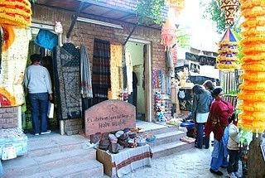
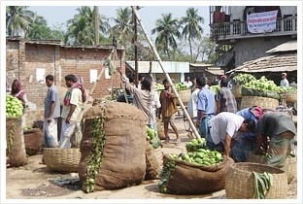
Traditional and developed markets

Slide 7
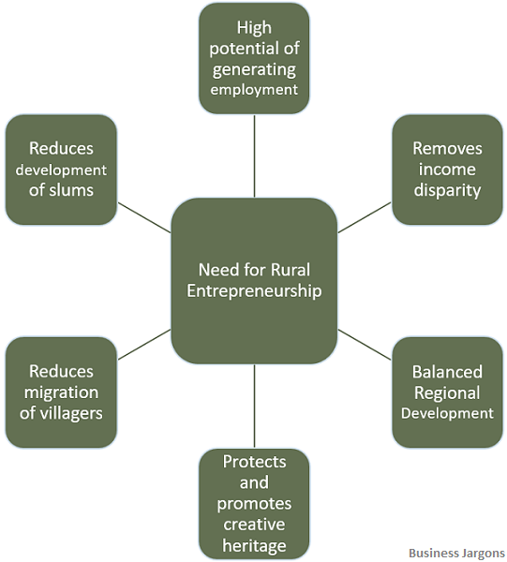

Slide 8
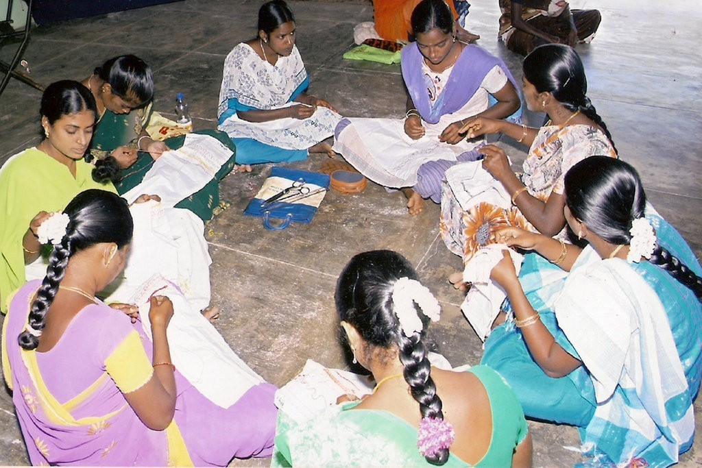
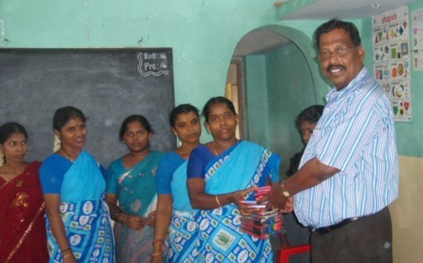
Training The
Entrepreneurs

Slide 9
Basic infrastructure
The importance of infrastructure for development ,however the minimum requirements are indicated below:
  All weather roads
  Electricity
  Water supply
  Telecommunications
  Banking etc.

Slide 10
Opportunities for rural entrepreneur
The number of opportunities existing in rural area are unlimited, considering its area, population, bio diversity and different agro climatic zones.

Slide 11
Farm based enterprise
Organic farming: the demand for organic products is increasing day by day.
The certified organic products have good export potential.
All inputs are available in rural areas ,if number of farmers take up this activity ,trading is another option for entrepreneurs.
Floriculture: good demand exist in urban areas. If the village is located near to urban areas ,cost of transportation will be low.

Slide 12


Organic farming and floriculture

Slide 13
High tech agriculture: Production of exotic vegetables, off-season vegetables, mushrooms etc are covered under this. The demand for the produce is increasing with increase in income of middle class.
Medicinal plants: demand for cultivated medicinal plants is increasing due to reduced availability of medicinal plants from forest.
Ayurvedic drug manufacturers are also entering into contracts with farmers for supply of medicinal plants.

Slide 14
Aromatic plants: demand for natural perfumes is increasing due to health issues related to chemical products. This has open gate for commercial production of aromatic plants.
Commercial forestry: waste lands not fit for agriculture can be used for commercial forestry. Plants like eucalyptus, poplar, bamboo etc can be raised. Paper mills, matchstick manufactures and furniture makers are buying these items. The bamboo tree can be utilized for more than 30 products.

Slide 15

Medicinal plants and spices

Slide 16
Food processing & agro waste based business
Food processing is most preferred activity for rural entrepreneurs.
The value addition is considerable and the market is open and expanding.
Millions of tons of agro waste is burnt every year.

Slide 17
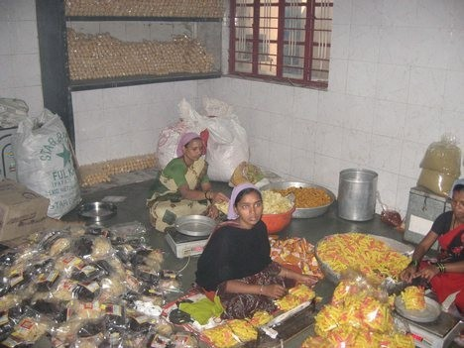
Food processing

Slide 18
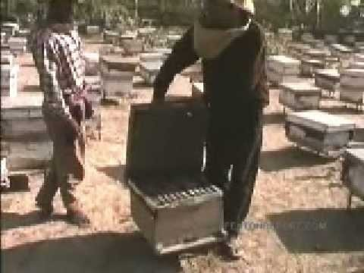
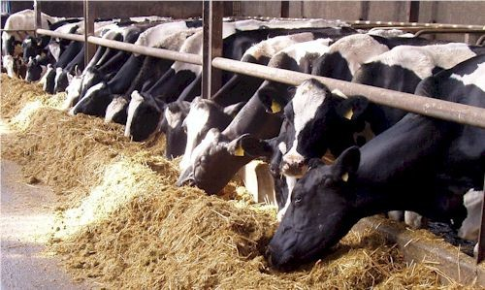
Bee keeping and Dairy farm

Slide 19
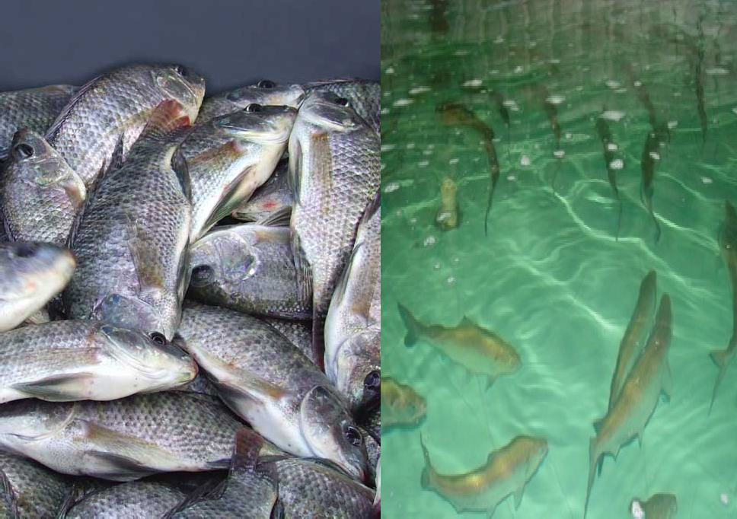
Fish farming

Slide 20
Traditional handicrafts
India is famous for traditional crafts based on skills and local materials.
There is huge export market for crafts and traditional products.
Those interested in trading can buy the products from small manufactures and sell it in urban markets.
The cooperatives or self help groups of producers can also take up trading activity.

Slide 21
Gathering ideas
•
Either the entrepreneur himself acts as innovator or he can contact certain institutions to get business ideas suitable for rural areas.
The following institutions are dealing in this area:
•
KVIC
NABARD
SIDBI
EXTEN. CENTERS OF AGRICULTURE UNIV.
NIDC,NIESBUD
TECHNICAL CONSULTANCY ORG IN EACH STATE
CENTERS FOR ENTREPRENEURSHIP DEVELOPMENT
DEVELOPMENT COMMISSIONER HANDICRAFTS/ COTTAGE INDUSTRIES

Slide 22
Contd…..
•
Some institutions are dealing purely in business ideas related to agriculture produce:
ICAR & ITS EXTENSION CENTERS
CFTRI
NHB
NATIONAL MEDICINAL PLANT BOARD
APEDA
NATIONAL INSTITUTE FOR ORGANIC FARMING
NBRI
CIMAP
FLAVOURS & FRAGRANCES DEVELOPMENT INSTITUTE ETC.

Slide 23
Training/skill development
•
Every entrepreneur should undergo specialized training before entering into a venture specially manufacturing, service or high tech agriculture.
•
Specific skills development or area specific training institutes are conducting training for youth, such as;
CIMAP for medicinal plants
NBRI for floriculture
CFTRI for food processing
NIRD for rural technology related projects
NABARD is sponsoring various skill training pogrammes through NGOs.
The intending youth can get details from various web sites and News Papers or contact Kisan Help Line
•

Slide 24
Problems of Rural Entrepreneurship
Paucity of Funds
Lack of technical know-how
Lack of training and development
Non-availability of skilled labors
Risk Element
Legal Formalities
Lack of technical knowledge
Lack of Quality Control
Lack of communication and market insights
Lack of storage and transportation facilities
Old and obsolete technology, machinery and equipment
Lack of promotional strategy
Lack of infrastructural facilities
Poor quality standards

Slide 25
Marketing issues
Marketing of rural produce is prime concern for the rural entrepreneurs .
The rural areas act as markets for the person choosing service industry or trading as business.
However, the urban areas and other villages act as markets for the manufacturing or producing enterprises.
Some of the rural products even have export markets .
Depending on the type of products market mix can be planned.

Slide 26
RURAL TECHNOLOGIES
There are many sources for getting technology inputs for establishing a rural enterprise however the Directory of Rural Technologies published by NIRD, Hyderabad is very useful .
The book in three volume covers technological inputs for construction, hi-tech agriculture, fertilizers, fisheries, post –harvest technologies, mechanical works, leather technology, water conservation, natural dyes, solar heaters and cookers, bio-gas ,food processing etc and is very useful for prospective entrepreneurs.

Slide 27
Reason is lack of infrastructure and awareness.
The media has spread the glamour of urban life and speeded up the process of migration.
Coordinated efforts of various agencies are required to achieve the goal of rural industrialization .

Slide 28
10 PROBLEMS FACED BY ENTREPRENEURS IN INDIA WHILE STARTING THEIR BUSINESS
10 common challenges that every entrepreneur faces while starting their business:-
Financing
Lack of Planning
Hiring the right talent
Effective marketing within a limited budget
Self-doubt and uncertainty
Dealing with criticism
Attractive Customers
Making Decisions
Time Management
Office Infrastructure

Slide 29
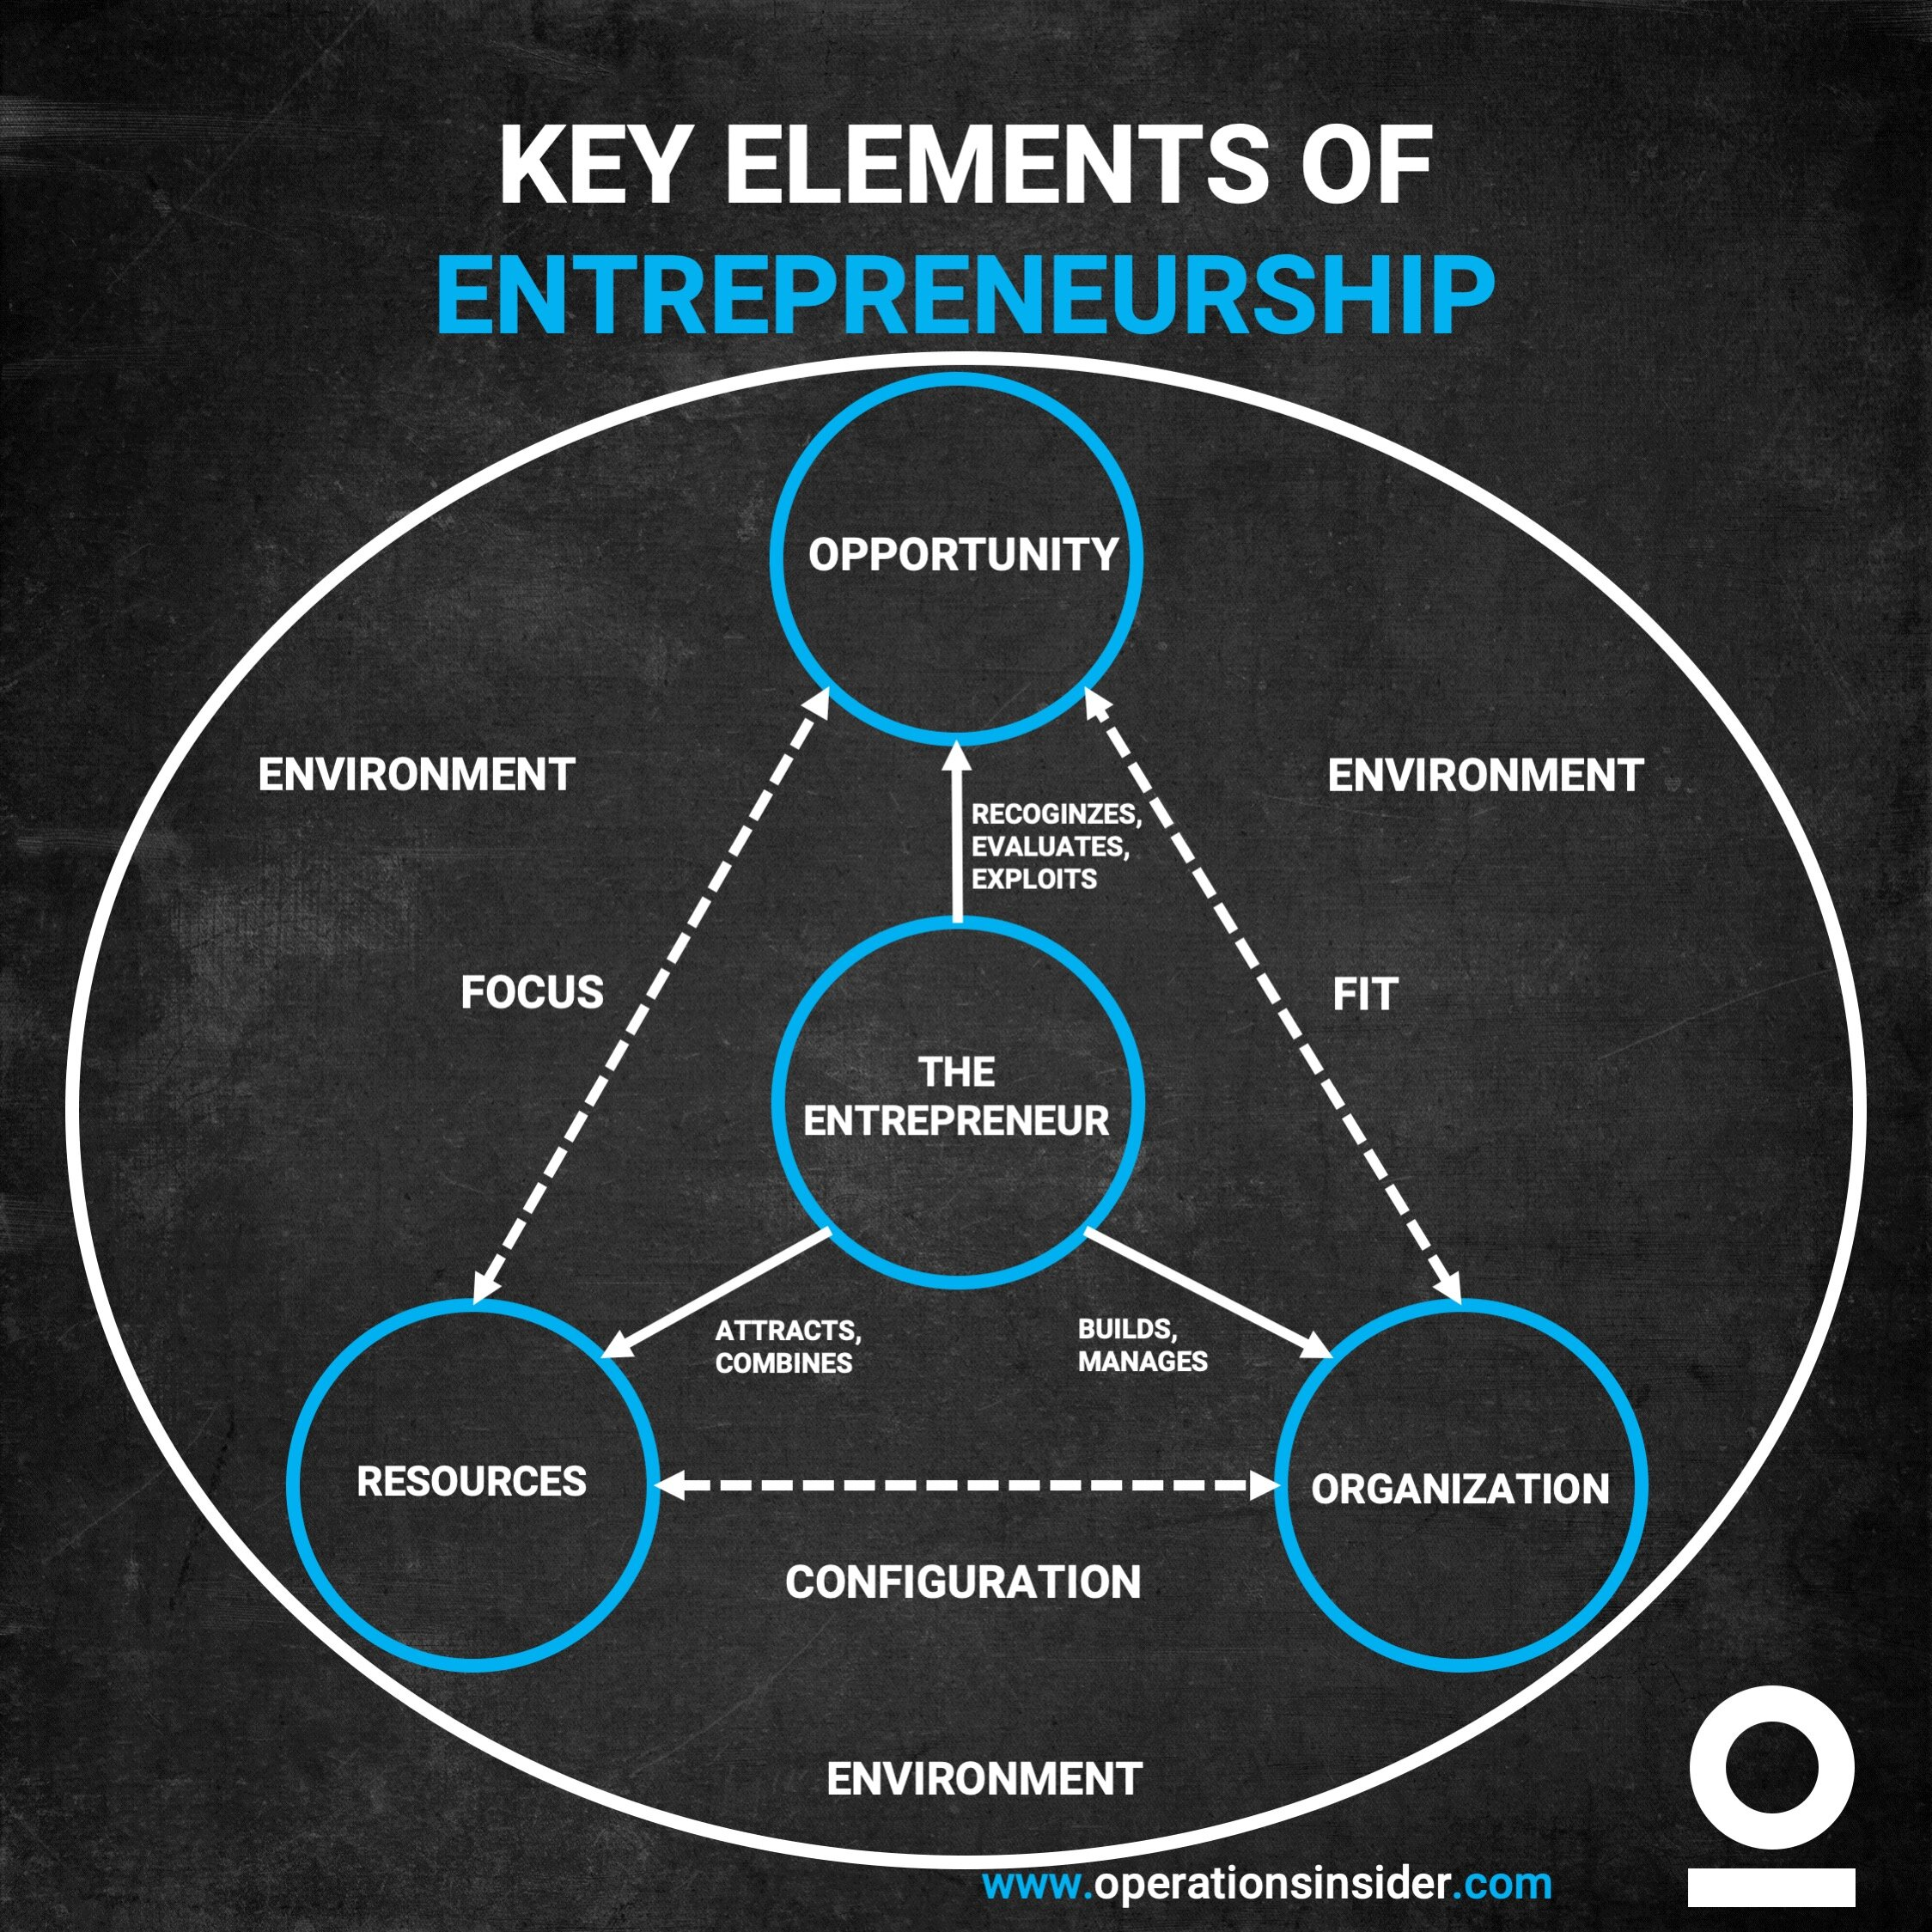

Slide 30
Successful Entrepreneur
Great entrepreneurship ventures can not be made in a single day or with sheer luck, people need elements of entrepreneurship within them which makes them excellent entrepreneurs.
The 5 Elements of Entrepreneurship are:-
Innovation
Organization
Decision Making
Risk Bearer
Vision

Slide 31
The most famous entrepreneurs from India all have the same entrepreneurial spirit.
1.NARAYANA MURTHY • Narayana Murthy is one of the founders of Infoys Technologies Limited. • In 1999, Infoys became the first Indian company to be listed on NASDAQ. • By 2006 the company employed over 50,000 people and had a turn over of two billion dollars. • Murthy has always believed that honesty, transparency and moral integrity are the key factors in business.
2. SHIV NADAR • He is the Chief Executive Officer of Hindustan Computers Limited (HCL), India's largest info tech conglomerate. • While working as an engineer with another company, Nadar wanted to become an entrepreneur by setting up his own business. • He quit his job and launched his own company making office products mainly copiers. • In 1970 when IBM quit India, Shiv Nadar's HCL stepped in for IBM.
3. TULSI TANTI • Tulsi Tanti is Chairman of Suzion Energy LTD, a company that deals in wind energy. • In 1990 Tanti invested in two windmills and from there realized the enormous potential. • In 1995, he formed Suzion and has made Suzion Energy the sixth largest wind energy company in the world.
4. RAHUL BAJAJ • Rahul Bajaj is Chairman of the Bajaj Group which is one of the top ten business groups in India. • His company has diversified interests in everything ranging from automobiles to home appliances. • After the recession and stock market collapse in 2001, the Bajaj Auto was hit hard. • However, the company re-invented itself and become a major success.
5. DR. PRATAP REDDY • Dr. Pratap Reddy developed India's first corporate hospital group, The Apollo Hospital Group. • He has revolutionized India's whole health care sector and today has over 750 corporate hospitals throughout the country. • The idea came to Dr. Reddy when a patient could not make it to Texas for open heart surgery and died. • Dr. Reddy created a medical infrastructure in India which made medical care more affordable and accessible for everyone.
6. KIRAN MAZUMDAR SHAW • She is the Chairman and Managing Director of Biocon LTD, the largest Biotechnology Company in India. • Shaw started Biocon in 1978 in a rented garage space. • Faced with a variety of problems and challenges since biotechnology was a new field and woman entrepreneur was very rare, Shaw overcame all entrepreneurial barriers and made Biocon a success.
7. NARESH GOYAL • Naresh Goyal is the founder and Chairman of Jet Airways, India's largest domestic airline. • After he graduated college, Goyal joined the travel business. • By 1974, Goyal founded Jet Airway to look after sales and marketing of foreign airlines in India. • In 1991, Goyal took advantage of the open skies policy of the Indian Government and set up Jet Airways for operation of scheduled air service on domestic flights in India.

Slide 32
MALLIKA SRINIVASAN • Current position: Director, TAFE (Tractor and Farm Equipment) • Mallika has an MBA from Wharton School of Business, Pennsylvania. • She joined TAFE in 1986 and has since been responsible for accelerating turnover from 85 crores to 2900 crores within a span of two decades. • Her innovative business ideas and excellent leadership qualities have won her laurels from every quarter. • She was awarded „Businesswoman of the year 2006‟ award by ET.
2.JOBS & WOZNIAK • Apple Computer‟s two Steves weren‟t the first Silicon Valley entrepreneurs to launch a billion-dollar business from a Palo Alto garage -- Hewlett and Packard were there before them • They were the first to democratize computing by creating a machine whose use was so wonderfully intuitive that even technophobes embraced it. • Combine the elegance of Wozniak‟s operating system design with Jobs‟ marketing savvy (remember Apple‟s “1984” ad?) and the result was a true phenomenon.
3.THIRUKKURUNGUDI VENGARAMASWAMY SUNDRAM • The founder of T V Sundram Iyengar and Sons Limited group of companies, one of India's largest industrial conglomerates. • With his humble beginning as a lawyer, he grew into one of the most successful industrialists of his time. • The Flagship Company of the group is TVS Motors. • It is the largest automobile distribution company in India, enjoys a turnover of about US$ 1 Billion (INR 40,000 Million) and has an employee strength of 40000.
4. LAXMI NIWAS MITTAL • The largest steel producer of the world He manages his empire that employs some 165000 workers. • Lakshmi Mittal – is an Indian born British steel billionaire and one of the richest men in the world . • As of March 2010, he is the fifth richest person in the world. • He is also the richest person in Europe with a personal wealth of US$28.7 billion
5.RASHMI SINHA • Rashmi is the founder-CEO of Slide Share. • She is an Indian internet entrepreneur. • Slide share is the world‟s largest community for individuals and organization to share their presentations. • Today, SlideShare receives more than 32 million unique visits in a month.
6.SANJEEV BIKHCHANDANI • Sanjeev is the founder of Naukri.com – an Indian job portal. • Sanjeev possesses a BA in Economics from Delhi University, he studied there although he had qualified for IIT. • After working a year, he qualified for IIM. • He is a management graduate from IIMAhmedabad. • In 1997, he left his cushy MNC job that paid Rupees 80,000 a month to set up Naukri.com, jobs portal on a server in the United States. By 2005, he was selected as a finalist for “Ernst and Young – Entrepreneur of the Year” award.
7. SARATHBABU ELUMALAI • He is an Indian entrepreneur, social worker and politician. • He is an alumnus of Indian Institute of Management Ahmedabad and Birla Institute of Technology and Science(Pilani). • After completing his management education, Sarathbabu decided to become an entrepreneur with the aim of providing employment to as many people as possible. • In 2006, he started his venture "Food King Catering services Private Limited" with a capital of Rs 2000 to cater to banks, software companies and educational institutions. • It is now located in 6 locations around India with a turnover of 8 crore. • The first unit of FoodKing was opened by Mr. Narayana Murthy, founder of Infosys.
8.NEELAM DHAWAN • Current position: MD, HP-India • A woman with „never-say-die‟ spirit, Neelam Dhawan is presently the Managing Director of Hewlett-Packard (HP), India. • Neelam is an iconic figure in Indian IT industry . • She is an inspiration for women working in IT sector. • She dared to enter the IT world in early 1980s when there were just a handful of women in this industry. • She had successful and rewarding stints with other leading players like IBM and HCL.

Slide 33
Conclusion
“There are not any secrets to success. It’s the results of preparation, hard work, and learning from failures.”
It would be worth it if your business succeeds on the primary try but that rarely happens. But most of the success comes from giving your best and learning from your past mistakes. This doesn’t offer you an excuse to fail.
Every attempt remains a trial at success. However, once you fail, you understand the reason for your downfall and try to improve in a subsequent time. Deliberate practice refers to a special variety of practice that’s purposeful and systematic. While regular practice might include mindless repetitions, deliberate practice requires focused attention and is conducted with the particular goal of improving performances.

