Slide 1
DPR involves a Detailed Study on various aspects of the Business Plan

Slide 2
Detailed Project Report (DPR)
1.Defining Objectives, Vision and Mission for the initiative
2.Study of Best Practices from similar contexts
3.Stakeholder Consultations
Business Process Reengineering (BPR)
  Existing e-Government services (Detailed AS-IS Scenario)
  Newly proposed services (Detailed TO-BE Scenario)
Functional Requirement Specifications (FRS)
6.Understand cost components for the project
7.Detailed analysis of business case
8.Business justification for the project (better
service levels)
Cost Benefit Analysis
Project Management structure

Slide 3
Detailed Project Report (DPR)
11. Change Management methodology
12. Capacity Building
Analysis of risks and mitigation measures
14. Financials
15. Time Lines

Slide 4
DPR should also include sections on
Government Support
  e-Governance Project Lifecycle
  Legislative changes/legal amendments,
  Infrastructure etc.
Sustainability
  Means of sustaining the project benefits
  Means of replicating the project success
Impact Assessment
  Evaluation methodology of the Impact Assessment Study

Slide 5
Address these 4 Questions
WHAT do we want to Achieve ?
Objectives, Services, Service Levels, Outcomes, Impact
HOW do we want to Implement ?
Technology, Process, Delivery Channels
WITH WHAT resources ?
Business Model, Service Charges, PPP
WHO will be responsible ?
Procurement, Training, Change Mgmt, O&M, M&E, Assessment
22

Slide 6
What is a Detailed Project Report (DPR)?
Complete Document for Investment Decision Making & Approval
Base Document for Planning& Implementation of Project
It helps in management of scope, cost, procurement, schedule & risk
Helps Identify Interventions Required for People, Process, Technology& Implementation
50

Slide 7
WHAT STAGE OF eGLC THE DPR IS PREPARED?
1. Vision & Strategy
Development
2. Current State
Assessment
4.
Implementatio n approach and sourcing
5. Develop IT system
implement antion
3. Future State Definition
6. Operate and sustain
Define implementation approach and phasing plan (functional and geographic)
Assess detailed funding requirements and business model
Prepare DPR
Develop vendor evaluation and selection criteria
Develop KPIs and performance levels for services and systems
Develop RFP
Bid evaluation and vendor selection
Project Management Office/Unit
Change Management and Communications

Slide 8
What is a DPR used for?
It is a comprehensive proposal prepared for all types of projects and used as a basis for:
Investment decision making
Approval of plans and designs
Project planning
Implementation scheduling and budgeting
53

Slide 9
Why Detailed Project Report (DPR)?
It provides an overview of the envisaged project
Submitted for administrative sanction
Prepared very early in the project
Concept of the project explained
Government is typically identified about the project by the time DPR is prepared
Project Governance mechanism is also defined there in.
And also prepared for:
Investment decision making
Project Planning
Approval of plans and designs
Implementation scheduling and budgeting
54

Slide 10
DPR - A High Level Document
○
Project Vision and Objectives
ProjectScope BenefitsEnvisaged
:Functionalscope& Geographicalscope
:Quantifiable
○
○
:Roles and responsibilities
:Decision making hierarchy
StakeholdersInvolved GovernanceMechanism
○
○
○
Budgeted Cost Estimates: Time-wise and Head of Ac ountwise
Break-upOfCosts
required ImplementationPlan
:Various items for which funds are
○
○
:Pilot study followed by rollout
HighLevelBusines Model :How will the project get paid for Sustenance :After the initial funding, sustenance
Of project
Metrics ForMeasurementOfProjectOutcomes And ImpactAsesment (I.E.EnvisagedServiceLevels)
○
○
○
55

Slide 11

The Pre-requisites For Preparing A
DPR?
1. Defining vision for e- Governance project
Defining governance mechanism
Identification of problems / needs
Baseline study
Stakeholder analysis
Scoping study
56

Slide 12
1. Defining Vision For e-Governance Project
Tells about the intended end state What a project intends to achieve
States what needs to be achieved by when shall target and something that cannot be easily done
Big thought
Easy to understand
Shared understanding of project objectives by various stakeholders
57

Slide 13
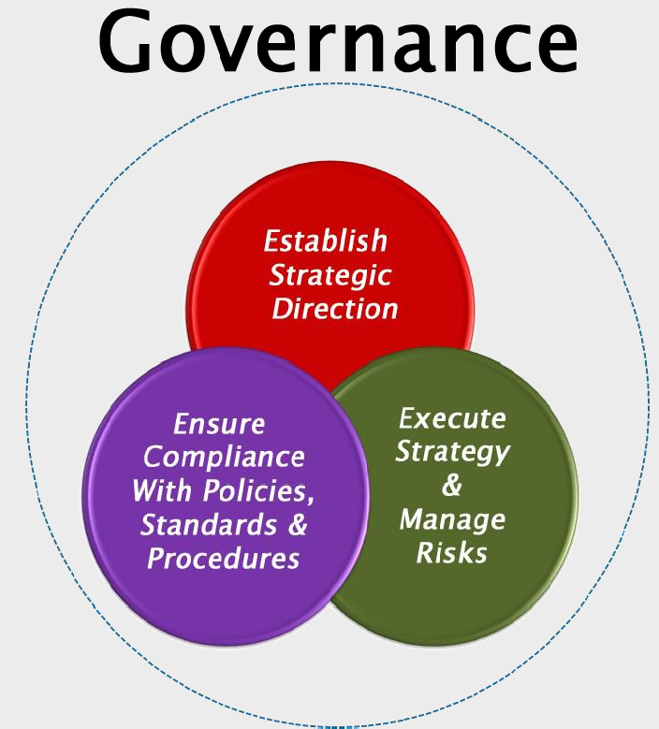

2. Defining Governance Mechanism
Multiple stakeholders are typically involved in project implementation
Mechanism required to sort out differences and agree on an approach acceptable to all the parties involved
Officers keep changing, a mechanism to ensure continuity of the project is required
Decision making hierarchy
Sanctioning authority
58

Slide 14
3. Identification Of Problems / Needs
How Can Problems Be Identified
•
•
•
Concerns raised by customers (citizens/businesses) Concerns raised by internal stakeholders - employees Through independent research/media
Need For Pro-active Methods (Adoption of pro-active methods for problem identification is encouraged)
How does our service compare to other (state) governments?
What aspect of our service delivery customers do not feel satisfied; complex, painful and unnecessary?
What is the current world class benchmark level?
•
•
59

Slide 15
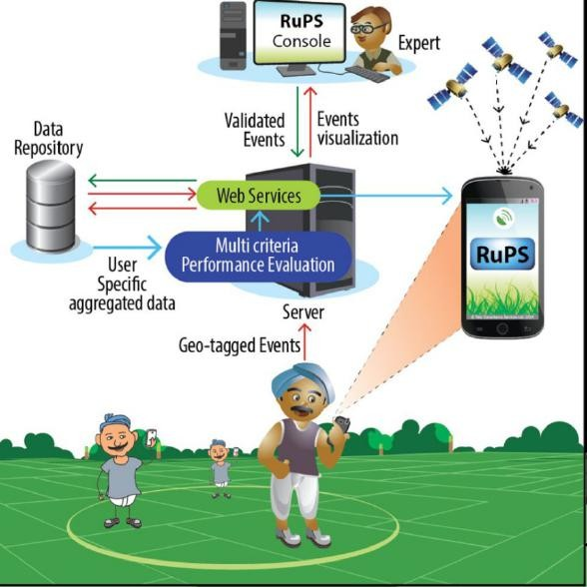
4. Baseline Study
•
Survey done at start of the Project
•
Baseline data about parameters which is expected to show improvement is captured
•
Data on the same set of parameters will be collected after Go-live of project
•
Baseline data and post Go-live data will be compared to objectively evaluate whether the project has attained its laid down objectives
60

Slide 16

5. Stakeholder Analysis
Ensure Buy-in
Identify Champions
Improve Sensitivity to Perceived Needs
61

Slide 17
Stakeholder Mapping: Understanding the Key stakeholders
Who are the key stakeholders?
Some of the key stakeholders in an e-Governance Project are:
Individuals such as Secretaries, Head of Ministries, Heads of Directorates;
Project sponsor, Project manager, Heads of budgeting and spending units in pilot Ministries; Business process owners; Funding Agencies
Consultants, Vendor/ Intermediaries
Divisions, departments or units, employees, user groups, legal entities, or location /
geography (e.g., headquarters, plant, location, state, country), citizens
All these stakeholders can perceive the same project in different ways depending upon their Expectations

Slide 18
STAKEHOLDER ENGAGEMENT STRATEGY
Determine who your key stakeholder are and their key groups and sub-groups
Stakehol der Identifica tion
How they will be affected, in what way, to what degree and what influence they can have on your project.
Stakehol der Analysis

Slide 19

6. Scoping Study
Services & Service Levels
Organization Structure
Applications & Data
Technology
65

Slide 20

DETAILED PROJECT REPORT
Section III :Project details
including its implementat
Section II Project overview or
ion mod
Summary
Section I
Background of project and other basic information

Slide 21
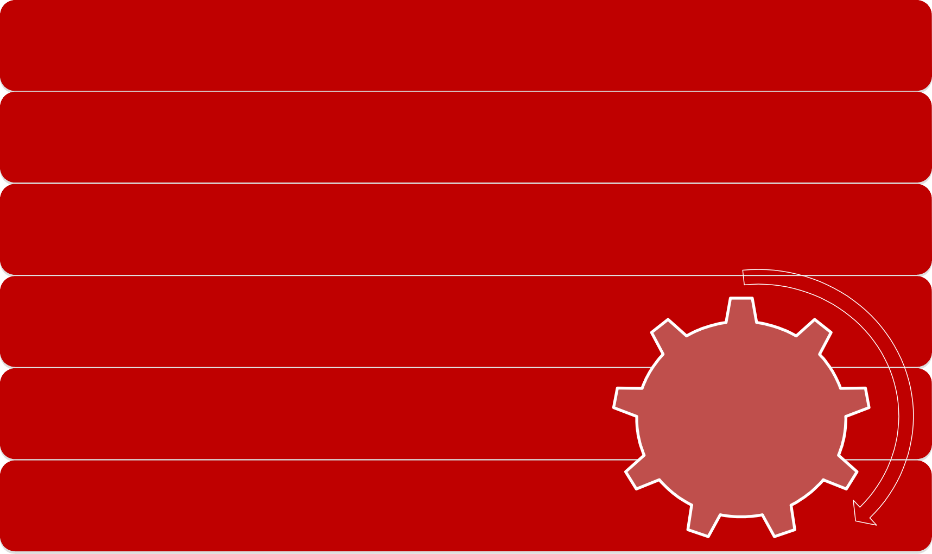
Section I: BACKGROUND OF PROJECT AND OTHER BASIC INFORMATION
Title of the Project
Does the project falls under an
existing Mission Mode Project (MMP)? If yes state which.
Whether Pilot, Roll out or Roll out without Pilot
Project Initiator details
Section I
Backgroun
Implementing Agency details ^{d of project}
and other
basic information
Location of project implementation

Slide 22

Section II:
PROJECT OVERVIEW OR SUMMARY
Identification of stakeholders
Introduce the Problem/issue the project is
Category of services: G2C, G2B or G2G Highlight in concrete terms the efficiencies envisaged to be enhanced for each of these services (In terms of service levels)
Past experience and lessons learnt
Key activities and timelines
Section II
designed to address
Explain in brief the causes and effects of the problem/issue
Total Project costs Source of funding
Project overview
or Summary

Slide 23
Section III:
PROJECT DETAILS INCLUDING ITS IMPLEMENTATION MODEL
Goal
Objectives : Identify SMART Objectives
Stakeholder Analysis
Identification of Services and Services Levels
Implementing Strategy
Key Activities :
  Scoping Study,
  Process Reengineering,
  Change Management,
  Infrastructure (Including Technology),
  Monitoring Evaluation & Assessment,
  Other Activities like Civil Work
Organization Structure : Existing & Proposed, Staffing & Deployment
Assumptions & Risk
i. Estimated demand for growth rate of proposed services in short. Medium and long term
Project Cost & Financing
If PPP provide key Design Features
Sustainability Plan m.Implementation Arrangements
n. Detailed Work Plan

Slide 24
