Slide 1
Entrepreneurship Development
Dr. Raj Seshadri

Slide 2
Entrepreneurship
Entrepreneurship is essentially the act of creation requiring the ability to recognize an opportunity, shape a goal, and take advantage of a situation. Entrepreneurs plan, persuade, raise resources, and give birth to new ventures.“

Slide 3
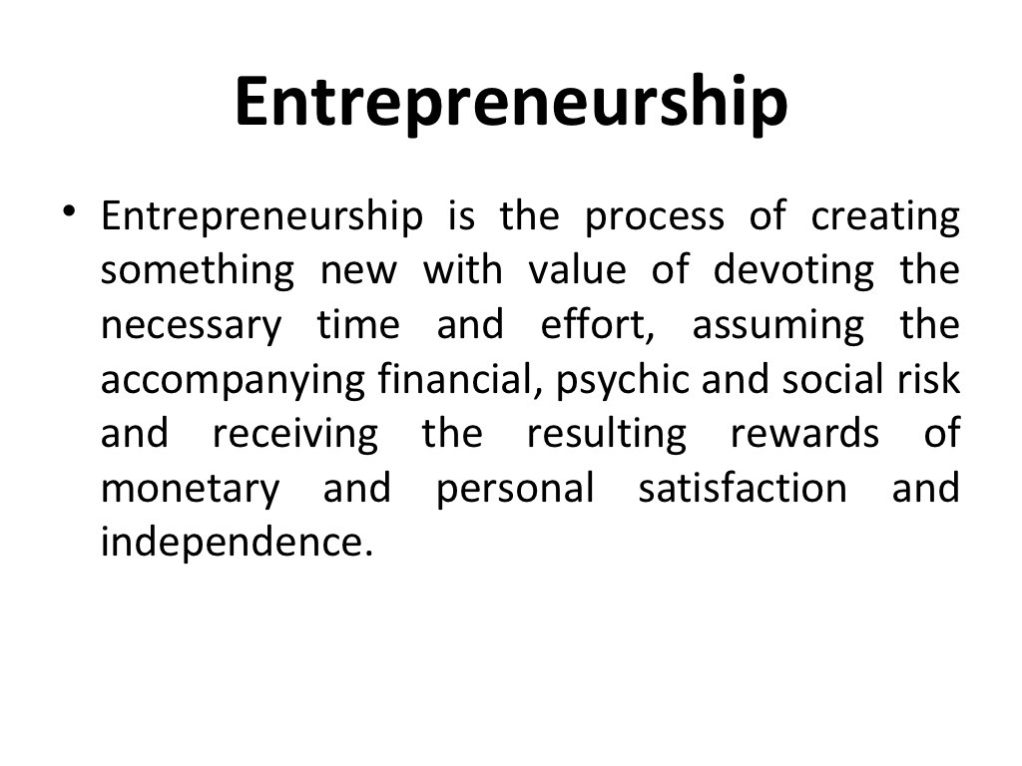
Make Effective Presentations
Using Awesome Backgrounds
Engage your Audience
Capture Audience Attention

Slide 4
What is an Entrepreneur?
A person who creates and manages change by the recognition of opportunities (needs, wants, opportunities, problems, and challenges) and develops people and manages resources to take advantage of the resources to take the opportunity and creates a venture (profitable business).

Slide 5
Entrepreneurs V. Intrapreneurs
Entrepreneurs are people that notice opportunities and take the initiative to mobilize resources to make new goods and services.
Intrapreneurs also notice opportunities and take initiative to mobilize resources, however they work in large companies and contribute to the innovation of the firm.
The term intrapreneurship refers to a system that allows an employee to act like an entrepreneur within a company or other organization. Intrapreneurs are self-motivated, proactive, and action-oriented people who take the initiative to pursue an innovative product or service.
Intrapreneurs often become entrepreneurs.

Slide 6
What are the different outcomes
of engaging in entrepreneurship?
Innovation or newness – product or service.
Organizing resources – finance, people, physical and information resource.
Creating new product or service.
Generating wealth
Taking risk in a business venture.
Prepared to face uncertainty.
Create job opportunity
Increase the abundance of wealth generation for the nation.

Slide 7
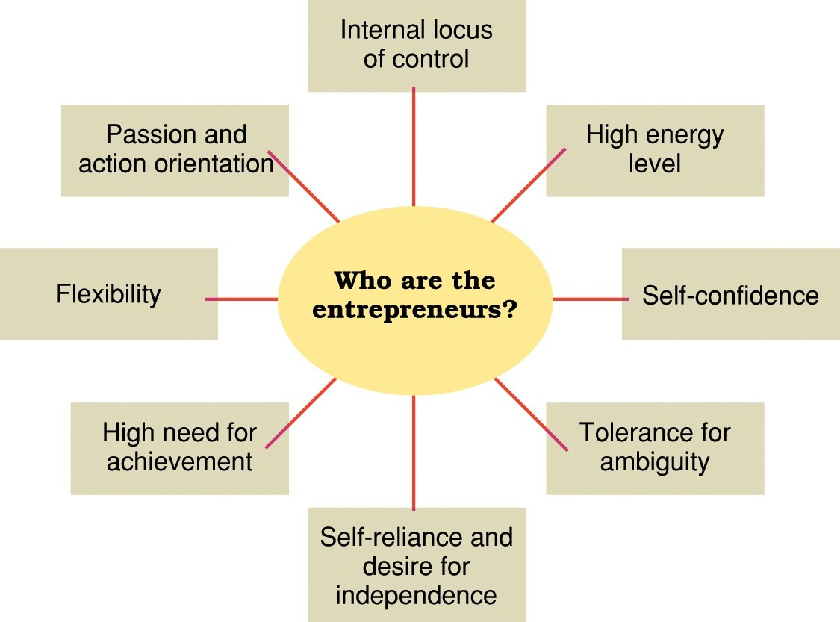
Personal traits and characteristics of entrepreneurs.
1

Slide 8
Entrepreneurs...Traits
Self-confident and optimistic
Able to take calculated risk
Respond positively to changes
Flexible and able to adapt
Knowledgeable of markets
Able to get along well with others
Independent minded
Dynamic Leadership
Responsive to suggestions
Take initiatives
Resourceful and preserving
Perceptive with foresight
Energetic and diligent
Creative, need to achieve

Slide 9
Characteristics or Personal Competency of an Entrepreneur.
Initiative
Sees and Acts on Opportunities
Persistence
Information seeking
Concern for High Quality Work and Output – Increased Productivity.
Commitment to Work Contract
Efficiency Orientation
Systematic and organized planning
Problem Solving
Self Confidence
Assertiveness – Negotiation with suppliers & customers
Persuasive & Influential – Peers and stakeholders
Inspirational - employees
Effective Communicator – external & internal of organization.

Slide 10
The Role of Entrepreneurship in Economic Growth.
– In order for Entrepreneurs to thrive in a nation, the Government must play important role in creating the kind of business environment that create the basis for growth, stability and future success of entrepreneurs.

Slide 11
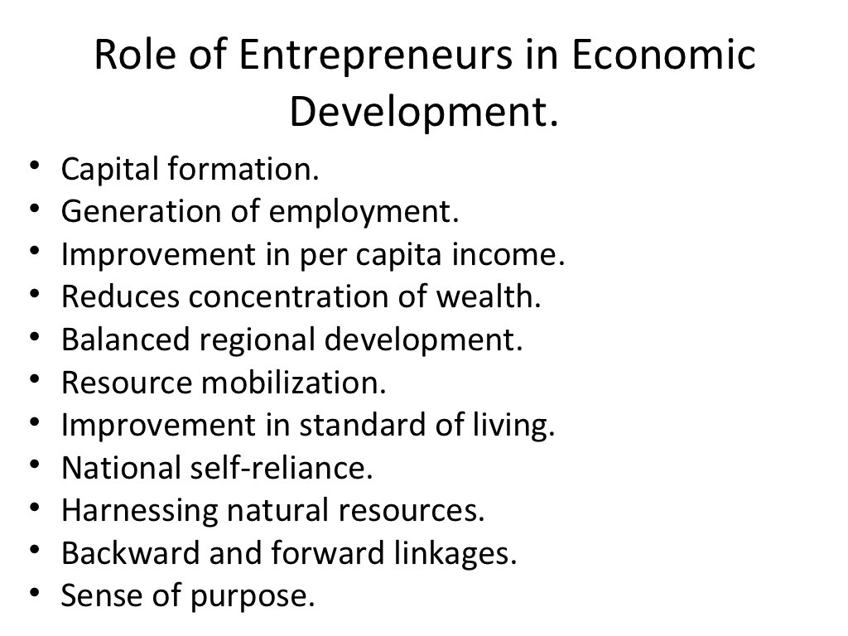

Slide 12
The Role of Entrepreneurship in Economic Growth.
Increasing the per capita output and income of the people of the country.
Initiating and creating change in the structure of business and society. Further growth and increased output arises, thus to enable more wealth to be divided among the various participants ( stakeholders).
Generation of innovation that leads to the creation of new product and service.
Improvisation and modification on existing product to better suit market and customers’ needs.
Creation of self employment and to cut back the dependency of potential employment of new workers in government sectors.
Streamline of the private sector and encourage the inclusion of new technology that is less labor dependent.
Increase in the national output which in turn lead to greater and stronger economic growth.
Laying the seed bed for creating new entrepreneur in various new technologies such as Bio Technology, Bio Technology Medicine, Nano Technology , New Material Technology etc.

Slide 13
Acting as a catalyst to nurture intrapreneurs and corporate entrepreneurs in a business organization.
Providing Government grant and subsidy to existing and would be entrepreneurs to aid their business development.
Providing Entrepreneurs in the SMI/SME various types of business loans to act as an impetus for business and economic growth in the nation. To facilitate this various business developments of entrepreneurs, Commercial Banks, SME Bank, etc..
Government decision to engage with different funding schemes for various entrepreneurship development start ups.
Providing knowledge and information through seminars, conferences, exhibitions, various business, small business and entrepreneurial business e-portals.
Providing of various financial, information resources support from various government agencies and national corporations such MDC,MARDI, FAMA, RISDA, FELDA, MATRADE, TELEKOMS MALAYSIA, TNB, MAS etc.

Slide 14
The Entrepreneurial Process
First Entrepreneurial Process:
Creation Process – creating something new of value.
Second Entrepreneurial Process:
Requires the commitment of the necessary time and effort. Appreciate and understand the importance of time and effort devoted to create something new and make it workable.
Third Entrepreneurial Process:
Involves the enjoyment of the rewards (Freedom, monetary) after the effort, followed by personal satisfaction.

Slide 15
Four distinct process:-
Identification and evaluation of the opportunity.
Development of the Business Plan.
Determination of the required resources
Management of the resulting enterprise.

Slide 16
The Benefits of Entrepreneurship:
– Opportunity to create your own destiny
Owning a business provides an entrepreneurs the independence and the opportunity to achieve what is important to them.
Entrepreneurs want to decide what they want in their lives, and they use their businesses to make their desire a reality (come true).

Slide 17
The Benefits of Entrepreneurship:
Opportunity to make a Difference
More and more entrepreneurs are starting businesses because they see this as an opportunity to make a difference in a route or way that is personally important to them.
Opportunity to reach your full potential.
Many people find their work not challenging and not exciting.
For entrepreneurs there is little difference between work and play.
Entrepreneurs see their business as a vehicle of self expression of personal desire and eventual self actualization of their personal goals – the pinnacle of their career success.

Slide 18
The Benefits of Entrepreneurship:
Opportunity to reap extraordinary profits.
– The profit earned by an entrepreneur are an important motivation and indication factor for further increased performance. Thus these could spur them to greater achievement and success.

Slide 19
The Benefits of Entrepreneurship:
Societal Responsibility and Recognition.
Small business owners are among the most admired, respected and trusted individuals of society.
Customers have shown their trust and faithfulness over their years for their business.
Help to contribute employment, business opportunity in a particular locality or area.

Slide 20
Steps in the Entrepreneurial
Process
Discovery: The stage in which the entrepreneur generates ideas, recognizes opportunities, and studies the market
Concept Development: Develop a business plan: a detailed proposal describing the business idea
Choose business location .Will a patent or trademark be required?
Resourcing: The stage in which the entrepreneur identifies and acquires the financial, human, and capital resources needed for the venture startup, etc
Actualization : The stage in which the entrepreneur operates the business and utilizes resources to achieve its goals/objectives.
Harvesting : The stage in which the entrepreneur decides on venture’s future growth & development.

Slide 21
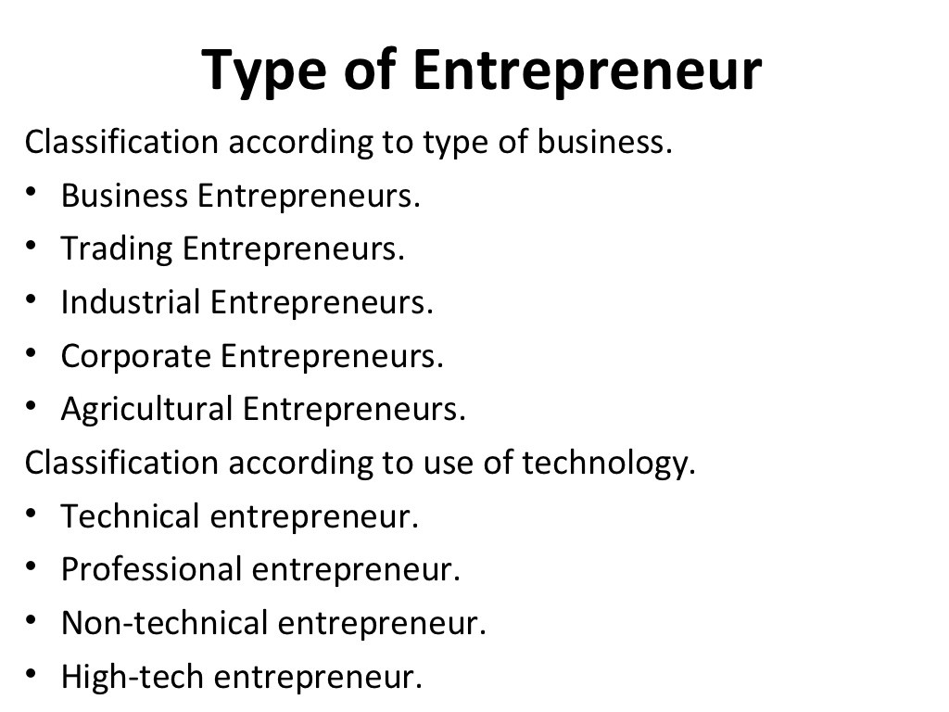

Slide 22
Type of Business
Business Entrepreneur( individuals who conceive an idea for a new product or service & then create a business to materialize their idea.)
Trading Entrepreneur (Is one who undertakes trading activities & is not concerned with the manufacturing work)
Industrial Entrepreneur (a manufacturer who identifies the potential needs of customers & tailors a product to meet the marketing needs)
Corporate Entrepreneur (Is a person who demonstrates his innovative skill in organizing & managing corporate undertaking)
Agricultural Entrepreneur ( Is one who undertake agricultural activities as raising & marketing of crops, fertilizers & other input.)
Retail Entrepreneur
Service Entrepreneur

Slide 23
Use of Technology
Technical Entrepreneur (he demonstrates his innovative capabilities in matter of production of goods & rendering services)
Non- Technical Entrepreneur (concerned only with developing alternatives marketing & distribution strategies to promote their business)
Professional Entrepreneur (a person who is interested in establishing the business but does not have interest in managing it once)

Slide 24
The Drawbacks of Entrepreneurship
Uncertainty of Income
Opening and a running a business provides no guarantee that an entrepreneur will earn enough money and survive.
Engaging in the wrong business and not able gain an advantage in the short run and eventually in the long run can be disastrous.
Great effort and proper and effective management need to used in beginning to ensure the organization success.

Slide 25
Risk of losing your entire Investment
Small business have a high failure rate.
Though is successful initially it faces financial difficulty within the next five years.
Entrepreneurs must be prepared to face the consequence of failure.
Entrepreneurs must have acute sense of observation and be able to detect the early signs of failure.
If a business fails the entrepreneur must have a contingency plan to overcome a bankruptcy or personal failure.

Slide 26
Long Hours and Hard Work
Entrepreneurs tend to be generally workaholic, and under tremendous pressure to produce the result they expect.
Entrepreneurs seldom find time to be away from the business but tend to pour all their effort and resources to achieve their personal entrepreneurial objective.
Some even go to extent of making big sacrifice and deprive themselves of a personal life, wife and children and social and family associates.

Slide 27
Lower Quality of Life until the business get established.
In order for the business to be successful the entrepreneur must engage himself to produce the kind of result he expects.
He cannot rest on his laurels (take it easy) until and certain the business has stabilized and established.

Slide 28
High level of stress
Starting the business can be very rewarding experience, but it can be stressful.
An entrepreneur have left the comfort and security of secured job to venture into their own business.
Failure can bring about tremendous personal failure, and in turn creates intense levels of anxiety and stress.
Financial burden may increase and the entrepreneur may face difficulty sustaining the business or may decide to call it for day and wind up the business for good.

Slide 29
Complete Responsibility
Must be prepared to make decision that are unfavorable (swallow the bitter pill).
Must make decision in areas that the entrepreneur is not familiar at all.
Fear of making decision that can have a devastating effect on the business and its people.
Tremendous pressure to perform as the entrepreneur is too deeply engaged in the business

Slide 30
Discouragement
To undertake a business requires a lot of dedication, discipline and tenacity.
During running the business they will face many difficulties, obstacles which may difficult to overcome.
Further difficulties, discouragement and disillusionment are common emotions.
Successful entrepreneurs escape through rough times or difficult times through sheer hard work, self confidence and full of optimisms.

Slide 31
Business entrepreneurship fail because:-
Management Mistakes Lack of Experience Poor financial control Weak marketing efforts
Failure to develop a strategic and effective plan Uncontrolled Growth
Poor location
Improper inventory control Incorrect or unsuitable pricing
The inability of to move into entrepreneurial thinking mindset from the previous secured permanent managerial position held.

Slide 32
How to avoid failure in a Entrepreneurial business.
Know your business in depth.
Develop a good, effective and solid Business Plan.
Manage your financial resources effectively.
Have a thorough and complete financial statement.
Learn hire and manage people effectively.
Keep physically fit, consume healthy foods, and avoid addictive consumption cigarettes and alcohol.

Slide 33
Entrepreneurial Ideation & Incubation Process

Slide 34
Entrepreneur Person who seeks a profitable opportunity and takes the necessary risks to set up and operate a business.
• Differ from many small-business owners in their strong desire to make their business grow.
• Differ from managers through their overriding responsibility to sue the resources of the organization to accomplish their goals.
• Willing to take risks.

Slide 35
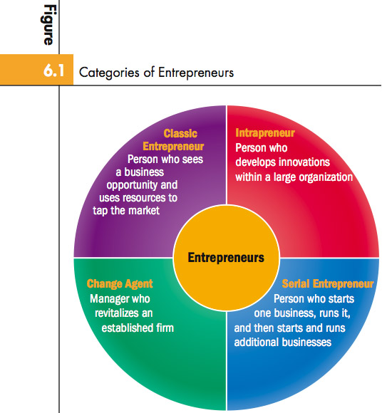
CATEGORIES OF ENTREPRENEURS

Slide 36
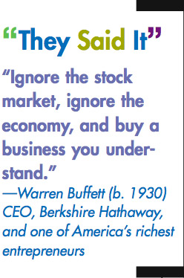
REASONS TO CHOOSE ENTREPRENEURSHIP
AS A CAREER PATH
• More than 11 percent of Americans run their own
business.
• In an average month, Americans start approximately
550,000 new businesses.
• Motivated by dissatisfaction with organizational work world.
• May believe their ideas are opportunities to meet customer needs.

Slide 37
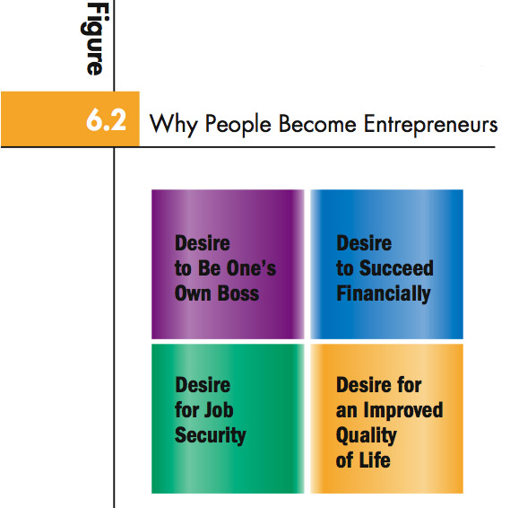

Slide 38
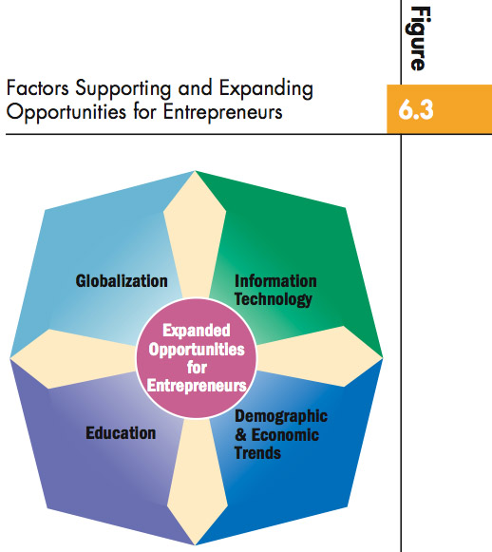
THE ENVIRONMENT FOR ENTREPRENEURS

Slide 39
Education
• One hundred U.S. colleges and universities offer entrepreneurship majors, 73 offer an emphasis in entrepreneurship, hundreds of others offer courses.
• Universities are helping students launch businesses.
• Some programs teach entrepreneurship to young people.
• Students who graduate from entrepreneurship programs are three times as likely as others to be self-employed and to help start new businesses.

Slide 40
Information Technology
•Helps entrepreneurs work quickly and efficiently, provide attentive customer service, increase sales, and project professional images.
• Entrepreneurs also produce and market products that apply new information technology.
• Internet also presents a challenge because customers can check prices and buy online from large or small companies anywhere in the world.
Demographic and Economic Trends
New opportunities:
Growth of two-income families.

Slide 41

Vision
• An overall idea for how to make their business a success.
High Energy Level
• Hard work of the entrepreneur compensates for small staff and limited resources available.
Need to achieve
• Enjoy the challenge of reaching personal goals and
are dedicated to personal success.

Slide 42

Self-confidence and Optimism
• Believe in their own ability to succeed and instill
optimism in others.
Tolerance for Failure
• Try and try again when others would give up and
view setbacks and failures as learning experiences.
Creativity
• Typically conceive new ideas for products and services and devise innovative ways to overcome difficult problems and situations.

Slide 43
Tolerance for Ambiguity
• Take uncertainty in stride but not reckless gamblers.
Internal Locus of Control
• Believe they control their own fates and take personal responsibility for success and failure.

Slide 44
INTRAPRENEURSHIP
Entrepreneurship Process of promoting innovation within the structure of an existing organization.
• Example: 3M
• Researchers spend 15 percent of their time working on their own ideas without approval from management.
• Helps firms retain valuable employees.

Slide 45

Generating Business Ideas…
  Potential sources of business ideas may include:
  Brainstorming – Individually or in groups/teams
  Own personal experiences – What jobs have been done in the past? Have you started businesses before? What was learnt from success and failures?
  Innovation and invention – A flash of individual inspiration
  Spotting flaws and errors in existing products – Can something being done already be done better?
  Copying ideas from other countries - e.g. Howard Schulz Starbucks founder, copied the idea of a coffee bar from Italy
  Spotting trends and anticipating their impacts on people’s lives e.g. Healthier lifestyles
  Taking a scientific approach, working in a laboratory (e.g. James Dyson)
  Noticing a gap in the market for something that is not currently being produced
  Purchasing a franchise

Slide 46
Generating Business Ideas
Today you will know sources of potential business ideas.
You will understand the factors that contribute to their success.

Slide 47
New-Product Development Process
Idea Generation
Prototype
Development
Idea Screening
Test Marketing
Concept
Development
& Testing
Commercialization
Business
Analysis

Slide 48
Idea Generation
Idea Generation:
  The initial stage for the new-product development process.

Slide 49

Idea Screening
Idea Screening:
  Evaluate the idea pool and reduce it to a smaller and more attractive set of potential new products.

Slide 50
Concept Development and Testing
Concept Development:
  The process of shaping and refining the idea into a more complete product concept.

Slide 51

Business Analysis
Business Analysis:
  Stage of the new-development process that calls for preparing initial marketing plans for the product.

Slide 52
Test Marketing
Test Marketing:
  Testing the product prototype and marketing strategy in simulated or actual market situations.
Simulated Test Marketing:
  Evaluating a new product in situations contrived to be similar to how consumers would purchase and use it.

Slide 53
Commercialization
Commercialization:
  The firm introduces the product on a full-scale basis, involving:
    Understanding Consumer Adoption
    Timing
    Coordination

Slide 54
Why Start-ups are needed?
It creates sustainable employment opportunities.
Scale up innovation led improvement in the quality of life.
It helps in GDP growth of the country in a healthy contribution.
Using innovative technology/processes it can develop new industries

Slide 55
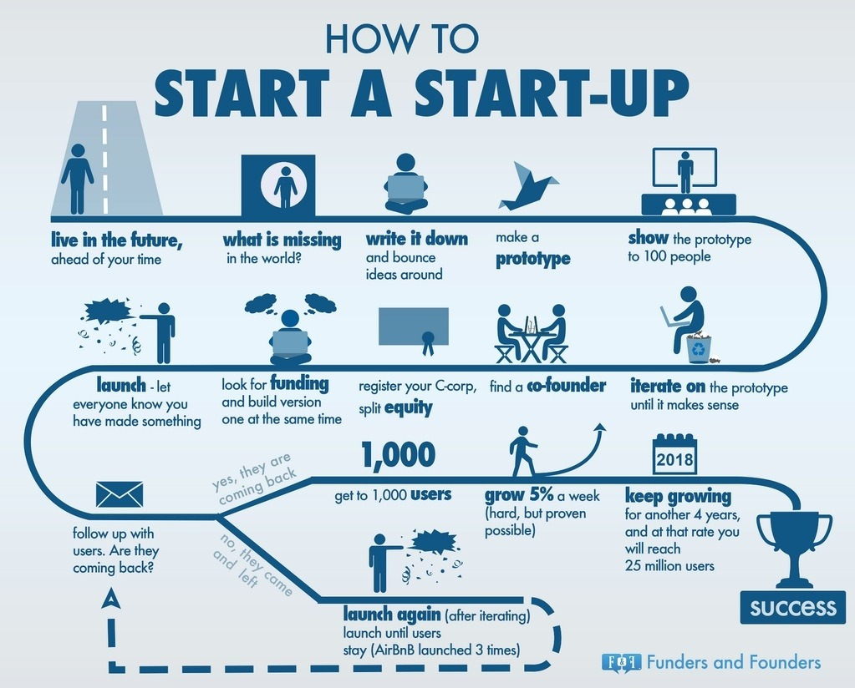

Slide 56
KEY TAKEAWAYS
A start-up is a company that's in the initial business stage.
Until the business gets off the ground, a start-up is often financed by its founders and the start-up attracts outside investment.
There are many different ways to fund start-ups including family and friends, venture capitalists, crowd funding, and credit.
Start-ups also have to consider where they'll do business and their legal structure.

Slide 57
ED funding
National Science & Technology Entrepreneurship Development Board (NSTEDB)
National Initiative for Developing and Harnessing Innovation (NIDHI)
New Gen Innovation and Entrepreneurship Development Centre (NewGen IEDC)
Science & Technology Entrepreneurship Development (STED)
Atal Innovation Mission (AIM)
Biotechnology Industry Research Assistance Council (BIRAC)
Ministry of Electronics and Information Technology (MeitY)
Ministry of Micro, Small & Medium Enterprises (MSME)
State Schemes (KSUM)
RUSA Funds

Slide 58
Funding schemes
Multiplier Grants Scheme (MGS)
Scheme to Support IPR Awareness Seminars/Workshops in E&IT Sector
NewGen Innovation and Entrepreneurship Development Centre (NewGen IEDC)
Atal Incubation Centres (AIC)
National Science & Technology Management Information System (NSTMIS)
Biotechnology Industry Partnership Programme (BIPP)
Assistance to Professional Bodies & Seminars/Symposia
Industry Relevant R&D by Science and Engineering Research Board (SERB
Promoting Innovations in Individuals, Startups and MSMEs (PRISM)

Slide 59
KSUM INNOVATION GRANT
1. Idea Grant, which will be primarily for conversion of idea to prototype and is limited to Rs. 2 lakhs/idea.
2. Product Grant, which is to convert the prototype into a production unit and is limited to a maximum Rs. 7 lakhs/idea.
3. Scale-up Grant, which is to help startups with a product having revenue or investment of atleast 12 lakhs in last one year, and is limited to maximum of Rs. 12 lakhs/idea.
4. R&D Grant, which will be given to highly promising hardware or deep tech Startups with working prototype/ IP which needs to be developed into a final product through extensive R&D. This grant is limited to Rs. 30 lakhs/startup

Slide 60
Schemes for women
KSUM supports women founders with 100% on the product showcasing, travel and marketing
Skill development ministry is running a project aiming to incubate 250 women-led startups
Udyam Sakhi Portal
Trade Related Entrepreneurship Assistance and Development (TREAD) Scheme for Women
The Women Enhancing Technology (WeTech).
TiE Global’s annual Women Entrepreneurship Programme AIRSWEEE
Annapurna Scheme Under this scheme, the Government of India offers women entrepreneurs in food catering business, loans upto ₹50,000.

Slide 61
What is Startup ?
Registered or incorporated not prior to period of seven years
Incorporated as either a Pvt. Ltd. Company or a Registered Partnership Firm or a LLP
With an annual turnover not exceeding Rs. 25 cr. for any of the financial years since incorporation
Entity should not have been formed by splitting up or reconstruction a business already in existence
Working towards innovation, development or improvement of products or processes or services, .
or if it is a scalable business model with a high potential of employment generation or wealth creation

Slide 62
FUNDING
Bootstrapping
Angel Investment
Venture Capital
Bank Loans
Crowd funding
Grants and Scholarships
Competitions – Hackathon, B plan contests

Slide 63
Here are the ways for Funding to a startup
Bootstrapping : Self-funding is also known as bootstrapping , is an effective way startup financing , especially when you are starting your business . You can invest from your own saving or can get from family and friends.
Crowd funding : is “the practice of Funding a project or venture by raising many small amounts of money from a large number of people , typically over the internet. Some of the popular crowd funding sites in india are Indiegogo ,Wishberry , Ketto and Fundlined .
Angel Investors : Angel investors are individuals with surplus cash and a keen interest to invest in upcoming startups .They can also offers mentoring or advice along with capital . Angel investor have helped many indian startups (Unacademy,Crown-it , BookEventz, WittyFeed .Some of top Angel investors are Mr. Ratan Tata , Rajan Anandan , Vijay shekhar Sharma , Sachin Bansal

Slide 64
Here are the ways for Funding to a startup
4.Venture Capital : Venture capitals are professionally managed funds who invest in companies that have huge potential to grow .They usually invest in a business against equity and exit when there is an IPO or an acquisition . Some of the well known Venture Capitalists in india are Helion Venture Partners , Accel Partners , Blume Ventures , Nexus Venture Partners .
5. Funding From Business Incubators & Accelerators : Early stage businesses can consider Incubator and Accelerator programs as a funding option. Found in almost every major city, these programs assist hundreds of startup businesses every year.
Incubators are like a parent to a child, who nurtures the business providing shelter tools and training and network to a business.
Accelerators so more or less the same thing, but an incubator helps/ assists/ nurtures a business to walk, while accelerator helps to run/take a giant leap.

Slide 65
Here are the ways for Funding to a startup
6. Govt Programs That Offer Startup Capital : Government has launched ‘Bank of Ideas and Innovations’ program. The Government of India has launched 10,000 Crore Startup Fund in the budget and Government backed ‘Pradhan Mantri Micro Units Development and Refinance Agency Limited (MUDRA)’ starts with an initial corpus of Rs. 20,000 crore to extend benefits to around 10 lakhs SMEs.
7. Raise Money Through Bank Loans :Normally, banks are the first place that entrepreneurs go when thinking about funding. • The bank provides two kinds of financing for businesses. One is working capital loan and other is funding. Working Capital loan is the loan required to run one complete cycle of revenue generating operations and the limit is usually decided by hypothecating stocks and debtors.
Funding from bank would involve the usual process of sharing the business plan and the valuation details, along with the project report, based on which the loan is sanctioned. • Almost every bank in India offers SME finance through various programs.

Slide 66
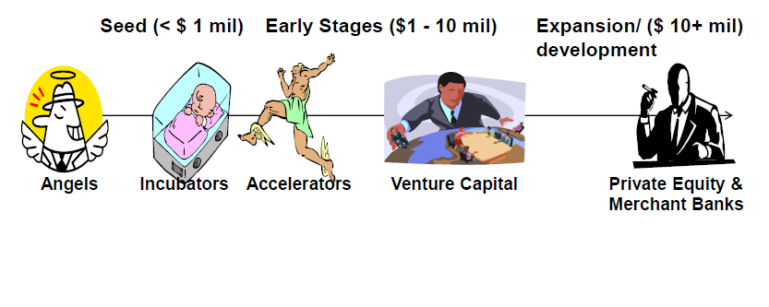
Start Up Financing : Capital Lifecycle

Slide 67
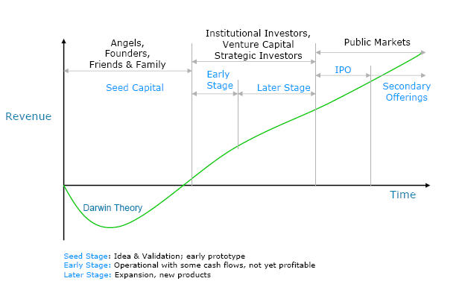
Fund Raising Pattern – Life Cycle of a Startup

