Slide 1
Chi-square, ANOVA & Time Series Analysis
Module IV

Slide 2
CHI-SQUARE TEST
Chi-square Tests:( χ²)
Chi-square test is used to test the association between two variables.
The following are the applications of Chi-square test.
Test of Independence
Goodness of fit
Test for homogeneity

Slide 3
CHI-SQUARE TEST
Introduction: Many times managers need to know whether the differences they observe among several sample proportions are significant or only due to chance.
Example: A marketing manager will be eager to know whether the difference in sales is due to market potential or sales man ship.

Slide 4
Chi-square Statistic-

Slide 5
Applications of Chi-Square Test
Test of Independence of attributes
Test of goodness-of-fit
Test for homogeneity

Slide 6
Illustration-1
 | Pass | Fail | Total
Boys | 16 | 19 | 35
Girls | 18 | 5 | 23
Total | 34 | 24 | 58

Slide 7
Illustration 2
 | Pass | Fail | Total
Boys | 29 | 6 | 35
Girls | 19 | 6 | 25
Total | 48 | 12 | 60

Slide 8
Chi-square Table-Illustration 1
Observed | Expected | O-E | (O-E)² | (O-E)²/E
16 | 20.52 | -4.52 | 20.43 | 0.99
19 | 14.48 | 4.52 | 20.43 | 1.41
18 | 13.48 | 4.52 | 20.43 | 1.52
5 | 9.52 | -4.52 | 20.43 | 2.15
 |  |  | Total | 6.07

Slide 9
Chi-square Table-Illustration 2
Observed | Expected | O-E | (O-E)² | (O-E)²/E
29 | 28 | 1 | 1 | 0.04
6 | 7 | -1 | 1 | 0.14
19 | 20 | -1 | 1 | 0.05
6 | 5 | 1 | 1 | 0.20
 |  |  | Total | 0.43

Slide 10
Example 1
A company is interested in determining an association between the commuting time of their employees and the level of stress-related problems on the job. A study of 116 assembly-line workers reveals the following. Test the hypothesis @ 5 % level.

Slide 11
Data
 | Stress | Stress | Stress
Commuting Time | High | Moderate | Low | Total
Under 20 Minutes | 9 | 5 | 18 | 32
20-50 Minutes | 17 | 8 | 28 | 53
Over 50 Minutes | 18 | 6 | 7 | 31
TOTAL | 44 | 19 | 53 | 116

Slide 12
Solution
H₀: P(TS)= P(T)P(S)- Null Hypothesis
H_{a}: P(TS) ≠ P(T)P(S)-Alternative Hypothesis
E11=32x44/116=12.14 E12=32x19/116=5.24 E13=32X53/116=14.62
E21=53X44/116=20.10 E22=53X19/116=8.68 E23=53X53/116=24.22
E31=31X44/116=11.75 E32=31X19/116=5.08 E33=31X53/116=14.17

Slide 13
Chi-square Table
Observed | Expected | O-E | (O-E)² | (O-E)²/E
9 | 12.14 | -3.14 | 9.85 | 0.811
5 | 5.24 | -0.24 | 0.05 | 0.009
18 | 14.62 | 3.38 | 11.42 | 0.781
17 | 20.10 | -3.10 | 9.61 | 0.478
8 | 8.68 | -0.68 | 0.46 | 0.052
28 | 24.22 | 3.78 | 14.29 | 0.589
18 | 11.75 | 6.25 | 39.06 | 3.324
6 | 5.08 | 0.92 | 0.84 | 0.166
7 | 14.17 | -7.17 | 51.40 | 3.627
 |  |  | Total | 9.837

Slide 14
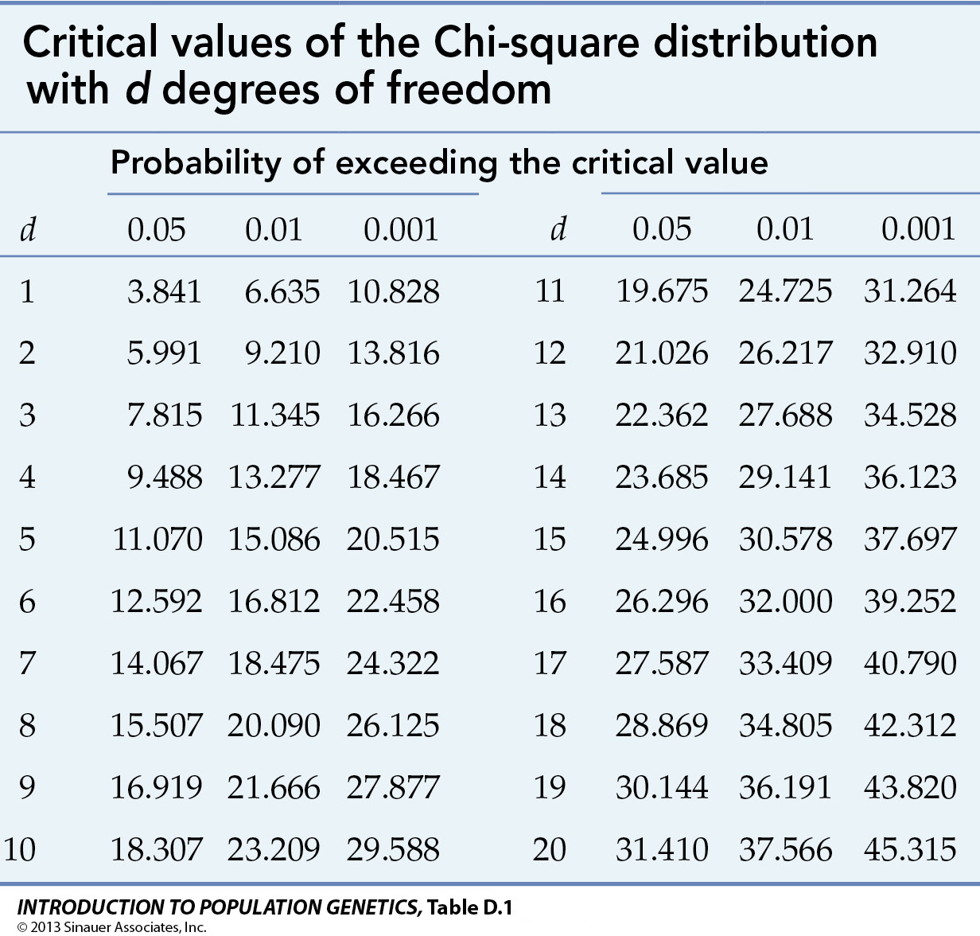

Slide 15
Chi-square Test
The critical value of Chi-square=9.49 at α =0.05and 4 degrees of freedom (3-1)x(3-1).Since the calculated value of Chi-square 9.837 is more than the critical value, the null hypothesis is rejected. Hence we conclude that stress on the job is dependent of the commuting time.

Slide 16
Example 2
A personnel manager is interested in trying to find-out whether absenteeism is greater on one day of the week than on another. His records for the past year show the following sample distribution
Day Mon Tue Wed Thu Fri
Absentees 66 57 54 48 75
Test whether the absence is uniformly distributed over the week at α =0.05

Slide 17
Solution
H₀:P(AD)= P(A)P(D)- Null Hypothesis
H_{a}:P(AD) ≠ P(A)P(D)-Alternative Hypothesis
Let us assume the null hypothesis that absence is uniformly distributed over the week. Since the total number of absentees during a week are 300 and if absenteeism is uniform, then we should expect 300/5=60 absentees on each day of the week.

Slide 18
Chi-square Table
Day | O | E | O-E | (O-E)² | (O-E)²/E
Mon | 66 | 60 | 6 | 36 | 0.60
Tue | 57 | 60 | -3 | 9 | 0.15
Wed | 54 | 60 | -6 | 36 | 0.60
Thu | 48 | 60 | -12 | 144 | 2.40
Fri | 75 | 60 | 15 | 225 | 3.75
Total | 300 | 300 |  | ^{Chi Square} | 7.50

Slide 19
Solution
The critical value of χ²⁼9.49 at α =0.05 and d.f=(5-1)=4. Since the calculated value of χ²⁼7.5 is less than its critical value, the null hypothesis is accepted. So we can conclude that the absenteeism is uniform through out the week.

Slide 20
Example 3
A movie producer is bringing out a new movie. In order to develop an advertising strategy, he wants to determine whether the movie will appeal most to a particular age group or it will appeal equally to all age groups. The following table gives the summary.

Slide 21
Table
Opinion | Under 20 | 20-39 | 40-59 | 60 and Above | Total
Liked | 146 | 78 | 48 | 28 | 300
Disliked | 54 | 22 | 42 | 22 | 140
Indifference | 20 | 10 | 10 | 20 | 60
Total | 220 | 110 | 100 | 70 | 500

Slide 22
Solution
Let us assume the null hypothesis that the opinion of all age groups is same about the new movie.
E11=300X220/500=132 E21=140X220/500=61.6
E12=300X110/500=66 E22=140X110/500=30.8
E13=300x100/500=60 E23=140X100/500=28
E14=70x300/500=42 E24=140X70/500=19.6
E31=60X220/500=26.4
E32=60X110/500=13.2
E33=60X100/500=12
E34=60X70/500=8.4

Slide 23

O | E | O-E | (O-E)² | (O-E)²/E
146 | 132.0 | 14.0 | 196.00 | 1.485
54 | 61.6 | -7.6 | 57.76 | 0.938
20 | 26.4 | -6.4 | 40.96 | 1.552
78 | 66.0 | 12.0 | 144.00 | 2.182
22 | 30.8 | -8.8 | 77.44 | 2.514
10 | 13.2 | -3.2 | 10.24 | 0.776
48 | 60.0 | -12.0 | 144.00 | 2.400
42 | 28.0 | 14.0 | 196.00 | 7.000
10 | 12.0 | -2.0 | 4.00 | 0.333
28 | 42.0 | -14.0 | 196.00 | 4.667
22 | 19.6 | 2.4 | 5.76 | 0.294
20 | 8.4 | 11.6 | 134.56 | 16.019
 |  |  | Total | 40.16

Slide 24
Solution
The critical value of χ²⁼12.59 for 6 d.f (3-1)(4-1)=6
at α =0.05 .
Since the calculated value of χ²⁼40.16 is greater than its critical value, the null hypothesis is rejected. So we can conclude that the opinion is heterogeneous.

Slide 25
Concept of One-Way ANOVA
SIAMA (South Indian Automobile Manufacturers Association) wants to find out which petrol is more efficient on cars. In order to test the same they chose 6 brands and tested the fuel efficiency on MARUTI 800. In order to avoid any errors they tested the mileage 4 times and the result is as follows. We want to find out whether the difference in mileage is statistically significant or not ?

Slide 26
ANOVA(Analysis of Variance)
 | Trial 1 | Trial 2 | Trial 3 | Trial 4 | Petrol Average
Indian Oil | 16 | 15 | 13 | 18 | 15.50
Bharath Petroleum | 15 | 14 | 20 | 22 | 17.75
Hindustan Petroleum | 17 | 16 | 14 | 20 | 16.75
Reliance | 14 | 20 | 21 | 22 | 19.25
Essar | 13 | 15 | 17 | 19 | 16.00
Shell | 15 | 14 | 20 | 22 | 17.75
Trial Average | 15.00 | 15.67 | 17.50 | 20.5 | 17.17

Slide 27
Concept of Two-Way ANOVA
SIAMA (South Indian Automobile Manufacturers Association) wants to find out which petrol is more efficient on cars. In order to test the same they chose 6 brands of petrol and 4 brands of cars. They got the following results. The question is whether the difference in mileage is due to the cars or due to the various brands of petrol? Is there any statistical significance in the findings?

Slide 28
ANOVA(Analysis of Variance)
 | MARUTI | HYUNDAI | KWID | DATSUN | Petrol Average
Indian Oil | 16 | 15 | 13 | 18 | 15.50
Bharath Petroleum | 15 | 14 | 20 | 22 | 17.75
Hindustan Petroleum | 17 | 16 | 14 | 20 | 16.75
Reliance | 14 | 20 | 21 | 22 | 19.25
Essar | 13 | 15 | 17 | 19 | 16.00
Shell | 15 | 14 | 20 | 22 | 17.75
Car Average | 15.00 | 15.67 | 17.50 | 20.5 | 17.17

Slide 29
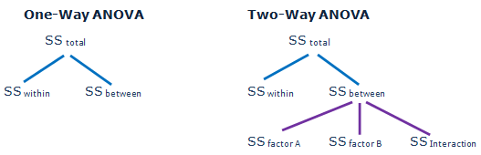

Slide 30
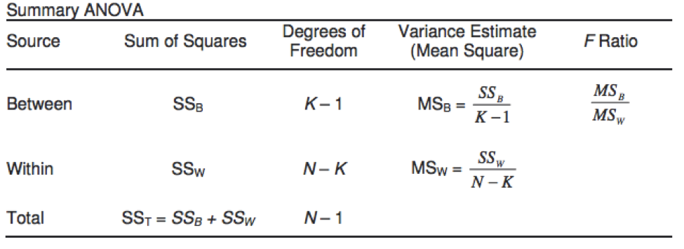

Slide 31
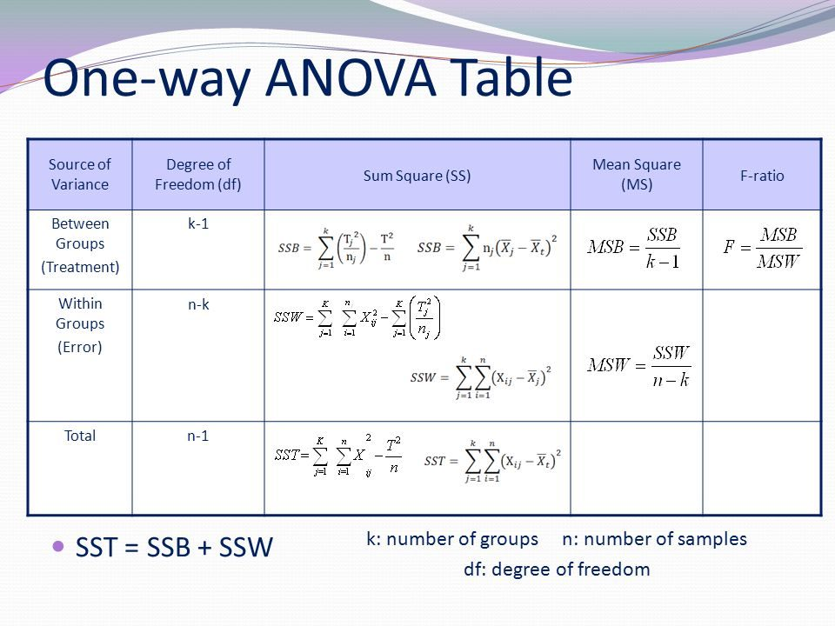

Slide 32
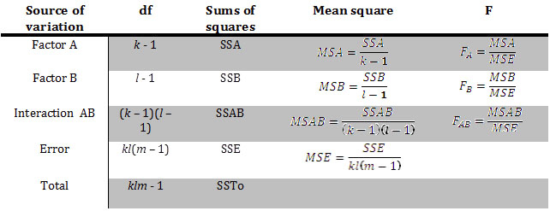
TWO-WAY ANOVA

Slide 33
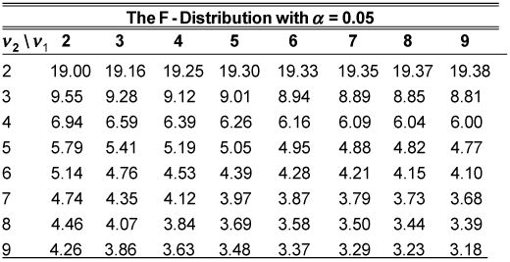

Slide 34
ONE-WAY CLASSIFICATION
Group A | Group B | Group C
16 | 15 | 15
17 | 15 | 14
13 | 13 | 13
18 | 17 | 14
64 | 60 | 56

Slide 35
S1²=14/4=3.5
S2²=8/4=2
S3²=2/4=0.5 σ1²⁼(14+8+2)/(4+4+4-3)=2.67 σ2²⁼4{(16-15)²+(15-15)²+(14-15)²}/(3-1)=4
F Ratio=Variance Between Samples/Variance Within Samples
4/2.67=1.498
Table value for (2,9) d.f=4.26, accept the Null Hypothesis
Group A |  |  | Group B |  |  | Group C
16 | 0 | 0 | 15 | 0 | 0 | 15 | 1 | 1
17 | 1 | 1 | 15 | 0 | 0 | 14 | 0 | 0
13 | -3 | 9 | 13 | -2 | 4 | 13 | -1 | 1
18 | 2 | 4 | 17 | 2 | 4 | 14 | 0 | 0
64 |  | 14 | 60 |  | 8 | 56 |  | 2

Slide 36
ONE- WAY ANOVA TABLE IN GENERAL FORM
Source of Variation | Sum of Squares SS | Degree of Freedom | Mean Squares MS | Variance Ratio F
Between Samples | SSB | k-1 | MSB=SSB/(k-1) | F=MSB/MSW
Within Samples | SSW | n-k | MSW=SSW/(n-k)
Source of Variation | Sum of Squares SS | Degree of Freedom | Mean Squares MS | Variance Ratio F
Between Samples | 8 | 3-1 | 8/2=4 | F=MSB/MSW
Within Samples | 24 | 12-3 | 24/9=2.67 | 4/2.67=1.498

Slide 37
TWO-WAY ANOVA
 | Salesmen
Seasons | A | B | C | D | Season Total
Summer | 36 | 36 | 21 | 35 | 128
Winter | 28 | 29 | 31 | 32 | 120
Monsoon | 26 | 28 | 29 | 29 | 112
Salesman Total | 90 | 93 | 81 | 96 | 360
 | Salesmen
Seasons | A | B | C | D | Season Total
Summer | 6 | 6 | -9 | 5 | 8
Winter | -2 | -1 | 1 | 2 | 0
Monsoon | -4 | -2 | -1 | -1 | -8
Salesman Total | 0 | 3 | -9 | 6 | 0

Slide 38
TWO-WAY ANOVA
Correction Factor=C=T²/N=(0)²/12=0
SSB=0/3+9/3+81/3+36/3=42
SSW=64/4+0/4+64/4=32
TSS=36+4+16+36+1+4+81+1+1+25+4+1=210

Slide 39
TWO- WAY ANOVA TABLE IN GENERAL FORM
Source of Variation | Sum of Squares SS | Degree of Freedom | Mean Squares MS | Variance Ratio F
Between Columns | SSC | c-1 | MSC=SSC/(r-1) | F=MSB/MSW
Within Rows | SSR | r-1 | MSR=SSR/(r-1)
Error | SSE | (c-1)(r-1) | MSE=SSE/(c-1)(r-1)

Slide 40
TWO- WAY ANOVA TABLE IN GENERAL FORM
Source of Variation | Sum of Squares SS | Degree of Freedom | Mean Squares MS | Variance Ratio F
Between Columns(Salesmen) | 42 | 4-1=3 | MSC=14 | F=0.62(3,6)
Within Rows (Seasons) | 32 | 3-1=2 | MSR=16 | F=0.71(2,6)
Error | 136 | 3x2=6 | MSE=22.67 | Accept H₀
Total | 210 | 12-1=11 |  | Accept H₀

Slide 41
Time Series Analysis
Time series is a set of numerical values of some variable obtained at regular period over time. The series is usually tabulated or graphed in a manner that readily conveys the behavior of the variable under study.

Slide 43
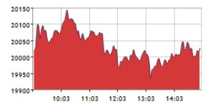

Slide 44
Petroleum Price Increases…
180% increase
150% increase
23-30% increase
1% increase

Slide 45
rends

Slide 46
Objectives of Time series Analysis
To identify the pattern and isolate the influencing factors (or effects) for prediction purposes as well as for future planning and control
The review and evaluation of progress made on the basis of a plan are done on the basis of time-series data.

Slide 47
Components of a Time Series
Trend : It is the broad long-term tendency of either upward or downward movement in the average value of the forecast variable over a period of time
Cycles: An upward and downward oscillation of uncertain duration and magnitude about the trend line due to seasonal effect with fairly regular period or long period with irregular swings are called a cycle

Slide 48
Components of Time Series
Seasonal: It is a special case of a cycle component of time series in which the magnitude and duration of the cycle do not vary but happen at regular interval each year.
Irregular: An irregular or erratic movements in a time series is caused by short-term unanticipated and non-recurring factors. These follow no specific pattern.

Slide 49
Time Series Decomposition Models
Multiplicative Model: It assumes that forecast is the product of four components at a particular time period.
Y= TxCxSxI ( Trend x Cycle x Seasonal x Irregular)
Addititive Model: In this model it is assumed that the effect of various components can be estimated by adding the various components of a time series.
Y= T+C+S+I

Slide 50
Time Series Components
Cycle
Trend
Random
movement
Time
Time
Seasonal
pattern
Trend with
seasonal pattern
Demand
Time
Time

Slide 51
1.Measurement of Trend
Freehand or Graphical Method
Method of Semi-Averages
Method of Moving averages
Method of Least Squares

Slide 52
2.Measurement of Seasonal Variations
Method of Simple averages(Seasonal Index)
Ratio-to-trend Method
Ratio-to-Moving Average Method
Link Relative Method

Slide 53
3.Measurement of Cyclical Variations
Residual Method
  Percent of Trend:
  Relative Cyclical Residual : X 100

Slide 54
4.Measurement of Irregular Variations
The irregular component, in a time series represents the residue of fluctuations after trend, cyclical, and seasonal movements have been accounted for. Thus if the original data is divided by T, C, and S we get I. i.e., TCSI/TCS= I

Slide 55
Example 1
Following are the figures of sales for the past six years. Determine the trend line by the free-hand method.
Year 1990 1991 1992 1993 1994 1995
Sales 80 115 105 135 125 150

Slide 56
Free-Hand Curve Method

Slide 57
Example 2
Apply the method of semi-average of measuring trend, plot a straight line trend for the following data.
1.
Year 1990 1991 1992 1993 1994 1995
Sales (‘000) 20 24 22 30 28 32
2.
Year 1987 1988 1989 1990 1991 1992 1993
Sales 100 105 109 96 102 108 112

Slide 58
Method of semi-average

Slide 59
Method of semi-averages

Slide 60
Example 3
Calculate the long term trend with three year moving average from the following data:
Year 1989 1990 1991 1992 1993 1994 1995 1996
Units 1632 1557 1652 2100 2620 3120 3236 3562

Slide 61
Solution
Year | Output | 3 Year Moving Total | 3 Year Moving Average
1989 | 1632
1990 | 1557 | 4841 | 1613.67
1991 | 1652 | 5309 | 1769.67
1992 | 2100 | 6372 | 2124.00
1993 | 2620 | 7840 | 2613.33
1994 | 3120 | 8976 | 2992.00
1995 | 3236 | 9918 | 3306.00
1996 | 3562

Slide 62
Example 4
Fit a straight line trend by method of least squares to the following data :
Year: 1992 1993 1994 1995 1996
Profit: 32 45 55 63 75

Slide 63
Solution
Year | Profit(Y) | X | XY | X²
1992 | 32 | -2 | -64 | 4
1993 | 45 | -1 | -45 | 1
1994 | 55 | 0 | 0 | 0
1995 | 63 | 1 | 63 | 1
1996 | 75 | 2 | 150 | 4
N=5 | ∑Y=270 | 0 | ∑XY=104 | ∑X²=10

Slide 64
Example 5
Fit a straight line trend by method of least squares to the following data :
Year 91 92 93 94 95 96 97 98
Sales 80 90 92 83 94 99 92 104

Slide 65
Solution
Year | Sales(Y) | X | XY | X²
1991 | 80 | -3.5 | -280.0 | 12.25
1992 | 90 | -2.5 | -225.0 | 6.25
1993 | 92 | -1.5 | -138.0 | 2.25
1994 | 83 | -0.5 | -41.5 | 0.25
1995 | 94 | +0.5 | 47.0 | 0.25
1996 | 99 | +1.5 | 148.5 | 2.25
1997 | 92 | +2.5 | 230.0 | 6.25
1998 | 104 | +3.5 | 364.0 | 12.25
N=8 | ∑Y=734 |  | ∑XY=105 | ∑X²=42

Slide 66
Example 6
Calculate the seasonal index from the following data.
Year Q1 Q2 Q3 Q4
1987 48 40 90 80
1988 77 35 100 90
1989 80 50 115 115
1990 100 60 125 118
1991 120 70 130 122

Slide 67
Solution
Year Q1 Q2 Q3 Q4
1987 48 40 90 80
1988 77 35 100 90
1989 80 50 115 115
1990 100 60 125 118
1991 120 70 130 122
Total 425 255 560 525
Average 85 51 112 105
Average of Averages = (85+51+112+105)/4=88.25
Seasonal Index 96.3 57.8 126.9 119

Slide 68
Example 7
Calculate the seasonal index from the following data using the ratio to trend method
Year Q1 Q2 Q3 Q4
1990 70 68 80 70
1991 75 71 83 75
1992 73 65 83 79
1993 76 74 84 78
1994 74 74 86 82

Slide 69
Calculation of Seasonal Index
Year | I | II | III | IV | Yearly Totals Y | Yearly Avg
1990 | 70 | 68 | 80 | 70 | 288 | 72
1991 | 75 | 71 | 83 | 75 | 304 | 76
1992 | 73 | 65 | 83 | 79 | 300 | 75
1993 | 76 | 74 | 84 | 78 | 312 | 78
1994 | 74 | 74 | 86 | 82 | 316 | 79

Slide 70
Calculation of Seasonal Index
Qtrly Avg(Y) | Origin 1992(X) | X² | XY | Trend Values
72 | -2 | 4 | -144 | 72.8
76 | -1 | 1 | -76 | 74.4
75 | 0 | 0 | 0 | 76.0
78 | 1 | 1 | 78 | 77.6
79 | 2 | 4 | 158 | 79.2
∑Y=380 |  | ∑x²=10 | ∑xy=16
a= 380/5=76 and b=16/10=1.6
Y_{c}= 76+1.6 x

Slide 71
Seasonal Index : Trend Values
Years | I | II | III | IV | T.V
1990 | 72.4 | 72.6 | 73.0 | 73.2 | 72.8
1991 | 74.0 | 74.2 | 74.6 | 74.8 | 74.4
1992 | 75.6 | 75.8 | 76.2 | 76.4 | 76.0
1993 | 77.2 | 77.4 | 77.8 | 78.0 | 77.6
1994 | 78.8 | 79.0 | 79.4 | 79.6 | 79.2

Slide 72
Trend Eliminated
Years | I | II | III | IV
1990 | 96.69 | 93.66 | 109.59 | 95.63
1991 | 101.35 | 95.69 | 111.26 | 100.27
1992 | 96.56 | 85.75 | 108.92 | 103.40
1993 | 98.45 | 95.61 | 107.97 | 100.00
1994 | 93.91 | 93.67 | 108.31 | 103.02
Total | 486.95 | 464.38 | 546.05 | 502.31
Average | 97.39 | 92.88 | 109.21 | 100.46
Average of averages |  | (97.39+92.88+109.21+100.460)/4 |  | =99.99
Seasonal Index | 97.40 | 92.89 | 109.23 | 100.48

Slide 73
Example 8
Compute the seasonal indices by the ratio to moving average method from the following data:
Year Q1 Q2 Q3 Q4
1994 75 60 54 59
86 65 63 80
90 72 66 85
100 78 72 93

Slide 74
Example 8
Year | Qtr | Price | 4 QMT | 4QMA | 4QCMA | RMA
1994 | I | 75
 |  |  | 248 | 62.00
 | II | 60 |  |  | 63.375 | 94.675
 |  |  | 259 | 64.75
 | III | 54 |  |  | 65.375 | 82.600
 |  |  | 264 | 66.00
 | IV | 59 |  |  | 67.125 | 87.896
 |  |  | 273 | 68.25
1995 | I | 86 |  |  | 70.875 | 121.340
 |  |  | 294 | 73.50
 | II | 65 |  |  | 74.000 | 87.838
 |  |  | 298 | 74.50
 | III | 63 |  |  | 75.375 | 83.582
 |  |  | 305 | 76.25
 | IV | 80 |  |  | 76.625 | 104.405
 |  |  | 308 | 77.00
1996 | I | 90 |  |  | 77.625 | 115.942
 |  |  | 313 | 78.25
 | II | 72 |  |  | 79.500 | 90.566
 |  |  | 323 | 80.75
 | III | 66 |  |  | 81.500 | 80.982
 |  |  | 329 | 82.25
 | IV | 85 |  |  | 83.000 | 102.410
 |  |  | 335 | 83.75
1997 | I | 100 |  |  | 84.750 | 117.994
 |  |  | 343 | 85.75
 | II | 78
 | III | 72
 | IV | 93

Slide 75
Ratio to Moving Average
Year | I | II | III | IV
1994 | ____ | 94.67 | 82.60 | 87.90
1995 | 121.34 | 87.84 | 83.58 | 104.41
1996 | 115.94 | 90.57 | 80.98 | 102.41
1997 | 117.99 | ______ | ___ | ____
Total | 355.27 | 273.08 | 247.16 | 294.72
Average | 118.42 | 91.03 | 82.39 | 98.24
Average of averages |  | (390.08)/4 =97.52 | Seasonal Index | (Avg/ Grand Average)*100
Seasonal Index | 121.43 | 93.34 | 84.48 | 100.74

Slide 76
Example 9
Compute the seasonal indices by the link relatives method from the following data:
Year 1991 1992 1993 1994 1995
Quarters
I 60 54 68 72 66
II 65 79 65 58 73
III 78 84 93 75 80
IV 87 73 64 85 71

Slide 77
Link Relative Method
Years | I | II | III | IV
1991 | - | 108.33 | 120.00 | 111.54
1992 | 62.07 | 146.30 | 106.33 | 86.90
1993 | 93.15 | 95.59 | 143.08 | 68.82
1994 | 112.50 | 80.56 | 129.31 | 113.33
1995 | 77.65 | 110.61 | 109.59 | 88.75
Total | 345.34 | 541.39 | 608.31 | 469.34
Average | 86.34 | 108.28 | 121.66 | 93.87
Chain Relative | 100 | 108.28 | 131.73 | 123.65
Average of Chain Relatives |  | (100+108.28+131.73+123.65)/4 |  | =115.92
Seasonal Index | 86.27 | 93.40 | 113.63 | 106.67

Slide 78
Adjustments
Chain relative for the first quarter using fourth quarter as previous year= (123.65X86.34)*100
=100.76, difference between the two relatives for the first quarter=106.76-100=6.76
Difference per quarter=6.76X1/4=1.69
Q1=100, Q2=108.28-1.69=106.59, Q3=131.73-(2X1.69)=128.35, Q4=123.65-(3x1.69)=118.58
Average=(100+108.28+106.59+128.35+123.65)/4=113.38
Seasonal Index for Q1=(100x100/113.38)=88.20
Q2=(100x106.59/113.38)=94.01
Q3=(100x128.35/113.38)=113.20
Q4=(100x118.58/113.38)=104.59

Slide 79
Example 10
A farmers’ marketing cooperative wants to measure the variations in its members’ wheat harvest over an 8-year period. Calculate the cyclical variation by Percent of Trend & Relative Cyclical Residual Method:
1988 1989 1990 1991 1992 1993 1994 1995
7.5 7.8 8.2 8.2 8.4 8.5 8.7 9.1
y= 8.3+ 0.2x

Slide 80
SOLUTION
Year Y
__________________________________________________
1988 7.5 7.6 98.7 -1.3
1989 7.8 7.8 100.0 0.0
1990 8.2 8.0 102.5 2.5
1991 8.2 8.2 100.0 0.0
1992 8.4 8.4 100.0 0.0
1993 8.5 8.6 98.8 -1.2
1994 8.7 8.8 98.9 -1.1
1995 9.1 9.0 101.1 1.1

Slide 81
Problem 1
From the following data, construct an Index Number of prices for the year 1996 using 1995 as base year.(Simple Aggregate Method)
Commodities | Price in 1995(Rs.) | Price in 1996(Rs.)
Rice | 10 | 14
Wheat | 8 | 10
Coconut Oil | 42 | 63
Sugar | 10 | 15

Slide 82
Solution 1
Commodities | Price in 1995(Rs.) | Price in 1996(Rs.)
Rice | 10 | 14
Wheat | 8 | 10
Coconut Oil | 42 | 63
Sugar | 10 | 15
Total | ∑P_{o}=70 | ∑P₁=102
Price Index (P₀₁)= (102/70)*100=145.71

Slide 83
Problem 2
From the following data, construct an Index Number of prices for the year 1997 using 1996 as base year.(Simple average of Relative method)
Commodities | Price in 1996(Rs.) | Price in 1997(Rs.)
Rice | 10 | 15
Wheat | 10 | 12
Coconut Oil | 40 | 60
Pulses | 20 | 30

Slide 84
Solution 2
Commodities | Price in 1996(Rs.) | Price in 1997(Rs.) | Price Relative
Rice | 10 | 15 | 150
Wheat | 10 | 12 | 120
Coconut Oil | 40 | 60 | 150
Pulses | 20 | 30 | 150
Total | ∑P_{o}=80 | ∑P₁=117 | ∑I=570
Simple Average of Relative Method= (570/4)=142.50
Simple Aggregate Method=(117/80)*100=146.25

Slide 85
Problem 3
From the following data, construct Price Index Using Laspeyre’s method
Commodity | Base Year |  | Current Year
 | Price | Quantity | Price | Quantity
X | 6 | 6 | 8 | 5
Y | 12 | 5 | 15 | 4
Z | 10 | 4 | 12 | 4

Slide 86
Solution 3
Items | Base Year |  | Current Year
 | Price | Quantity | Price | Quantity | p₁q₀ | p₀q₀
X | 6 | 6 | 8 | 5 | 48 | 36
Y | 12 | 5 | 15 | 4 | 75 | 60
Z | 10 | 4 | 12 | 4 | 48 | 40
P01(L)=(171/136)*100=125.735 |  |  |  |  | ∑p₁q₀ = 171 | ∑p₀q₀ = 136

Slide 87
Problem 4
From the following data, construct Price Index Using Paasche’s method
Item | 1995 |  | 1996
 | Price | Quantity | Price | Quantity
A | 8 | 4 | 10 | 5
B | 5 | 4 | 6 | 4
C | 8 | 5 | 9 | 4
D | 10 | 5 | 12 | 6

Slide 88
Solution 4
Item | 1995 |  | 1996
 | p₀ | q₀ | p₁ | q₁ | p₁q₁ | p₀q₁
A | 8 | 4 | 10 | 5 | 50 | 40
B | 5 | 4 | 6 | 4 | 24 | 20
C | 8 | 5 | 9 | 4 | 36 | 32
D | 10 | 5 | 12 | 6 | 72 | 60
P01(P)=(182/152)*100=119.74 |  |  |  |  | ∑P1Q1 = 182 | ∑P0Q1 = 152

Slide 89
Problem 5
From the following data, construct Price Index Using Fisher’s Ideal Method
Item | Base Year |  | Current Year
 | Price | Quantity | Price | Quantity
A | 5 | 7 | 3 | 4
B | 8 | 12 | 7 | 5
C | 15 | 20 | 6 | 4
D | 6 | 8 | 3 | 4

Slide 90
Solution 5
Item | 1995 |  | 1996 |  | Fisher’s Ideal Index
 | p₀ | q₀ | p₁ | q₁ | p₁q₀ | p₀q₀ | p₁q₁ | p₀q₁
A | 5 | 7 | 3 | 4 | 21 | 35 | 12 | 20
B | 8 | 12 | 7 | 5 | 84 | 96 | 35 | 40
C | 15 | 20 | 6 | 4 | 120 | 300 | 24 | 60
D | 6 | 8 | 3 | 4 | 24 | 48 | 12 | 24
 |  |  |  |  | ∑=249 | ∑=479 | ∑=83 | ∑=144
P01(F)= √(249/479)*(83/144)*100 |  |  |  |  | Fisher’s Ideal Index= 54.74

Slide 91
Problem 6&7
From the following data, construct Price Index Using Marshal Edge worth method & Dorbish & Bowley method
Item | 1990 |  | 1996
 | Price | Quantity | Price | Quantity
A | 20 | 8 | 40 | 6
B | 50 | 10 | 60 | 5
C | 40 | 15 | 50 | 15
D | 10 | 20 | 20 | 25

Slide 92
Solution 6
Item | 1995 |  | 1996 |  | Marshall- Edge worth Method
 | p₀ | q₀ | p₁ | q₁ | (q₀+q₁) | p₀(q₀+q₁) | p₁(q₀+q₁)
A | 20 | 8 | 40 | 6 | 14 | 280 | 560
B | 50 | 10 | 60 | 5 | 15 | 750 | 900
C | 40 | 15 | 50 | 15 | 30 | 1200 | 1500
D | 10 | 20 | 20 | 25 | 45 | 450 | 900
 |  |  |  |  |  | ∑=2680 | ∑=3860
P01(MEI)=144.03 {(3860)/(2680)}*100 |  |  |  |  | Marshal Edge worth =144.03

Slide 93
Solution 7
Item | 1995 |  | 1996 |  | Dorbish & Bowley Method
 | p₀ | q₀ | p₁ | q₁ | P₁q₀ | p₀q₀ | p₁q₁ | p₀q₁
A | 20 | 8 | 40 | 6 | 320 | 160 | 240 | 120
B | 50 | 10 | 60 | 5 | 600 | 500 | 300 | 250
C | 40 | 15 | 50 | 15 | 750 | 600 | 750 | 600
D | 10 | 20 | 20 | 25 | 400 | 200 | 500 | 250
 |  |  |  |  | ∑=2070 | ∑=1460 | ∑=1790 | ∑=1220
 |  |  |  |  | Dorbish & Bowley Method = 144.25

Slide 94
Problem 8&9
From the following data, construct Price Index Using Kelly’s Method & Walsch’s Method
Items | 1990 |  | 1996
 | Price | Quantity | Price | Quantity
X | 8 | 6 | 12 | 8
Y | 12 | 7 | 15 | 9
Z | 20 | 9 | 25 | 7

Slide 95
Solution 8
Item | 1995 |  | 1996 |  | Kelley’s Method
 | p₀ | q₀ | p₁ | q₁ | q= (q_{o}+q₁)/2 | P₀q | p₁q
X | 8 | 6 | 12 | 8 | 7 | 56 | 84
Y | 12 | 7 | 15 | 9 | 8 | 96 | 120
Z | 20 | 9 | 25 | 7 | 8 | 160 | 200
 |  |  |  |  |  | ∑=312 | ∑=404
 |  |  |  |  | Kelley’s Method = 129.49

Slide 96
Solution 9
Item | 1995 |  | 1996 |  | Walsch’s Method
 | p₀ | q₀ | p₁ | q₁ | q₀q₁
X | 8 | 6 | 12 | 8 | 48 | 6.93 | 83.16 | 55.44
Y | 12 | 7 | 15 | 9 | 63 | 7.94 | 119.10 | 95.28
Z | 20 | 9 | 25 | 7 | 63 | 7.94 | 198.50 | 158.88
 |  |  |  |  |  |  | ∑=400.76 | ∑=309.6
 |  |  |  |  | Walsch’s Method = 129.44

Slide 97
Problem 10
From the following data, construct Cost of Living Index
Group | Index | Weight
Food | 360 | 60
Clothing | 295 | 5
Fuel & Lighting | 287 | 7
House Rent | 110 | 8
Miscellaneous | 315 | 20

Slide 98
Solution10
Group | Index | Weight | IW
Food | 360 | 60 | 21600
Clothing | 295 | 5 | 1475
Fuel & Lighting | 287 | 7 | 2009
House Rent | 110 | 8 | 880
Miscellaneous | 315 | 20 | 6300
 |  | ∑W=100 | ∑IW=32264
CLI(Cost of Living Index)= 32264/100=322.64

Slide 99
Solution(Q-24)
Year Q1 Q2 Q3 Q4
1 104 100 156 120
2 84 108 128 112
3 60 132 148 136
96 136 164 160
Total 344 476 596 528
Average 86 119 149 132
Average of Averages = (86+119+149+132)/4=121.5
Seasonal Index 70.78 97.94 122.63 108.64

Slide 100
Example 8
Year | Qtr | Price | 4 QMT | 4QMA | 4QCMA | RMA
1 | I | 104
 |  |  | 480 | 120.00
 | II | 100 |  |  | 117.5 | 85.11
 |  |  | 460 | 115.00
 | III | 156 |  |  | 116.0 | 134.48
 |  |  | 468 | 117.00
 | IV | 120 |  |  | 113.5 | 105.73
 |  |  | 440 | 110.00
2 | I | 84 |  |  | 109.0 | 77.07
 |  |  | 432 | 108.00
 | II | 108 |  |  | 105.0 | 102.86
 |  |  | 408 | 102.00
 | III | 128 |  |  | 105.0 | 118.52
 |  |  | 432 | 108.00
 | IV | 112 |  |  | 110.5 | 101.36
 |  |  | 452 | 113.00
3 | I | 60 |  |  | 116.0 | 51.72
 |  |  | 476 | 119.00
 | II | 132 |  |  | 123.5 | 106.88
 |  |  | 512 | 128.00
 | III | 148 |  |  | 128.5 | 115.18
 |  |  | 516 | 129.00
 | IV | 136 |  |  | 131.0 | 103.82
 |  |  | 532 | 133.00
4 | I | 96 |  |  | 136.0 | 70.59
 |  |  | 556 | 139.00
 | II | 136
 | III | 164
 | IV | 160

Slide 101
Ratio to Moving Average
Year | I | II | III | IV
1 | ____ | 85.11 | 134.48 | 105.73
2 | 77.07 | 102.86 | 118.52 | 101.36
3 | 51.72 | 106.88 | 115.18 | 103.82
4 | 70.59 | ______ | ___ | ____
Total | 199.38 | 294.85 | 368.18 | 310.91
Average | 66.46 | 98.28 | 122.73 | 103.64
Average of averages |  | (391.11)/4 =97.78 | Seasonal Index | (Avg/ Grand Average)*100
Seasonal Index | 67.97 | 100.51 | 125.52 | 105.99

Slide 102
Deseasonalised Time Series
Year | Qtr | Price | Seasonal Index | Deseasonalised Data
1 | I | 104 | 67.97 | 153.00
 | II | 100 | 100.57 | 99.43
 | III | 156 | 125.52 | 124.28
 | IV | 120 | 105.99 | 113.22
2 | I | 84 | 67.97 | 123.58
 | II | 108 | 100.57 | 107.39
 | III | 128 | 125.52 | 101.98
 | IV | 112 | 105.99 | 105.67
3 | I | 60 | 67.97 | 88.27
 | II | 132 | 100.57 | 131.25
 | III | 148 | 125.52 | 117.91
 | IV | 136 | 105.99 | 128.31
4 | I | 96 | 67.97 | 141.24
 | II | 136 | 100.57 | 135.23
 | III | 164 | 125.52 | 130.66
 | IV | 160 | 105.99 | 150.96

Slide 103
Example 8
TREND FORECAST
Year | Qtr | Price (Y) | X | XY | X²
1 | I | 153.00 | -7.5 | -1147.5 | 56.25 | 112.045
 | II | 99.43 | -6.5 | -646.295 | 42.25 | 113.375
 | III | 124.28 | -5.5 | -683.54 | 30.25 | 114.705
 | IV | 113.22 | -4.5 | -509.49 | 20.25 | 116.035
2 | I | 123.58 | -3.5 | -432.53 | 12.25 | 117.365
 | II | 107.39 | -2.5 | -268.475 | 6.25 | 118.695
 | III | 101.98 | -1.5 | -152.97 | 2.25 | 120.025
 | IV | 105.67 | -0.5 | -52.835 | 0.25 | 121.355
3 | I | 88.27 | 0.5 | 44.135 | 0.25 | 122.685
 | II | 131.25 | 1.5 | 196.875 | 2.25 | 124.015
 | III | 117.91 | 2.5 | 294.775 | 6.25 | 125.345
 | IV | 128.31 | 3.5 | 449.085 | 12.25 | 126.675
4 | I | 141.24 | 4.5 | 635.58 | 20.25 | 128.005
 | II | 135.23 | 5.5 | 743.765 | 30.25 | 129.335
 | III | 130.66 | 6.5 | 849.29 | 42.25 | 130.665
 | IV | 150.96 | 7.5 | 1132.2 | 56.25 | 131.995
Total |  | 1952.38 | a=122.02 | 452.07 | 340 | b=1.33

Slide 104
Example 8
RELATIVE CYCLICAL RESIDUAL METHOD
Year | Qtr | Price (Y)
1 | I | 153.00 | 112.045 | 136.55 | 36.55
 | II | 99.43 | 113.375 | 87.70 | -12.30
 | III | 124.28 | 114.705 | 108.35 | 8.35
 | IV | 113.22 | 116.035 | 97.57 | -2.43
2 | I | 123.58 | 117.365 | 105.29 | 5.29
 | II | 107.39 | 118.695 | 90.48 | -9.52
 | III | 101.98 | 120.025 | 84.97 | -15.03
 | IV | 105.67 | 121.355 | 87.08 | -12.92
3 | I | 88.27 | 122.685 | 71.95 | -28.05
 | II | 131.25 | 124.015 | 105.83 | 5.83
 | III | 117.91 | 125.345 | 94.07 | -5.93
 | IV | 128.31 | 126.675 | 101.29 | 1.29
4 | I | 141.24 | 128.005 | 110.34 | 10.34
 | II | 135.23 | 129.335 | 104.56 | 4.56
 | III | 130.66 | 130.665 | 99.99 | -0.01
 | IV | 150.96 | 131.995 | 114.37 | 14.37

