Slide 1
Unit III
Sampling & Sampling Distributions
Hypothesis Testing

Slide 2
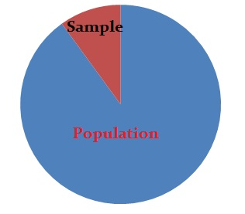

Slide 3
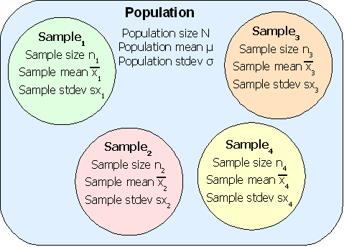

Slide 4
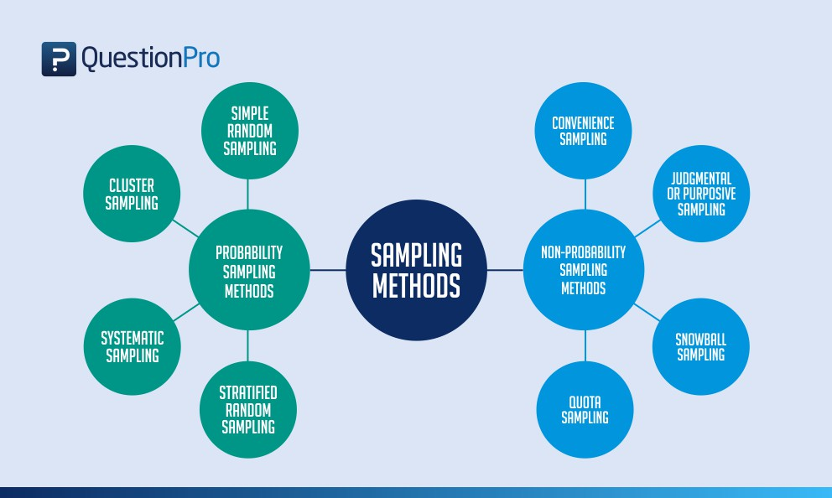

Slide 5
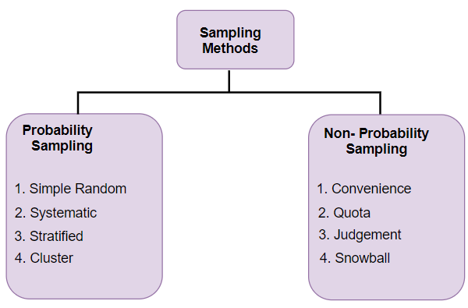

Slide 6
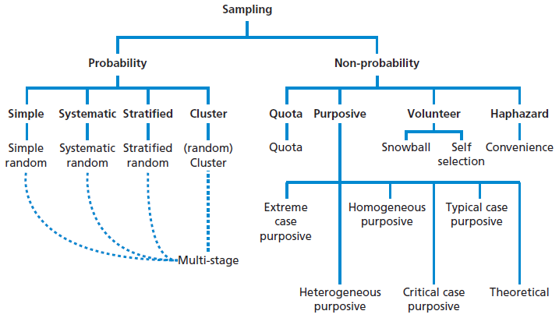

Slide 7
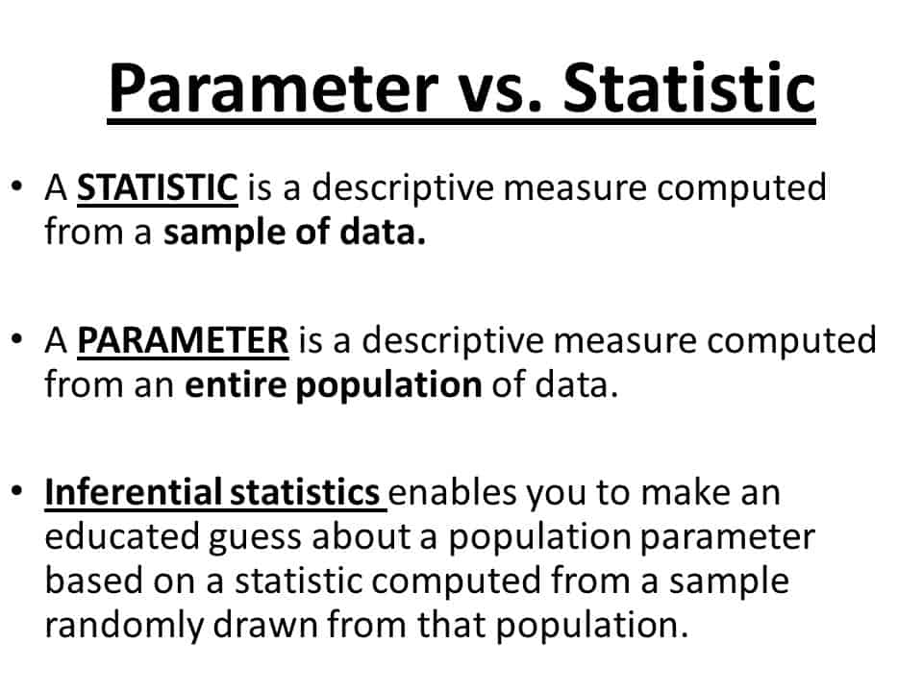

Slide 8
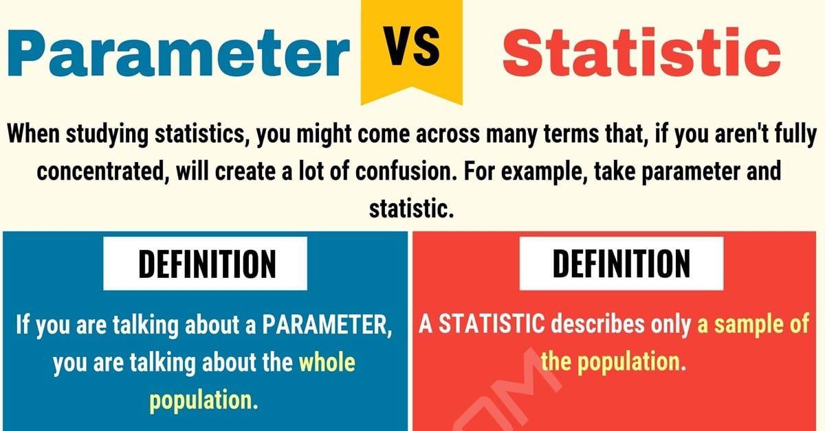

Slide 9
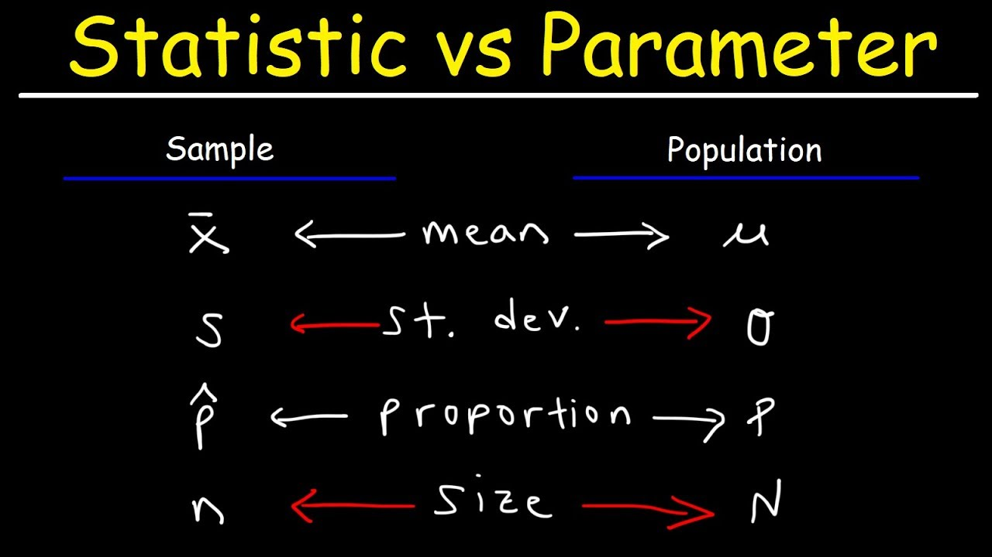

Slide 10
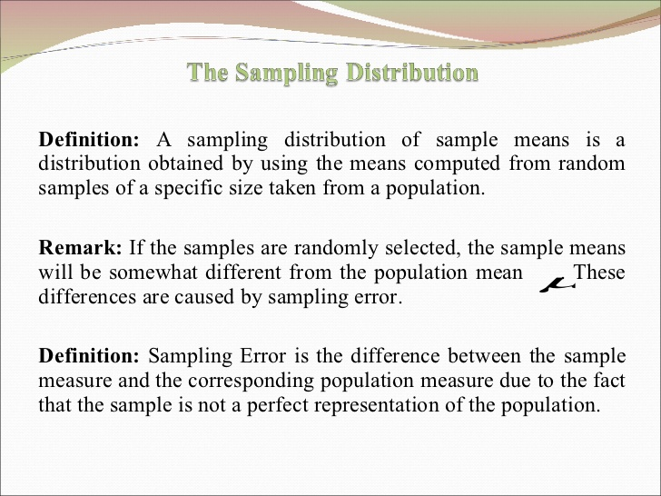

Slide 11
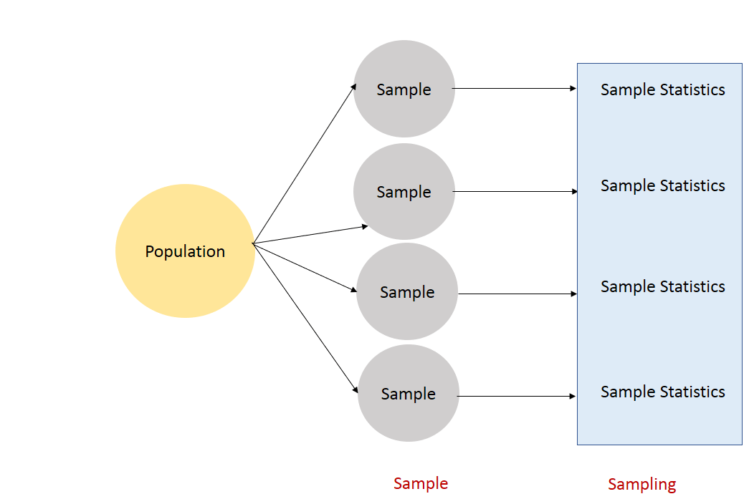

Slide 12
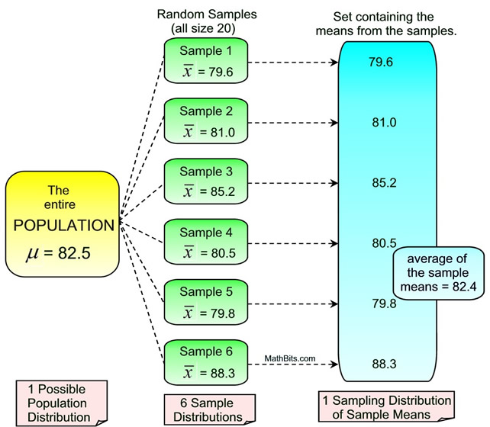

Slide 13
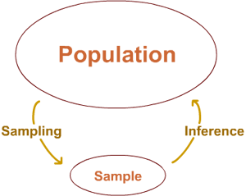

Slide 14
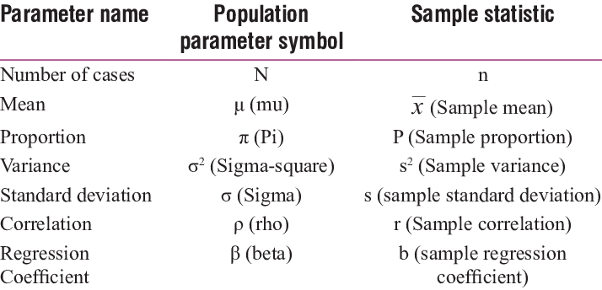

Slide 15
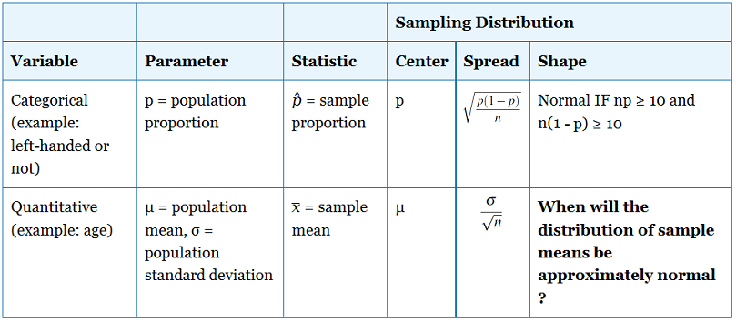

Slide 16
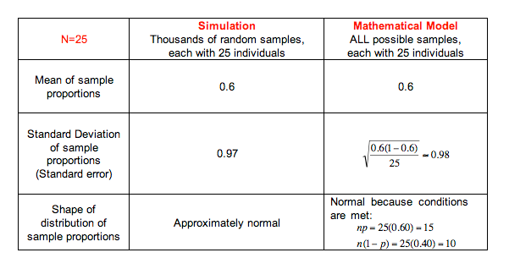

Slide 17
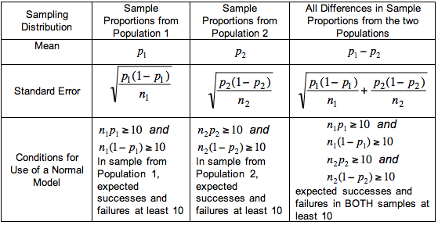

Slide 18
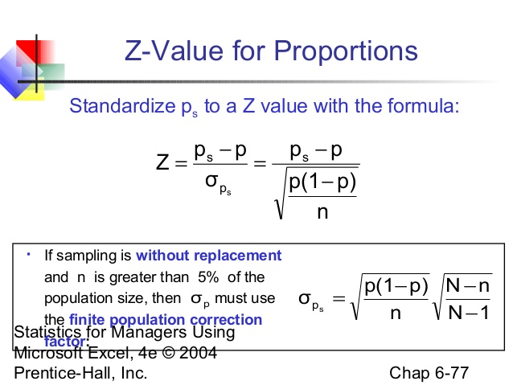

Slide 19
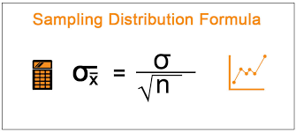

Slide 20
Mathematical Expectation
The mean of a probability distribution is a measure of its centrality or location, as is the mean or average of a frequency distribution. It is a weighted average, with the values of the random variable weighted by their probabilities.
The expected value of a discrete random variable X is equal to the sum of each value of the random variable multiplied by its probability.

Slide 21
DISTRIBUTIONS
The probability distributions of a random variable may be:
The theoretical pattern followed by the random variable.
A model for prediction.
A sound basis for taking rational and dependable decisions.

Slide 22
DISTRIBUTIONS
Amongst theoretical or expected frequency distributions, the following are more popular.
Binomial Distribution:(James Bernoulli 1713)
Poisson Distribution: (S.D. Poisson 1837)
Normal Distribution: (De Moivre, Gauss, & Laplace in 18th Century)
Among these the first two distributions are discrete type and the third one is a continuous one.

Slide 23
BINOMIAL DISTRIBUTION
The Binomial distribution also known as ‘Bernoulli Distribution’ is associated with the name of a Swiss Mathematician James Bernoulli also known as Jacques or Jakob (1654-1705). Binomial distribution is a probability distribution expressing the probability of one set of dichotomous alternatives, i.e., success or failure. This distribution has been used to describe a wide variety of processes in business and social sciences and other areas. The type of process which give rise to this type of distribution is called ‘Bernoulli trial or Bernoulli Process’.

Slide 24
ASSUMPTIONS
An experiment is performed under the same conditions for a fixed number of trials say ‘n’.
In each trial there are only two possible outcomes namely “success” & “failure”
The probability of success is denoted by p and failure by 1-p
The trials are statistically independent, i.e., the outcomes of any trial or sequence of trials do not affect the outcomes of subsequent trials.

Slide 25
The Binomial Probability Distribution
The binomial probability distribution:(p.d.f)
where :
p is the probability of success in a single trial,
q = 1-p,
n is the number of trials, and
x is the number of successes.

Slide 26
POISSON DISTRIBUTION
Poisson distribution is a discrete probability distribution and is very widely used in statistical work. It was developed by French Mathematician Simeon Denis Poisson (1781-1840).Poisson distribution may be used in cases where the chances of happening of an event is very small.
It is also called as ‘law of improbable events’.
Examples: Number of road accidents, printing mistakes, wrong numbers etc.,

Slide 27
ASSUMPTIONS
‘n’ the number of trials is indefinitely large, i.e., n→∞
p the constant probability of success for each trial is indefinitely small i.e., p→0
np= λ (say) is finite.

Slide 28
POISSON DISTRIBUTION
The p.d.f (probability density function) of a Poisson distribution is given below.
X=0,1,2…
e=2.712
λ=np (n= number or trials, p=probability of success)

Slide 29
NORMAL DISTRIBUTION
The normal distribution was first described by Abraham De Moivre (1667-1754) as the limiting form of the Binomial model in 1733.Normal distribution was rediscovered by Gauss in 1809 and by Laplace in 1812.
The normal distribution is an approximation to binomial distribution.

Slide 30
THE NORMAL DISTRIBUTION
A normal curve: Bell shaped
Density is given by
μand σ² are two parameters: mean and standard variance of a normal population
(σ is the standard deviation)

Slide 31
STANDARD NORMAL DISTRIBUTION
The normal distribution with mean 0 and standard deviation 1 is called a standard normal distribution.
A normal curve with mean and standard deviation σ can be converted into a standard normal curve by doing a change of scale and change of origin.

Slide 32
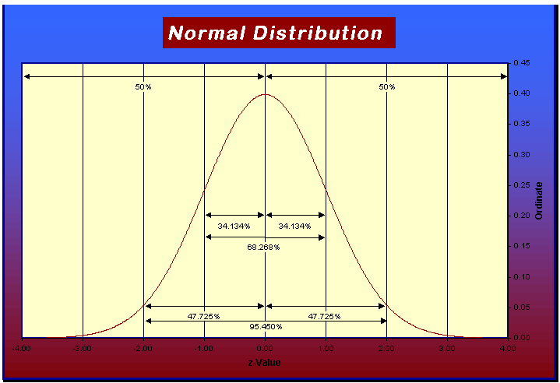
The Theoretical Normal Curve
(from http://www.music.miami.edu/research/statistics/normalcurve/images/normalCurve1.gif

Slide 33
Properties
Has a mean = 0 and standard deviation = 1.
General relationships: ±1 s = about 68.26%
±2 s = about 95.44%
±3 s = about 99.72%

Slide 34
Z-Scores
Are a way of determining the position of a single score under the normal curve.
Measured in standard deviations relative to the mean of the curve.
The Z-score can be used to determine an area under the curve known as a probability.
Formula: Z =

Slide 35
The bulbs manufactured by a company gave a mean life of 3000 hours with standard deviation of 400 hours. If a bulb is selected at random, what is the probability it will have a mean life less than 2000 hours?
OF a large group of men 5% are less than 60 inches in height and 40% are b/n 60&65 inches. assuming a normal distribution, find the mean & standard deviation of heights.

Slide 36
Table I: Area Under the Standard Normal Curve
z .00 .01 .02 .03 .04 .05 .06
0.0 .0000 .0040 .0080 .0120 .0160 .0199 .0239
0.1 .0398 .0438 .0478 .0517 .0557 .0596 .0636
0.2 .0793 .0832 .0871 .0910 .0948 .0987 .1026
0.3 .1179 .1217 .1255 .1293 .1331 .1368 .1404
0.4 .1554 .1591 .1628 .1664 .1700 .1736 .1772
0.5 .1915 .1950 .1985 .2019 .2054 .2088 .2123
… … … … … … … …
1.0 .3413 .3438 .3461 .3485 .3508 .3531 .3554
1.1 .3643 .3665 .3686 .3708 .3729 .3749 .3770

Slide 37
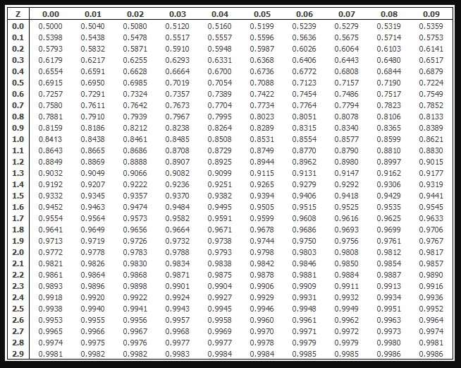

Slide 38
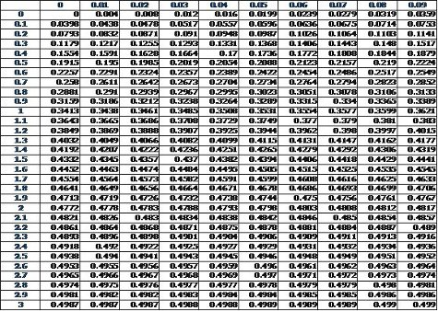

Slide 39
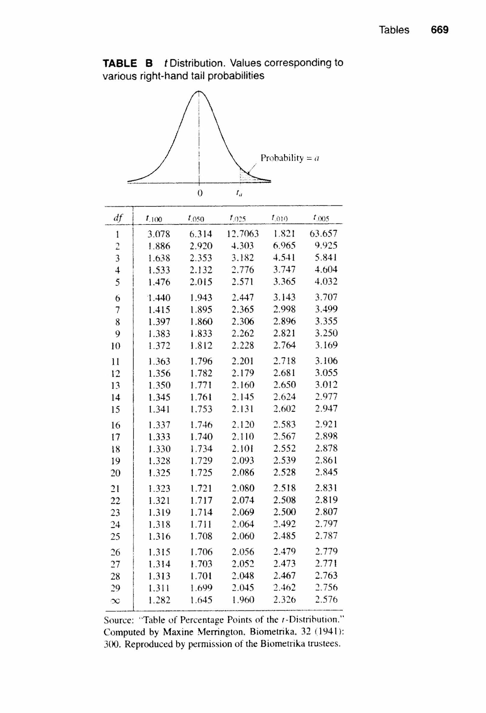

Slide 40
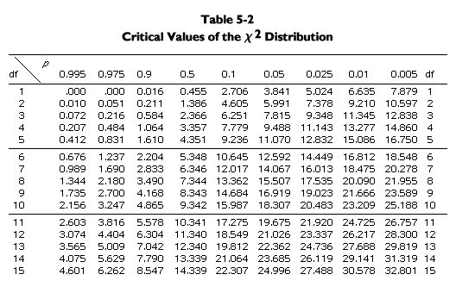
Chi-Square Table

Slide 41
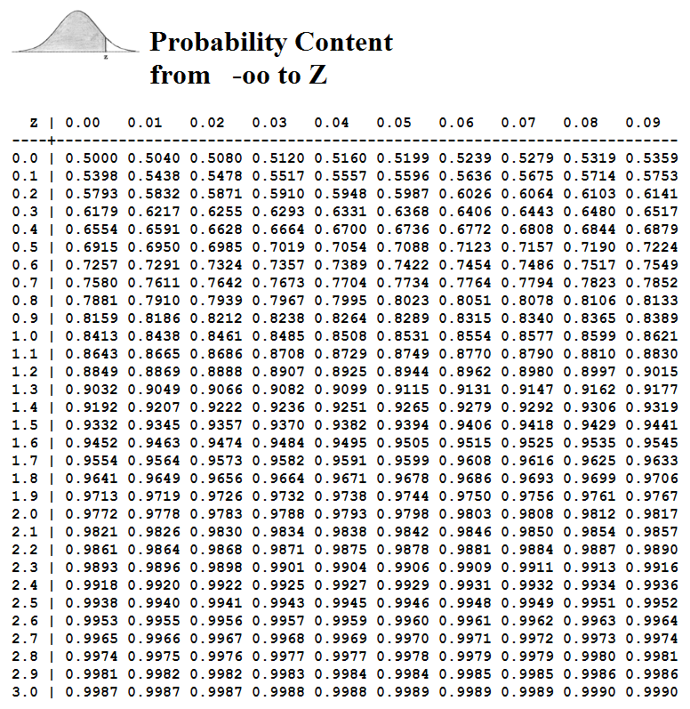
Normal distribution table
Standard normal table
Unit normal table

Slide 42
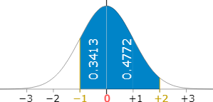

Slide 43
Hypothesis
Meaning : Research Hypothesis is a predictive statement capable of being tested by scientific methods, that relates an independent variable to some dependent variable.

Slide 44
Types of Hypothesis
Based on Function:
Descriptive Hypothesis
Relational Hypothesis
Based on Level of Abstraction:
Simple Description-Common Sense Hypothesis
Logical Derivation-Complex Hypothesis
Abstraction-Analytical Hypothesis
Based on Use:
Null Hypothesis
Alternate Hypothesis
Working Hypothesis
Statistical Hypothesis

Slide 45
Sources of Hypothesis
Theory:
Observation:
Analogies:
Experience:
Study Findings:
Culture:
State of Knowledge:
Continuity of Research:
“Keen Observation, Creative Thinking, Hunch, Wit, Imagination, Vision, Insight and sound Judgment are the sources of a reasonable Hypothesis”

Slide 46
Features of a Good Hypothesis
Conceptual Clarity:
Specificity:
Testability:
Availability of Techniques:
Theoretical Relevance:
Consistency:
Objectivity:
Simplicity:

Slide 47
Basic Concepts Concerning Hypothesis
Null Hypothesis and Alternative Hypothesis
The Level of Significance
Decision Rule for test of Hypothesis
Type I and Type II Errors
One-tailed and Two-Tailed Tests

Slide 48
Null Hypothesis and Alternative Hypothesis
H₀:µ =µ_{H0} - Null Hypothesis
Ha:µ≥ µ_{H0} –Alternative Hypothesis
Ha:µ≤ µ_{H0}-Alternative Hypothesis
Ha:µ≠ µ_{H0}-Alternative Hypothesis
The Null Hypothesis is the one which we wishes to disprove and alternative hypothesis is the one we wishes to prove

Slide 49
The Level of Significance
The significance level is the maximum value of the probability of rejecting H₀ when it is true and is usually decided in advance before testing the hypothesis. A significance level of 5% means there is a risk of rejecting H_{o} when it is true with a probability of 0.05

Slide 50
Decision Rule for Test of Hypothesis
Given a hypothesis H₀ and alternative hypothesis H_{a}, we make a rule which is known as decision rule according to which we accept H₀ or reject H₀. Here we must decide the number of items to be tested and the criterion for accepting or rejecting the hypothesis.

Slide 51
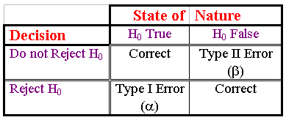
Type I and Type II Errors
A contingency table illustrates the possible outcomes of a statistical hypothesis test.

Slide 52
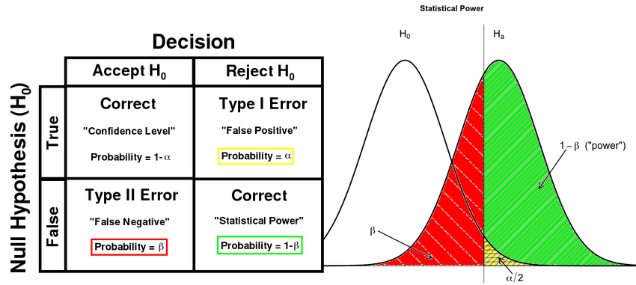

Slide 53
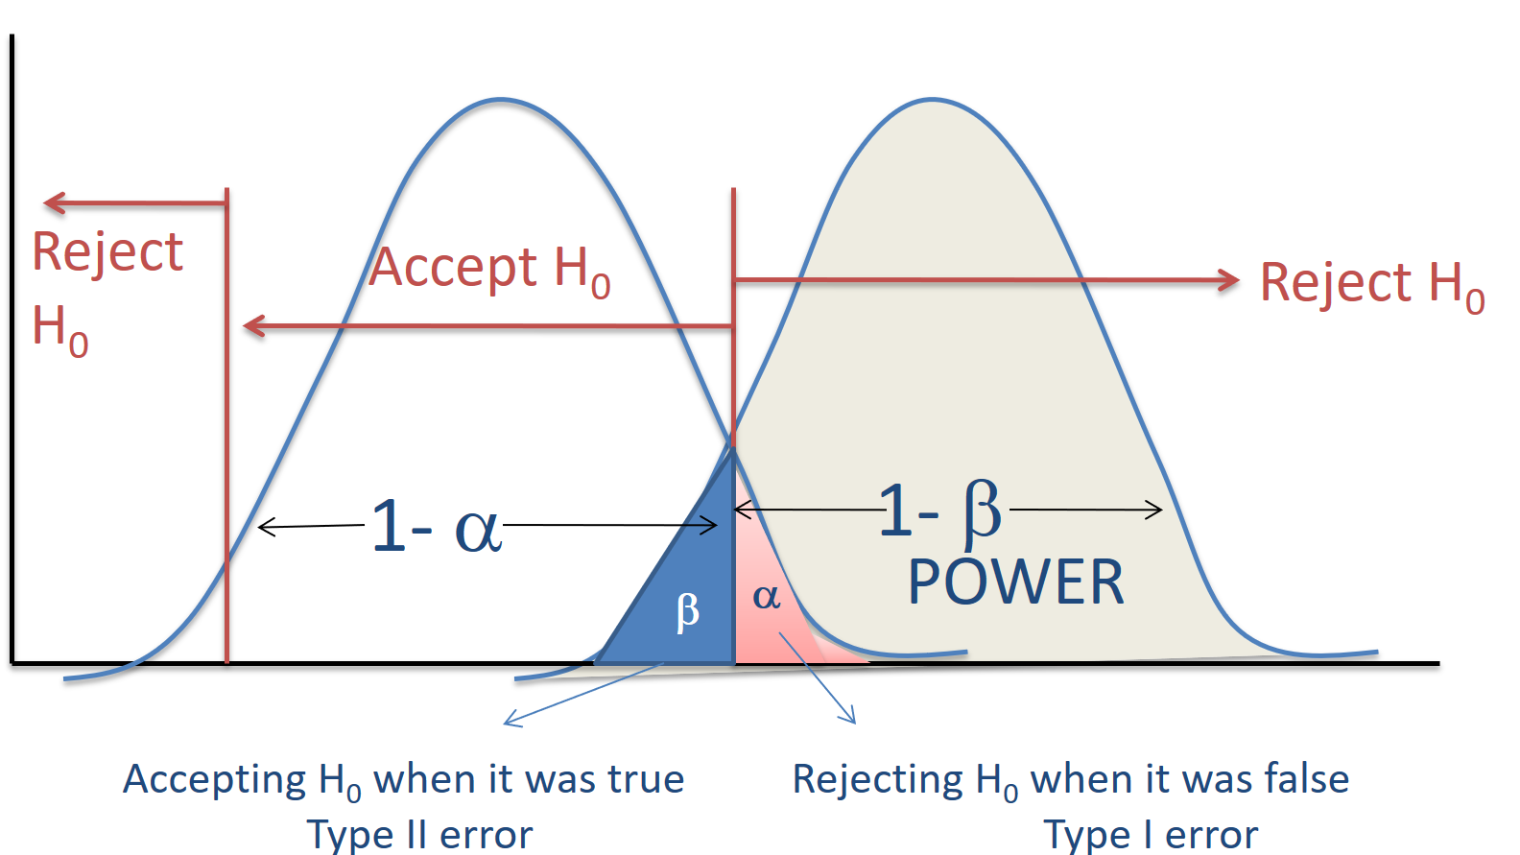

Slide 54
Two-Tailed and One-Tailed Tests
When we have H₀:µ =µ H₀ and H_{a}:µ ≠ µ H_{0,} a two-tailed test is appropriate. Thus in a two tailed test, there are two rejection regions.
T
h
e
H
y
p
o
t
h
e
s
i
z
e
d
S
a
m
p
l
i
n
g
D
i
s
t
r
i
b
u
t
i
o
n
o
f
t
h
e
M
e
a
n
0
.
8
0
.
7
.95
0
.
6
0
.
5
0
.
4
0
.
3
0
.025
.025
.
2
0
.
1
0
.
0
27.02
μ₀=28
28.98

Slide 55
One-Tailed Test
A one-tailed test would be used when we are to test the population mean is either lower or higher than some hypothesized value. Ex: H₀:µ=µ H₀and,H_{a}:µ<µ H₀ then we apply the left tailed test. When H₀:µ=µ H₀ and H_{a}:µ>µ H_{0,} then a right tailed test would be appropriate.

Slide 56
Right Tailed Test
Critical Point for a Right-Tailed Test
0
.
4
0
0.99
.
3
f(z)
0
.
2
0
0.01
.
1
0
.
0
-
5
0
5
z
2.326
2.5
Nonrejection
Region
Rejection
Region

Slide 57
Left-Tailed Test
Critical Point for a Left-Tailed Test
0
.
4
0
.
0.95
3
0
.
f(z)
2
0.05
0
.
1
0
.
0
-
5
0
5
-1.645
z
-0.4
Rejection
Region
Nonrejection
Region

Slide 58
The Power of a Test
The power of a statistical hypothesis test is the probability of rejecting the null hypothesis when the null hypothesis is false.
Power = (1 - β)

Slide 59
The Power Function
The probability of a type II error, and the power of a test, depends on the actual value of the unknown population parameter. The relationship between the population mean and the power of the test is called the power function.
Value of μ β Power = (1 - β)
61 0.8739 0.1261
62 0.7405 0.2695
63 0.5577 0.4423
64 0.3613 0.6387
65 0.1963 0.8037
66 0.0877 0.9123
67 0.0318 0.9682
68 0.0092 0.9908
69 0.0021 0.9972
P
o
w
e
r
o
f
a
O
n
e
-
T
a
i
l
e
d
T
e
s
t
:
μ
=
6
0
,
α
=
0
.
0
5
1
.
0
0
.
9
0
.
8
0
.
Power
7
0
.
6
0
.
5
0
.
4
0
.
3
0
.
α=0.05
2
0
.
1
0
.
0
μ
6
0
6
1
6
2
6
3
6
4
6
5
6
6
6
7
6
8
6
9
7
0

Slide 60
Test Statistics

