Slide 1
Module II
Probability, Theorems on Probability, & Bayes’ Theorem

Slide 2
Introduction to Probability
Probability conveys the meaning of chance, likely, possible, probable etc.,
It is associated with games of chance like throwing a die, tossing a coin, drawing cards from a pack of cards etc…
To understand probability, the following terms should be understood.
Random Experiment, Sample Space, Outcome, Event etc.,

Slide 3
Probability is:
A quantitative measure of ‘uncertainty’
A measure of the ‘strength of belief’ in the occurrence of an uncertain event
A measure of the degree of ‘chance’ or ‘likelihood of occurrence’ of an uncertain event
Measured by a number between 0 and 1 (or between 0% and 100%)

Slide 4
Basic Terms in Probability
Random Experiment
Sample Space
Event
Types of Events
    Mutually Exclusive Events
    Independent and Dependent Events
    Equally Likely Events
    Simple and Compound Events
    Exhaustive Events
    Complementary Events

Slide 5
PROBABILITY DEFINED AS
A general definition of probability states that probability is a numerical measure between (0 and 1inclusively) of the likelihood or chance of occurrence of an uncertain event.
Approaches
Classical or ‘a priori’ Probability Approach
Relative Frequency Approach (‘ a posteriori’ probability)
Subjective Approach
Axiomatic Approach

Slide 6
1.Classical Approach
This approach of defining the probability is based on the assumption that all the possible outcomes (finite) of an experiment are mutually exclusive and equally likely.
P(A)= Number of favorable out comes
Total number of possible outcomes
Since the probability of occurrence of an event is based on prior knowledge of the process involved, this approach is often called an ‘a priori classical probability approach.’
Ex: Tossing Coins, Die, Picking a Card from a deck of cards etc.,

Slide 7
2.Relative Frequency Approach
This probability is derived from past records
It is also called as statistical or empirical or ‘a posteriori’ probability.
P(A)= Total number of occurrence of the event
Total number of trials
This approach of computing probability is based on the assumption that a random experiment can be repeated a large number of times under identical conditions where trials are independent to each other.

Slide 8
3.Subjective Probability
Based on personal experience or opinion.
Also called as personalistic theory of probability
Such probabilities are calculated purely on the basis of personal opinion of some experts
Commonly used in business decision making
Based on beliefs, convictions, experience and hunch.
This approach should be used when sufficient data are not available or sources of data are not known.

Slide 9
4.Axiomatic Approach
Axiomatic approach to probability is based on the following axioms
0≤ P(A) ≤1
P(S)=1
P(AUB)=P(A)+P(B), provided A and B are mutually exclusive events.

Slide 10
IMPORTANCE OF PROBABILITY
Classical Decision Procedures of estimation & testing
Predictions
Construction of econometric models
Management Planning & Control

Slide 11
THEOREMS OF PROBABILITY
The addition Theorem:
The addition rules are helpful when we have two events and are interested in knowing the probability that at least one of the events occurs.
The Multiplication Theorem:
The multiplication rules are helpful when we have two events and are interested in knowing the probability of happening of both the events.

Slide 12
The Addition Theorem
Mutually Exclusive Events
If two events A and B are mutually exclusive (disjoint), then
P(AUB)= P(A)+P(B)
Overlapping Events
If two events A, and B are not-mutually exclusive, then
P(AUB)=P(A)+P(B)-P(A∩ B)

Slide 13
Multiplication Theorem
Independent Events:
When the occurrence of an event does not affect and is not affected by the probability of occurrence of any other event, the events are said to be statistically independent events.
P(AB)=P(A)P(B)
Dependent Events(Conditional Events):
P(AB)= P(A)P(B/A)=P(B)P(A/B)

Slide 14
Conditional Probability
Conditional Probability - Probability of A given B
(Multiplication Rule in case of dependent events)
  Independent events:

Slide 15
Baye’s Theorem
Let A1 and A2 be the set of events which are mutually exclusive and exhaustive and ‘B’ a simple event which intersects each of the ‘A’ events, then
P(A1/B)= P(A1) P(B/A1)
P(A1) P(B/A1) + P(A2)P(B/A2)
i.e., you can calculate ‘posterior’ probabilities from ‘prior’ probabilities and ‘conditional’ probabilities.

Slide 16
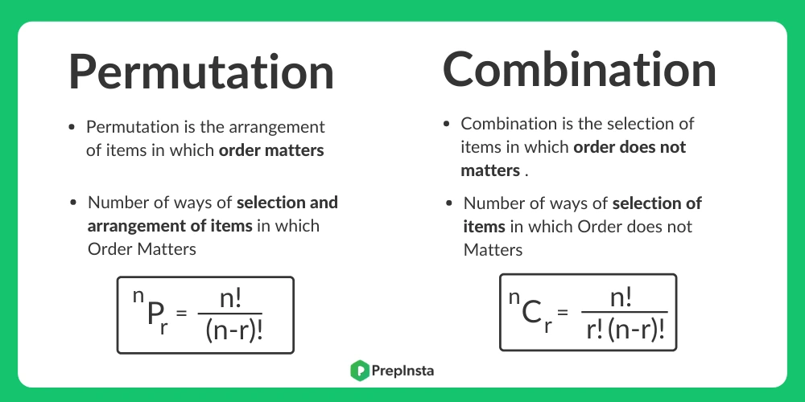

Slide 17
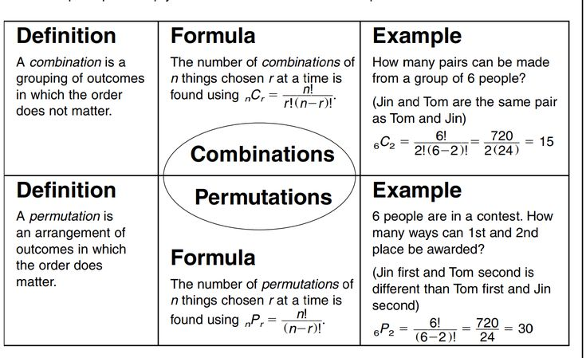

Slide 18
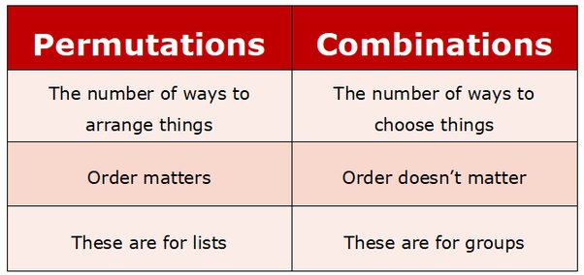

Slide 19
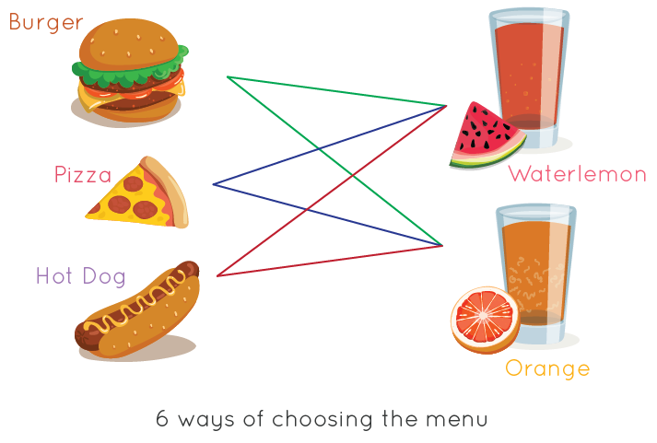

Slide 20
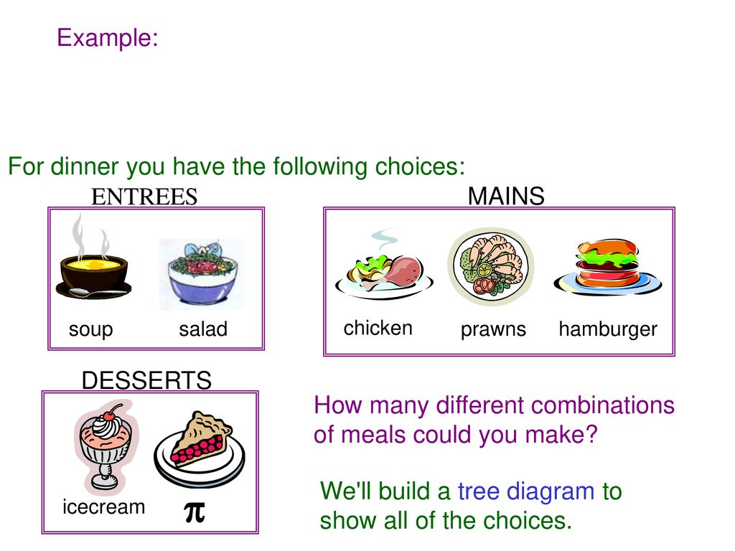

Slide 21
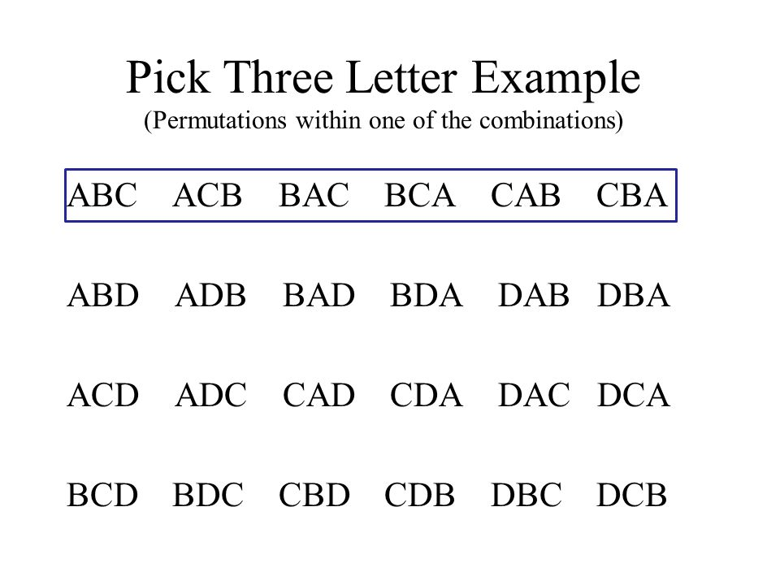
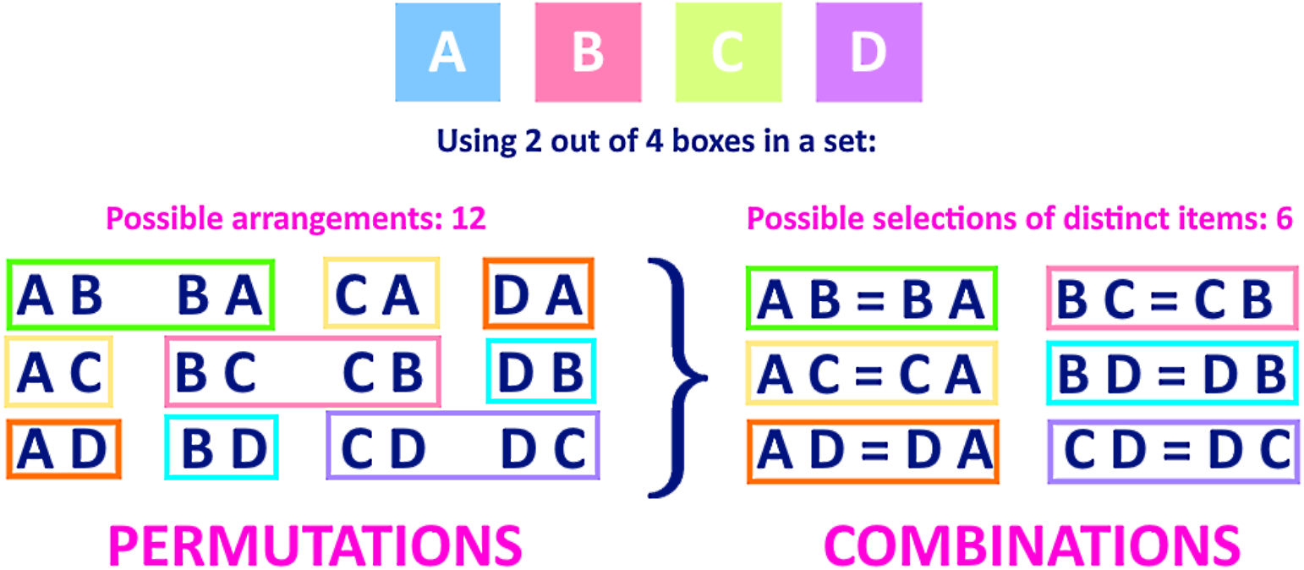

Slide 22
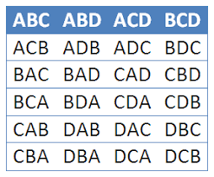

Slide 23
