Slide 1

Module I
Introduction to Statistics,
Measures of Central Tendency, Dispersion, Correlation & Regression

Slide 2
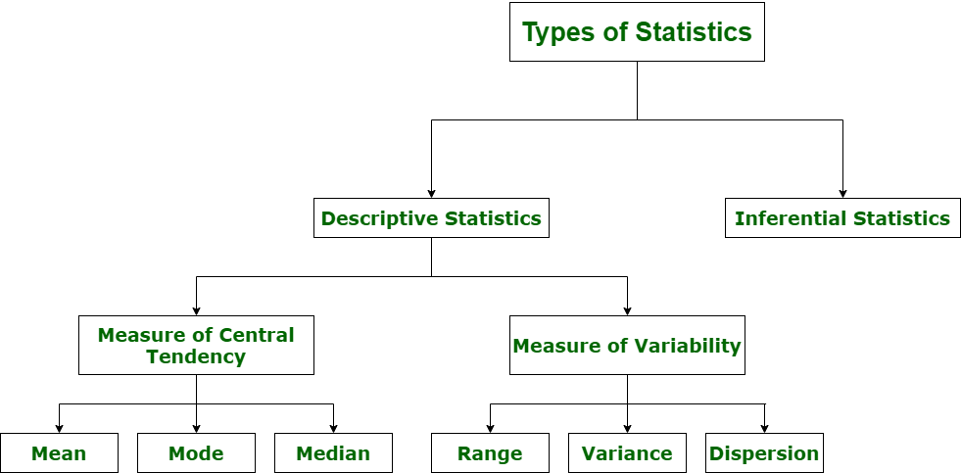

Slide 3
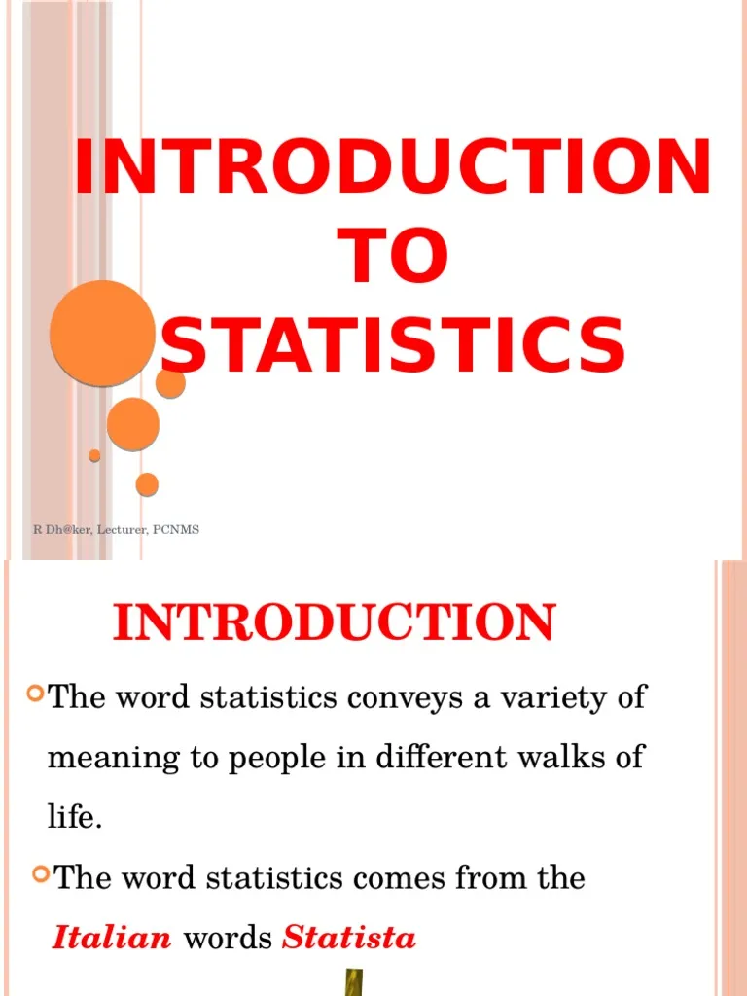

Slide 4
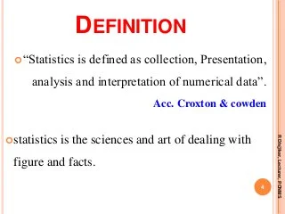

Slide 5
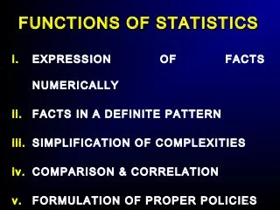

Slide 6
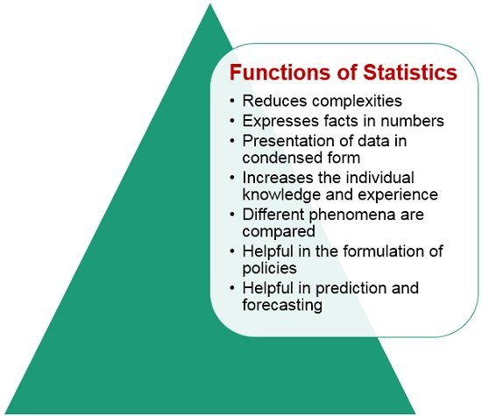

Slide 7
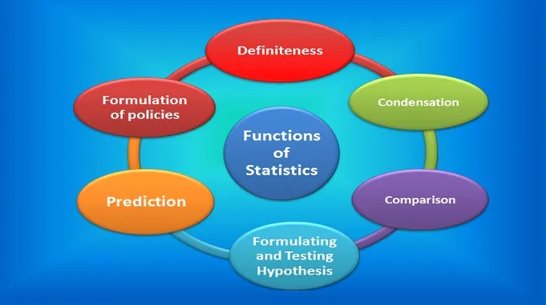

Slide 8
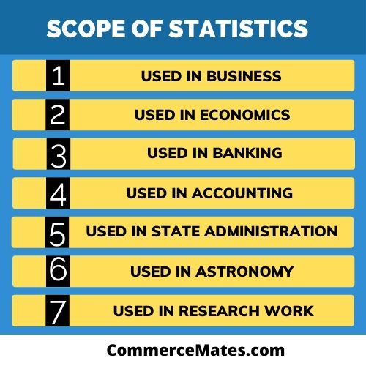

Slide 9
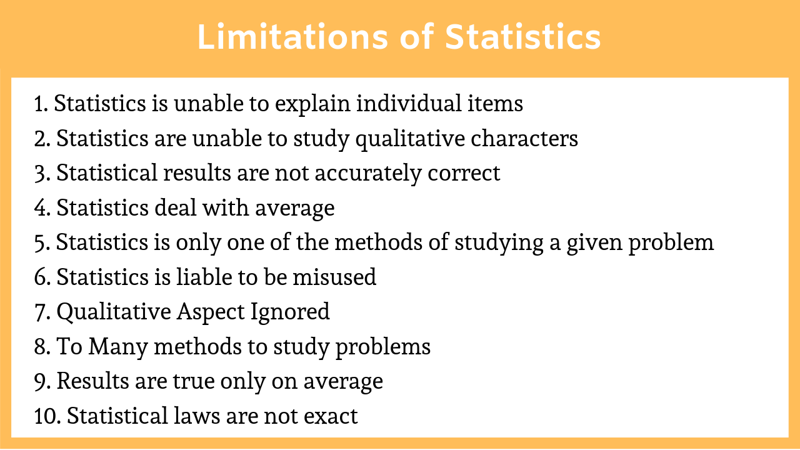

Slide 10
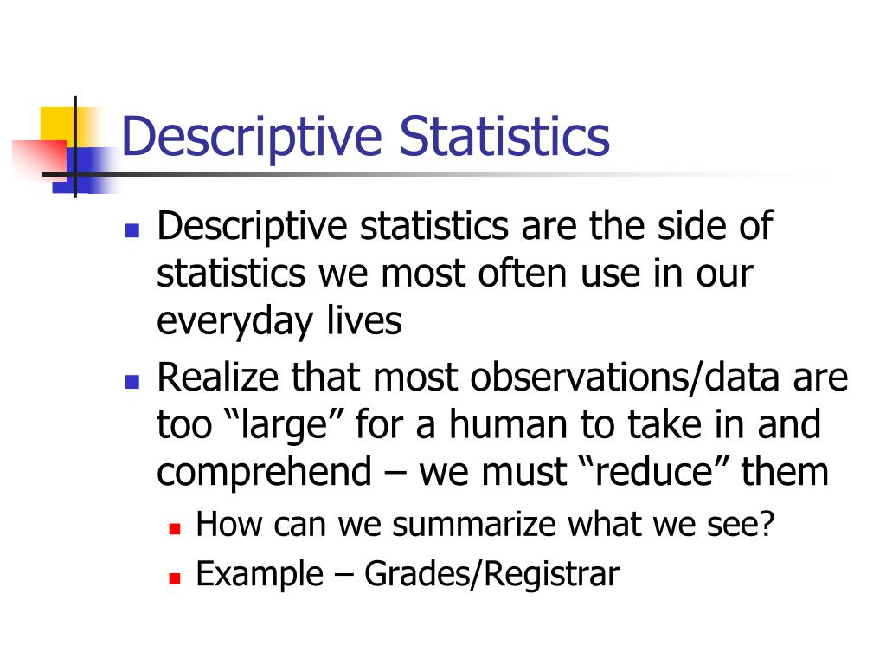

Slide 11
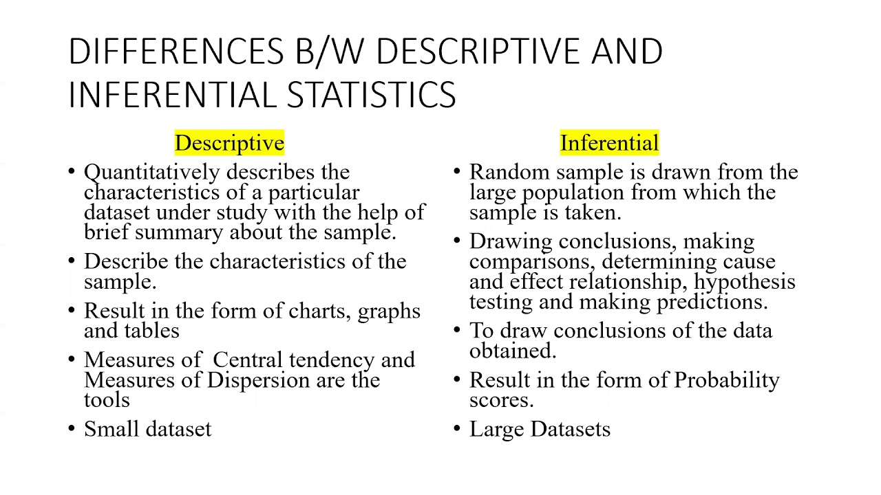

Slide 12
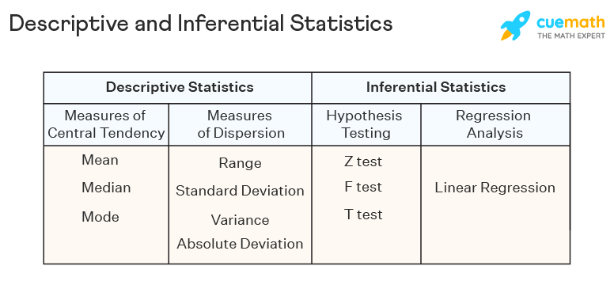

Slide 13
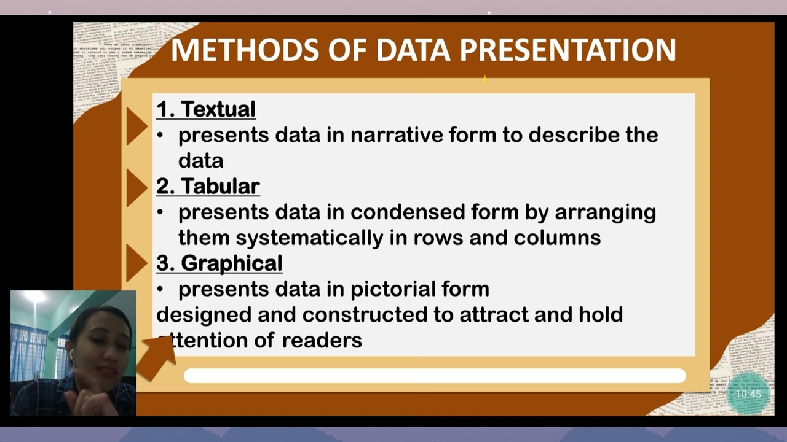

Slide 14
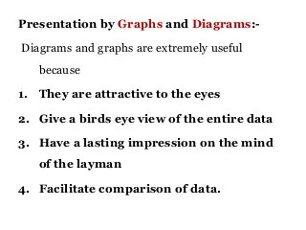

Slide 15
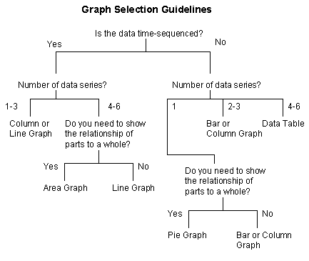

Slide 16
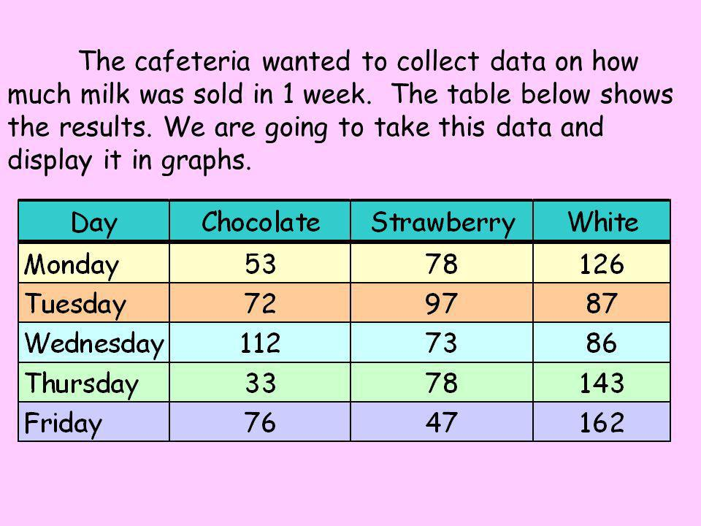

Slide 17
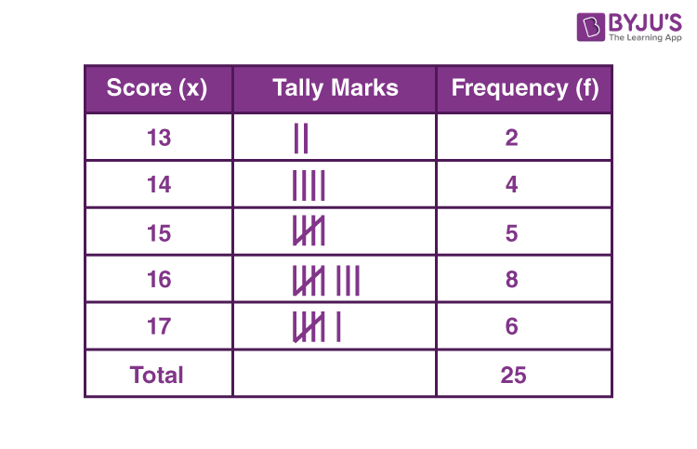

Slide 18
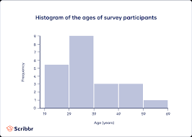

Slide 19
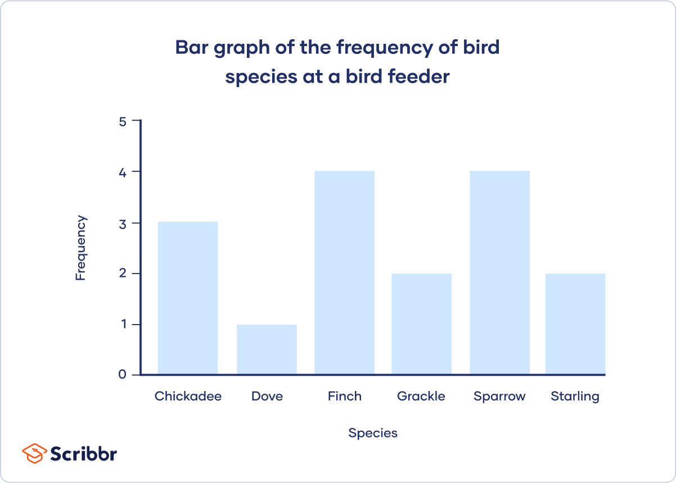

Slide 20
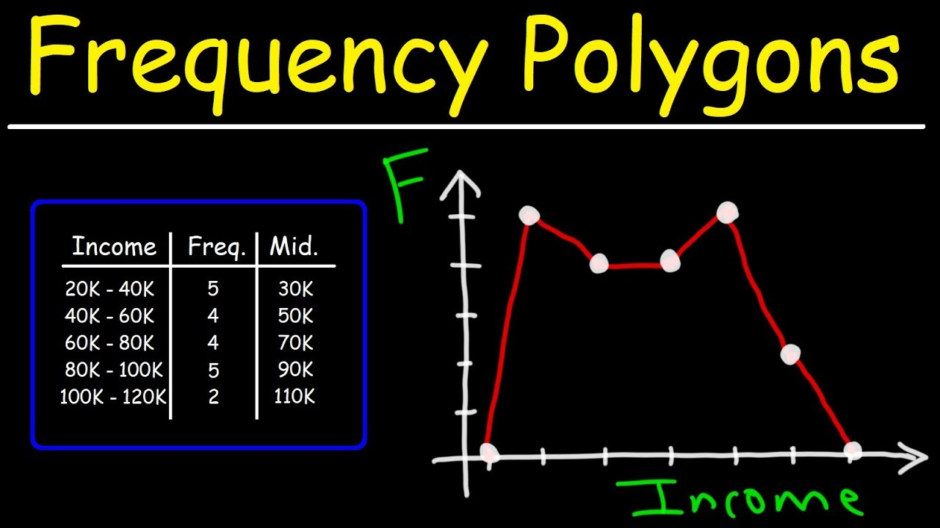

Slide 21
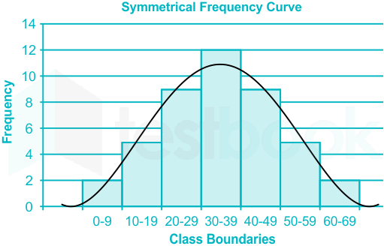

Slide 22
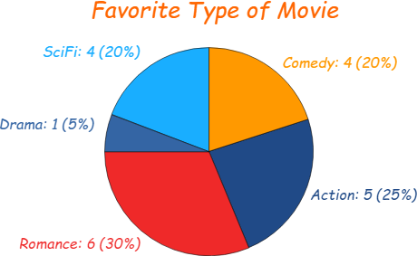

Slide 23
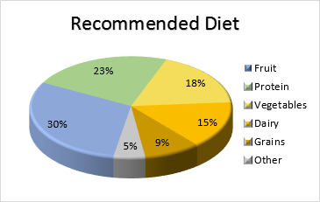

Slide 24
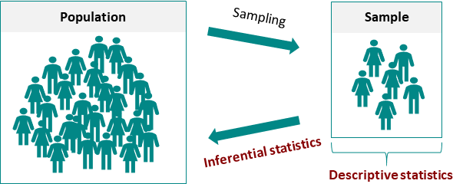

Slide 25
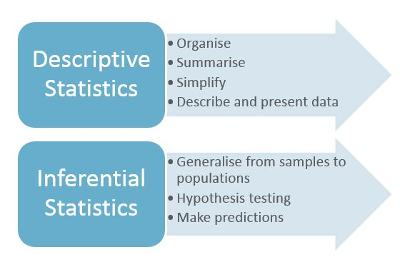

Slide 26
Learn from Comparison | INDIA | CHINA
Real GDP | 5 % | 7.8 %
GDP/Capital at PPP in $ | 3950 | 9210
Population BPL | 21.09 % | 10.2 %
Proportion of Forest Land | 23 % | 21.9 %
UNDP’S HDI- Rank | 136 | 2
Co2 Emissions: Tones (2010) | 2009 | 8287
Population using improved water sources | 92 % | 92%
Slum Population as a % of Urban | 29.4 % | 29.4 %
TB per lakh Population | 249 | 104
Source : E.T : 21-08-2013

Slide 27
CENTRAL TENDENCY
Definition :
“Average is an attempt to find one single figure to describe the whole of figures”
“The average is some time described as a number which is typical of the whole group”
Ex: Sachin Tendulkar’s Average is 55.44 in Test Cricket.
The average temperature in Coimbatore is 34⁰ Centigrade.

Slide 28
Requisites of a Good Average
Easy to Understand.
Simple to compute.
Based on all items.
Not to be unduly affected by extreme items.
Rigidly defined.
Capable of further algebraic treatment.
Statistically Stable.

Slide 29
Objectives of Averaging
To get a single value that describes the characteristics of the entire group.
To facilitate comparison.
To get a single figure expressed in some quantitative form.
To get a value capable of giving a central idea about the series it represents.

Slide 30
Types of Averages
Arithmetic Mean
  Simple Arithmetic Mean
  Weighted Arithmetic Mean Mathematical
Geometric Mean(G.M) Averages
Harmonic Mean(H.M)
Median Positional
Mode Averages

Slide 31
1. Arithmetic Mean
The mean of a set of observations is their average- the sum of the observed values divided by the number of observations.
The term ‘central tendency’ was coined because observations(numerical values) in most data sets show a distinct tendency to group or cluster around a value of an observation located some where in the middle of all observations.

Slide 32
Simple & Weighted Means
Simple Mean gives equal importance(weight) to each observation in the data set.
Ex: Marks scored in University Examinations(%), followed in Universities
Weighted Mean:
Importance of all the numerical values in the given data set is not equal.
Ex: CGPA(Cumulative Grade Point Average) followed in IIMs

Slide 33
2. Median
Median by definition refers to the middle value in the distribution
Median is a ‘positional average’ as distinct from the arithmetic mean which is calculated from the value of every item in the series.
Median is calculated as the size of the (N+1)/2nd item in the ascending or descending order.

Slide 34
2. Median
Median= L+ (N/2-c.f)/f x i
L= Lower limit of the median class
c.f= cumulative frequency of the class preceding the median class
f= frequency of the median class
i= Class interval of the median class

Slide 35
3.Mode
Mode is a positional average
It is defined as the value around which the items are most heavily concentrated and is the most common item of the series.
In other words it is the item having the largest frequency.
It may be regarded as the most typical of the series of values.

Slide 36
3.Mode
Mode = L+ {(f₁-f₀)/(2f₁-f_{o}-f₂)} x i
L= Lower limit of the modal class
f₀₌frequency of the class preceding the modal class
f₁= frequency of the modal class
f₂= frequency of the class succeeding the modal class.
i= Class interval.

Slide 37
4.Geometric Mean (G.M)
In many business and economic problems, we deal with quantities that change over a period of time. In such cases we need to calculate another measure of central tendency, called Geometric Mean (G.M). G.M is defined as the N^{th} root of the product of N items or values.
Uses of Geometric Mean
Calculating Growth Rates.(CARG)
Compounding Interest Rates.
Construction of Index Numbers.

Slide 38
5.Harmonic Mean (H.M)
Harmonic mean is based on the reciprocals of the numbers averaged.
It is defined as the reciprocal of the arithmetic mean of the reciprocal of the individual observations.
Uses
  Useful in calculating the average rate of change of speed, profit, sales etc., over a period of time.

Slide 39
Empirical Relationship
For any set of observations, it’s A.M., G.M., and H.M., are related to each other in the following ways.
A.M≥G.M ≥H.M
Mode=3 Median-2Mean

Slide 40
Types of Data
Data can be represented by 3 ways:
Individual Series
Discrete Series
Continuous Series

Slide 41
Mean-Individual Series
The following table gives the marks obtained by 10 students in a class. Calculate arithmetic mean?
No. | 1 | 2 | 3 | 4 | 5 | 6 | 7 | 8 | 9 | 10
Marks | 40 | 50 | 30 | 60 | 70 | 80 | 40 | 50 | 60 | 90

Slide 42
Mean Individual Series
Roll No. | Marks
1 | 40
2 | 50
3 | 30
4 | 60
5 | 70
6 | 80
7 | 40
8 | 50
9 | 60
10 | 90
A.M=570/10=57 | ∑x=570

Slide 43
Mean-Discrete Series
Income | f | fx
220 | 5 | 1100
250 | 10 | 2500
300 | 15 | 4500
370 | 7 | 2590
450 | 3 | 1350
500 | 10 | 5000
Mean= 340.8 (17040/50) | ∑f=50 | ∑fx=17040

Slide 44
Mean- Continuous Series
Marks | M.V | f | mf
0-10 | 5 | 5 | 25
10-20 | 15 | 3 | 45
20-30 | 25 | 7 | 175
30-40 | 35 | 25 | 875
40-50 | 45 | 20 | 900
 |  | ∑f=60 | ∑mf=2020
 | Mean= ∑mf/∑f=2020/60=33.67

Slide 45
Median-Individual Series
Median = Size of (N+1)/2nd item
Example : Find the median of the Income of the following 7 individuals:
110,115,140,117,109,113,120
Ascending Order : 109,110,113,115,117,120,140
Median = (N+1)/2nd item = (7+1)/2nd item =4th item = 115

Slide 46
Median-Individual Series
Median = Size of (N+1/2) ^{nd} item
Example : Find the median of the Income of the following 10 individuals:
38,24,45,50,85,60,95,40,56,63
Ascending Order :
24,38,40,45,50,56,60,63,85,95
Median = (N+1)/2nd item = (10+1)/2nd item =5.5th item = (5th item+6th item )/2=
(50+56)/2=53

Slide 47
Median-Discrete Series
Median = Size of (N+1/2) ^{nd} item
From the following data calculate median:
Income : 1200 1800 5000 2500 3000 1600 3500
No : 12 16 02 10 03 15 07
Solution: Median = Size of (N+1/2) ^{nd} item
Income: 1200 1600 1800 2500 3000 3500 5000
f : 12 15 16 10 03 07 02
cf : 12 27 43 53 56 63 65
Median= Size of (65+1)/2nd item = 33rd item =1800

Slide 48
Median-Continuous Series
Median = Size of (N+1/2) ^{nd} item
From the following data calculate median:
Marks : 0-10 10-20 20-30 30-40
No. : 8 12 20 25
Marks : 40-50 50-60 60-70 70-80
No. 30 50 35 27
Marks : 80-90 90-100
No. 13 05

Slide 49
Median-Continuous Series
X | f | Cf
0-10 | 8 | 8
10-20 | 12 | 20
20-30 | 20 | 40
30-40 | 25 | 65
40-50 | 30 | 95
50-60 | 50 | 145 | (N+1)/2ndItem
60-70 | 35 | 180
70-80 | 27 | 207
80-90 | 13 | 220
90-100 | 5 | 225

Slide 50
Median-Continuous Series
Median = L+{(N/2-c.f)/f}*i
L=50
N/2=112.5
c.f=95
f =50
i=10
Median = 50+{(112.5-95)/50}*10=53.5
Median=53.5

Slide 51
Mode-Individual Series
Mode = Most repeated value.
Example : Find the mode of the following data:
14,16,16,14,22,15,14,23,14,25
Mode = 14
Find the mode of the following data
10,20,30,40,50,60,70,80,90,100
Mode= Multimodal

Slide 52
Mode-Discrete Series
Mode = Most repeated value.
Example : Find the mode of the following data:
Marks : 10 20 30 40 50 60 70
Freq: 07 08 10 30 12 10 03
Mode = 40

Slide 53
Mode-Continuous Series
Mode = L+{(f1-f0)/(2f1-f2-f0)}*i (Most repeated value).
Marks No.
00-10 5
10-20 7
20-30 8
30-40 20
40-50 10
50-60 06
60-70 02
70-80 02

Slide 54
Mode-Continuous Series
Solution :
Modal Class=30-40
L=30
f0=8
f1=20
f2=10
i=10
Mode= 30+{(20-8)/(40-18)}*10=35.45

Slide 55
G.M-Individual Series
Calculate the G.M of the following data:
85,15,500,70,75,250,45,8,40,36.
X : 85 15 500 70 75
Log X:1.9294 1.1761 2.6990 1.8451 1.8751
X :250 45 08 40 36
Log X:2.3979 1.6532 0.9031 1.6021 1.5563
∑log x= 17.6373
G.M= Antilog of (17.6373)/10=58.04

Slide 56
G.M-Discrete Series
x | f | log x | f log x
150 | 10 | 2.1761 | 21.7610
260 | 6 | 2.4150 | 14.4900
350 | 4 | 2.5441 | 10.1764
250 | 2 | 2.3979 | 4.7958
175 | 3 | 2.2430 | 6.7290
 | N=25 |  | ∑f log x=57.9522
G.M= Antilog ∑f log x/ N= Anti log (57.9522)/25=2.3181
G.M= Anti log of 2.3181= 208.02

Slide 57
G.M-Continuous Series
Marks | M.V(x) | f | log x | f log x
0-10 | 5 | 5 | 0.6990 | 3.4950
10-20 | 15 | 13 | 1.1761 | 15.2893
20-30 | 25 | 7 | 1.3979 | 9.7853
30-40 | 35 | 10 | 1.5441 | 15.4410
40-50 | 45 | 5 | 1.6532 | 8.2660
50-60 | 55 | 10 | 1.7404 | 17.4040
 |  | N=50 |  | ∑f log x=69.6806
G.M= Antilog ∑f log x/ N= Anti log (69.6806)/50=1.3936=24.75

Slide 58
H.M-Individual Series
Find the H.M from the following values
5,10,15,20,25
X | Reciprocal (1/x)
5 | 0.2000
10 | 0.1000
15 | 0.0667
20 | 0.0500
25 | 0.0400
 | ∑(1/x)=0.4567
H.M= N/∑(1/x) | =5/0.4567=10.95

Slide 59
H.M-Discrete Series
x | f | 1/ x | f/ x
20 | 4 | 0.05000 | 0.2000
21 | 2 | 0.04762 | 0.09524
22 | 7 | 0.04545 | 0.31815
23 | 1 | 0.04348 | 0.04348
24 | 3 | 0.04167 | 0.12501
25 | 1 | 0.04000 | 0.04000
 | N=18 |  | ∑f/x=0.82188
H.M= N/∑f/x=18/0.82188 H.M=21.90

Slide 60
H.M-Continuous Series
Marks | M.V(x) | f | 1/x | f /x
0-20 | 10 | 11 | 0.1000 | 1.1000
20-40 | 30 | 13 | 0.0333 | 0.4329
40-60 | 50 | 17 | 0.0200 | 0.3400
60-80 | 70 | 21 | 0.0143 | 0.3003
80-100 | 90 | 23 | 0.0111 | 0.2553
 |  | N=85 |  | ∑f/x=2.4285
H.M=N/∑f/x=85/2.4285 H.M=35.001

Slide 61
DISPERSION
An average is a single value which represents a set of values in a distribution.
Dispersion on the other hand, indicate the extent to which individual values fall away from the average or central value.
“Dispersion is the measure of variation of the items”
“The degree to which numerical data tend to spread about the average value is called the variation or dispersion”

Slide 62
MEASURES OF DISPERSION
Range
Inter-quartile range
Quartile Deviation
Mean Deviation(Mean Absolute Deviation)
Standard Deviation
Lorenz Curve
Co-efficient of Variation (CV)

Slide 63
1.Range
Range is defined as the difference between the two-extreme values of a series. i.e., the largest and smallest item.
Range= L-S (Largest- Smallest)
Co-efficient of Range=(L-S)/(L+S)
Uses
Quality Control
Share Price Movements
Weather Forecasts
Everyday life

Slide 64
2.Inter Quartile Range
Inter quartile range is defined as the difference between two extreme quartiles of a series. In other words, IQR is the difference between the 3rd and 1st quartile.
IQR= (Q3-Q1)
Co-efficient of IQR= (Q3-Q1)/(Q3+Q1)

Slide 65
3.Semi Inter Quartile Range (QD)
Semi Inter quartile range(Quartile Deviation) is defined as the average of the difference between two extreme quartiles of a series. In other words, Quartile Deviation=(Q3-Q1)/2
Co-efficient of Q.D= (Q3-Q1)/(Q3+Q1)

Slide 66
4.Mean Deviation (MD)
Mean Deviation may be defined as the arithmetic average of the deviations of items of a series taken from its central value ignoring the plus and minus signs.
The central value may be any type of average, but preference is given for mean, median and mode.
If nothing is mentioned about the average, the median is the average about which deviation should be taken.
Co-efficient of Mean Deviation= M.D/ Average

Slide 67
Mean Absolute Deviation
The mean absolute deviation formula can be represented using Sigma Notation:
Where mean is represented by and n is the number of items.

Slide 68
5.Standard Deviation (SD)
Standard Deviation may be defined as the square root of the arithmetic averages of the squares of the deviations taken from the arithmetic average of a series.
Introduced by a mathematician Prof. Karl Pearson in 1823.
Standard deviation is also called as Root Mean Square Deviation. (R.M.S)

Slide 69
Standard Deviation for a Frequency Distribution

Slide 70
6.Lorenz Curve
Graphical way of studying dispersion.
Devised by Max O Lorenz, a famous economic statistician.
Used to study the distribution of profits, wages, turnover etc…
The most common use of this curve is in the study of the degree of inequality in the distribution of income and wealth between countries, or between different time periods.

Slide 71
Lorenz Curve
% of National Income
This line represents the situation if income was distributed equally. The poorest 10% would earn 10% of national income, the poorest 30% would earn 30% of national income.
30%
10%
10%
30%
Percentage of Population

Slide 72
Lorenz Curve
In In this second example, the Lorenz curve lies further below the line of equality. Now, the poorest 30% only earn 7% of the national income.
% of National Income
The Lorenz Curve will show the extent to which equality exists. The greater the gap between the line of equality and the curve the greater the degree of inequality.
In this example, the poorest 30% of the population earn 20% of the national income.
20%
7%
30%
Percentage of Population

Slide 73
7.Coefficient of Variation (CV)
The co-efficient of variation (CV) measures the standard deviation relative to the mean in percentages. In other words, CV indicates how large the standard deviation is in relation to the mean and is computed as follows:
(Standard Deviation/Mean)*100

Slide 74
Range
32.Range= L-S= 500-150=350
Co-efficient of Range= (L-S)/(L+S)= 350/650=0.54
33.Range= L-S=80-10=70
Co-efficient of Range= 70/90=0.78
34.Range=40-10=30
Co-efficient of Range=30/50=0.6

Slide 75
Quartile Deviation(Individual)
Find out the QD and its co-efficient from the following data :
Roll No:1 2 3 4 5 6 7
Marks : 20 28 40 12 30 15 50
Q1= Size of (N+1)/4th item i.e. (7+1)/4th = 2nd item =15
Q3= Size of 3(N+1)/4th item.i.e =6th item =40
Q.D=(Q3-Q1)/2= (40-15)/2=12.5

Slide 76
Quartile Deviation(Discrete)
Compute coefficient of quartile deviation from the following data.
Marks: 10 20 30 40 50 60
No. Students 04 07 15 08 07 02
Cumu.freq 04 11 26 34 41 43
Q1= Size of 11th item =20
Q3= Size of 33rd item=40.
Q.D= (Q3-Q1)/2= (40-20)/2=10.
Co-efficient of Q.D= (Q3-Q1)/(Q3+Q1)=20/60=0.33

Slide 77
Quartile Deviation(Continuous)
Compute coefficient of quartile deviation from the following data.
Wages: <35 35-37 38-40 41-43 >43
No: 14 62 99 18 07
c.f 14 76 175 193 200
Q1= L+{(N/4-c.f)/f}*i=36.16
Q3= L+{(3N/4-c.f)/f}*i=39.49
Co-efficient of Q.D= (Q3-Q1)/(Q3+Q1)= (3.33)/75.65=0.044

Slide 78
Mean Deviation(Individual)
Calculate MEAN DEVIATION AND ITS COEFFICIENT OF THE TWO INCOME GROUPS OF FIVE AND SEVEN MEMBERS GIVEN BELOW
G1: 4000 4200 4400 4600 4800
G2: 3000 4000 4200 4400 4600 4800 5800
Ans:Median of G1=4400
Median of G2= 4400

Slide 79
Mean Deviation
X | ІDI | Y | IDI
4000 | 400 | 3000 | 1400
4200 | 200 | 4000 | 400
4400 | 0 | 4200 | 200
4600 | 200 | 4400 | 0
4800 | 400 | 4600 | 200
 |  | 4800 | 400
 |  | 5800 | 1400
N=5 | ∑IDI=1200 | N=7 | ∑IDI=4000
∑IDI/N | MD=240 | ∑IDI/N | MD=571.43

Slide 80
M.D (Discrete Series)
Calculate M.D from the following data:
X: 10 11 12 13 14
F: 03 12 18 12 03

Slide 81
M.D (Discrete Series)-Ans
x | f | cf | IDI | fIDI
10 | 03 | 03 | 02 | 06
11 | 12 | 15 | 01 | 12
12 | 18 | 33 | 00 | 0
13 | 12 | 45 | 01 | 12
14 | 03 | 48 | 02 | 06
 | N=48 | MD=36/48=0.75 |  | ∑fIDI=36

Slide 82
M.D (Continuous Series)
Calculate M.D from the following data:
Class: 0-10 10-20 20-30 30-40
f : 07 12 18 25
Class:40-50 50-60 60-70
f: 16 14 08
Ans: Median = 30+{(50-37)/25}*10=35.2

Slide 83
M.D (Continuous Series)
Class | f | c.f | m.p (m) | IDI | fIDI
0-10 | 7 | 7 | 5 | 30.2 | 211.4
10-20 | 12 | 19 | 15 | 20.2 | 242.4
20-30 | 18 | 37 | 25 | 10.2 | 183.6
30-40 | 25 | 62 | 35 | 0.2 | 5.0
40-50 | 16 | 78 | 45 | 9.8 | 156.8
50-60 | 14 | 92 | 55 | 19.8 | 277.2
60-70 | 8 | 100 | 65 | 29.8 | 238.4
 | N=100 | MD=1314.8/100 =13.148 |  | ∑f IDI=1314.8

Slide 84
S.D (Individual Data)
Calculate S.D from the following data:
240 260 290 245 255 288 272 263 277 251
Ans: S.D = √ V(X)=
E(X²)=(240²+260²+290²+245²+255²+288²+272²+263²+277²+251²)/10=700177/10=70017.7
E(X)=(240+260+290+245+255+288+272+263+277+251)/10=2641/10=264.1
^{S.D= √70017.7-69748.81=16.39}

Slide 85
S.D (Discrete Data)
Calculate S.D from the following data:
Size of the item : 3.5 4.5 5.5 6.5 7.5
Frequency : 3 7 22 60 85
Size of the item : 8.5 9.5
Frequency : 32 8
Ans: S.D=
E(X²)= 3.5²X3+ 4.5²X7+ 5.5²X22+ 6.5²X60+ 7.5²X85+
+8.5²X32+9.5²X8=(11,194.24)/217=51.59
E(X)=3.5X3+ 4.5X7+ 5.5X22+ 6.5X60+ 7.5X85+
+8.5X32+9.5X8=(1538.5)/217=7.09
V(X)= E(X²)- [E(X)]²⁼ 51.58-50.27=1.31; SD=√1.31=1.14
S.D= 1.14

Slide 86
S.D (Continuous Data)
Calculate S.D from the following data:
Class: 0-10 10-20 20-30 30-40
No. :05 12 30 45
Class:40-50 50-60 60-70
No. :50 37 21
Ans:
Mid point: 05 15 25 35 45 55 65
No. 05 12 30 45 50 37 21

Slide 87
S.D (Continuous Data)
V(X)= E(X²)- [E(X)]²
E(X²)=5²X5+ 15²X12+ 25²X30+ 35²X45+ 45²X50
+55²X37+65²X21=(378600/200)=1893
E(X)=5X5+ 15X12+ 25X30+ 35X45+ 45X50
+55X37+65X21=(8180/200)=40.9
V(X)= 1893-(40.9²)=220.19
S.D= =14.84

