Slide 1
BUSINESS ETHICS
Business ethics focuses on what constitutes right or wrong behavior in the world of business. Corporate business executives have a responsibility to their shareholders and employees to make decisions that will help their business make a profit. But in doing so, business people also have a responsibility to the public and themselves to maintain ethical principles.

Slide 2
BUSINESS ETHICS
Although ethics provides moral guidelines, individuals must apply these guidelines in making decisions. Ethics that applies to business (business ethics) is not a separate theory of ethics; rather, it is an application of ethics to business situations. Although all people have ethical responsibilities, higher ethical standards are imposed upon professionals who serve as social models, such as physicians, attorneys, and businesspeople.

Slide 3
The Relationship Between Law and Ethics
The law is an expression of the ethical beliefs of our society.
Law and ethics are not the same thing. The question, “Is an act legal?” is different from the question, “Is an act ethical?” The law cannot codify all ethical requirements. Therefore, an action might be unethical, yet not necessarily illegal. For example, it might be unethical to lie to your family, but it is not necessary illegal.

Slide 4
Similarly, just because an act is illegal does not necessarily mean it is immoral.
Eg: Rosa Parks was acting illegally when she refused to give up her seat on the bus to a white male, but that does not necessarily mean she was acting unethically.
Should an individual obey the law even if it would be unethical to do so? Under the theory of civil disobedience espoused by Martin Luther King, Mahatma Ghandhiji and others, an immoral law deserves to be disobeyed. Can you think of any examples of acts that would be illegal, yet arguably ethical?

Slide 5
THEORIES OF ETHICAL CONDUCT
Theories of ethics present standards by which a person can analyze and evaluate his or her own moral conduct.
Over the centuries, two different philosophical frameworks developed:
Ethical standards based on universal duties (Deontology) and Ethical standards based on consequences (Utilitarianism).

Slide 6
Deontology
Deontology is the philosophical practice of defining and adhering to an absolute set of standards by which ethical behavior can be measured. It tries to define universal duties that serve as moral guides to decision making. When a moral dilemma arises, a person can apply these universal standards to determine a course of action that is good.

Slide 7
In Deontology, a person fulfills absolute moral duties regardless of whether good comes from the actions. A person decides upon actions by asking if a particular action is morally right or wrong. The act of carrying out that duty is important rather than the consequences of the act.

Slide 8
The Rights Model
The rights model analyzes ethical issues by focusing on an action’s impact on human rights. Under this model, human rights are the rights all people have. An action that maximizes respect for human rights and minimizes their violation is morally correct. When encountering ethical dilemmas, a person applying the rights model selects the action that minimizes the violation of stakeholder’s rights.

Slide 9
The two necessities to be fully human are freedom and well-being. Thus, two basic categories of human rights exist within the model:
(1) Rights of Liberty: Privacy
Free consent
Free speech
Freedom of conscience
Right to life
(2) Rights of well-being.
Employment
Food
Housing
Education

Slide 10
Utilitarianism
Utilitarianism is an approach to establishing ethical standards based on the consequences of an action. In an ethical dilemma, a person selects the action that brings about the greatest amount of good for the greatest number of people. The model determines correctness in terms of social benefit. Many business people favor the “cost/benefit” approach of utilitarianism.

Slide 11
Applying the Rights Model
Identify the facts.
Identify the ethical issues.
Identify the alternative courses of action.
Identify the stakeholders.
Determine to which extent each alternative respects the dignity and fundamental rights of stakeholders or violates their rights.
Choose the alternative that maximizes the dignity of stakeholders and minimizes the violation of their rights.

Slide 12
Applying Utilitarianism
Identify the facts.
Identify the ethical issues.
Identify the alternative courses of action.
Identify the stakeholders.
For each alternative, calculate the costs and benefits (identify who would be harmed and who would benefit).
Choose that alternative which results in the greatest amount of good for the greatest number of stakeholders.

Slide 13
Example
A secretary who has worked for your corporation for fifteen years is involved in a car accident in which she permanently loses the use of her right hand. Thus, she can no longer effectively type, file, or perform many of the other functions that she previously had performed and that are included in her job description.

Slide 14
Your corporation has a very tight budget and does not have sufficient funds to pay for an additional secretary without reallocating budget items. The injured secretary has been very loyal to your corporation, and you have been very satisfied with her work and dedication. She wants to stay at her job.

Slide 15
Moreover, she does not believe that she could find other employment at this time. Should your corporation fire her, lay her off with compensation, or find a way to retain her? In resolving this dilemma, apply:
  Utilitarianism
  The Rights Model
  Your own personal opinion

Slide 16
Morality and Ethics
Morality is concerned with understanding of what is right and wrong behaviour. In the study of business ethics many people treat the concept of ethics and morality as same. There is no harm in it. However treating them as different but strongly inter-related is a better approach in enriching the field of business ethics. Morality could be considered as one of the subject matter of study in business ethics.

Slide 17
Virtues and Ethics
Virtues are the good moral habits that are acquired over a period of time by repeatedly choosing the good.
Virtues play an important role in the decision making process of individuals and that is why virtues are important from the ethics point of view.
The foundation of morality lies in the development of virtues.
Good character traits or moral habits, when learned and practiced repeatedly, gets cultured or internalized in the people and takes the form of virtues.

Slide 18
Right conduct, action or behaviour of an individual which we call morality can be temporal but through the development of virtues righteousness becomes a habit.
Virtues imply that there is a set of qualities which will make people fulfill their functions as people, properly and well. Without virtue, people are unable to do justice with their tasks.
According to the Philosophers : the difference between doing something and doing it well or excellently lies in virtues. In other words, we do not display virtue when we do something that happens to be good, but we must act with a deliberate desire to perform our function as human beings properly.

Slide 19
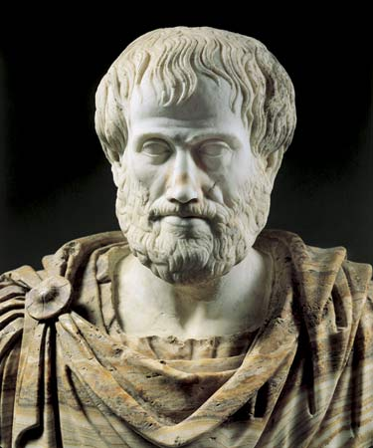
Aristotle on Virtues
Virtues
Moral Virtues
Moral virtues relates to those virtues which an individual develops or acquires through practice.
Intellectual Virtues
These virtues are developed over a period of time through experience

Slide 20
Cardinal Virtues
Prudence
Prudence can be equated to good judgment and right reasoning
Self-Control
It is the ability to control the self and acquire self mastery
Justice
Justice could be described as the conscious realization of a person about the others rights and giving them what they deserve
Courage
Courage is the ability to face and to overcome difficult situations

Slide 21
Three Approaches to Ethics
Immanuel Kant - Deontological
Aristotle - Teleological
Emmanual Levinas - Relational
384 BC – 322 BC
January 1906 – December 1995
April 1724 – February 1804

Slide 22
Teleological approach
A teleological moral theory defines right action in terms of the good.
A moral theory is regarded as teleological to the extent that it defines and explains right actions in terms of the bringing about some good state of affairs.
For example, a moral theory that maintains that the rightness of an action is one which achieves the goal of maximizing happiness counts as a teleological theory.

Slide 23
Teleology and Deontology
A teleological connection between the theory of right and the theory of value, therefore, emphasizes that morality (good behavior) is oriented toward bringing about a certain goal. A non-teleological connection denies this.
It can be concluded that while deontology is action oriented, teleology is both action as well as result oriented.

Slide 24
Teleology and Utilitarianism
Teleological ethics theory of morality that derives duty or moral obligation from what is good or desirable as an end to be achieved. Utilitarian type theories hold that the end consists in an experience or feeling produced by the action.
Simply speaking utilitarianism is result oriented where as teleology is both action and result oriented.
All together speaking deontology and utilitarianism both make up what is known as teleological approach.

Slide 25

Aristotle
Aristotle considered ethics to be a practical science, that is, one mastered by doing rather than merely reasoning.
“If it is true that in the sphere of action there is an end which we wish for its own sake, and for the sake of which we wish everything else … it is clear that this will be the good or the supreme good.
In order to become happy we develop habits that represent the best of what it means to be human.
Aristotle calls these excellences virtues.

Slide 26
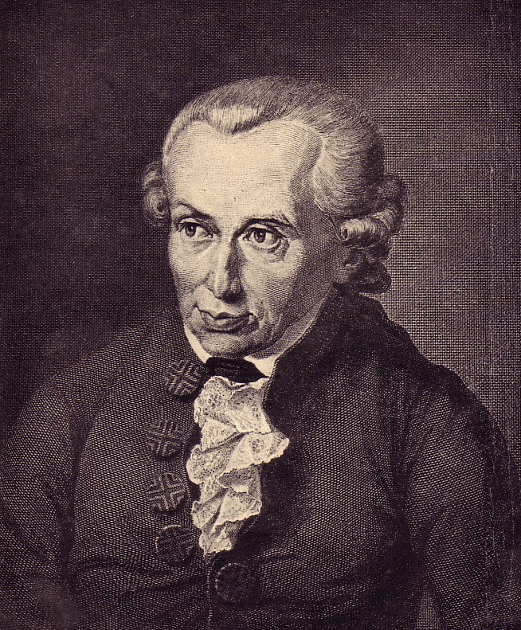
Three Approaches to Ethics: Deontological
Kant saw two types of ways of how we come to know things:
  Theoretical Reason
  and
  Practical Reason

Slide 27
Three Approaches to Ethics: Deontological
Theoretical Reason
How we come to know how laws of nature govern human behaviour
Freedom of choice not an issue

Slide 28
Three Approaches to Ethics: Deontological
Practical Reason
Helps us understand how people make choices
People act on conscious choice based on principles
Understand what we ought to do

Slide 29
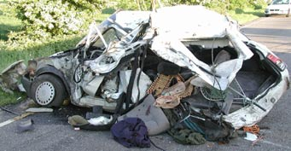
Three Approaches to Ethics: Deontological
Drinking and Driving
Theoretical Reason tells us the effect of alcohol consumption on the body
Practical Reason tells us that we ought not to drink and drive

Slide 30
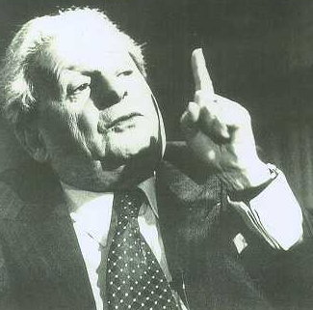
Three Approaches to Ethics: Relational
Emmanuel Levinas (1905-1995)
Perceived a contrast between Jewish beliefs and Western philosophy

Slide 31
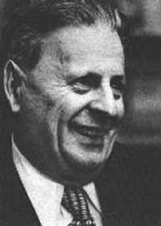
Three Approaches to Ethics: Relational
The Good is Infinite
The search for the Good is the central question of philosophy for Levinas. This is the search for God.
Individuals are unique and this uniqueness is the interest of the Good

Slide 32
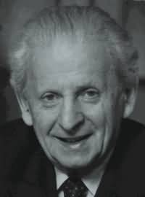
Three Approaches to Ethics: Relational
These unique things are traces of God
We do not encounter God directly, but rather the trace of God.

Slide 33
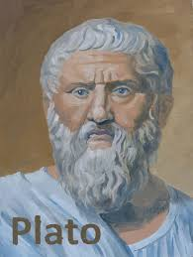
Approaches of prosperity Plato
Plato maintains a virtue-based conception of ethics.
Human well-being is the highest aim of moral thought and conduct, and the virtues are the requisite skills and dispositions needed to attain it.
Plato's conception of happiness is elusive and his support for a morality of happiness seems somewhat subdued.
He defines happiness as a self-sufficient state of the active individual.

Slide 34
A Brief Biography of Jeremy Bentham (1748-1832)
Born in London, England
Studied law at Queen’s College, Oxford, England
Instead of practicing law, he spent his life looking for and writing about ways in which existing laws could be improved

Slide 35
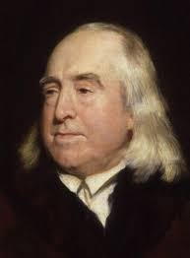
Jeremy Bentham
Bentham formulated the principle of utility, which approves of an action in so far as an action has an overall tendency to promote the greatest amount of happiness. He defines happiness as pleasure and the absence of pain.

Slide 36
Bentham’s Principle of Utility
Pain and pleasure dictate how people think they should behave and more importantly, how they actually do behave
So, according to Bentham (and behavioral psychologists) people will act in a manner that increases the likelihood of pleasure and reduces the likelihood of pain as the result of their action(s)

Slide 37
Pleasure and Pain
Types of Pleasure:
Sense
Wealth
Skill
Amity
Power
Piety
Benevolence
Malevolence
Memory
Imagination
Expectation
Friendship
Relief
Types of Pain:
Awkwardness
Pains of the senses
Enmity
Piety
Benevolence
Malevolence
Memory
Imagination
Expectation
Friendship
A bad reputation

Slide 38
In Summary, Bentham thought that,
People are motivated by pleasure and -- pain-avoidance.
The amount of pleasure in the world should be increased
Laws should increase the amount of pleasure in the community and not increase the amount of pain
Punishment should only be used when it was absolutely necessary and should be proportional to the offense; he did not believe in groundless, needless, ineffectual, or expensive punishment
Notes:
It is important to remember that Bentham went to law school and much of his writing was concerned with law and government

Slide 39
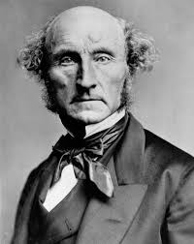
John Stuart Mill
The ethical theory of John Stuart Mill (1806-1873) is most extensively articulated in his classical text Utilitarianism (1861).
Its goal is to justify the utilitarian principle as the foundation of morals.
This principle says actions are right in proportion as they tend to promote overall human happiness.
So, Mill focuses on consequences of actions and not on rights nor ethical sentiments.

Slide 40
Essence of Mill’s Theory
Utilitarianism
Maximization of good over bad – greatest happiness principle
“actions are right in proportion as they tend to promote happiness; wrong as they tend to produce the reverse of happiness”.

Slide 41
Essence of Mill’s Theory
Libertarian – On Liberty
people can do anything they like as long as it does not harm others
Moral and economic liberty
Free markets
He believed that freedom would lead to the best possible outcome for society

Slide 42
Essence of Mill’s Theory
Advocates and critics of Mill's views have argued that he does not take liberty - as an absolute standard of value and believed that -- equality and social progress are more important goals than liberty
He was interested in redistribution of income in order to achieve best possible outcome – the greatest happiness

Slide 43
How was J.S. Mill influenced by the ideas of Jeremy Bentham?
Bentham's focus on social reform which was of interest to J.S. Mill, but Mill did not agree with Bentham on all matters
  Bentham treats all forms of happiness as equal, whereas Mill argues that intellectual and moral pleasures are superior to more physical forms of pleasure.
  Mill not believe in the dogmatic view that pain/pleasure was the only way to analyze human behavior

Slide 44
Ethics
Committee

Slide 45
What is an Ethics Committee?
An ethics committee is a committee formally designated to review and approve the initiation of involving human participants and to provide continuing review of Ethical practices
Institutional Review Board = Ethics Committee

Slide 46
Responsibilities of an Ethics
Committee
The responsibility of an ethics committee is to ensure the protection of the rights, safety and well-being of participants involved in.

Slide 47
Composition of an Ethics
Committee
Collective qualifications and experience
At least 5 members
At least one member of Institution
At least one member independent of the institution/study site.

Slide 48
Operation of an Ethics
Committee
EC members make decisions at announced meeting, Only members independent of investors and sponsor can vote, members who participate in the review and discussion can vote.
Head of Institution can provide information but cannot vote.

Slide 49
Procedures and Records
Maintain a list of EC members
Follow written procedures
Retain records for at least 3 years after completion of study

Slide 50
ETHICS OFFICER

Slide 51
ETHICS OFFICER
An ethics officer is someone who aligns the practices of a workplace with the stated ethics and beliefs of that workplace and holding people accountable to ethical standards.
Ethics officers are an increasingly common sight in the business community, and they can also be found at colleges and universities, where ethical conduct is often an issue of grave concern for students and staff.
Special qualifications are not required to act as an ethics officer, although people in this position generally tend to have excellent ethics.

Slide 52
EO’s - Objective
The ethics officer serves as the organization's :-
internal control point for ethics and improprieties,
allegations,
complaints,
conflicts of interest
provides corporate leadership and advice on corporate governance issues.

Slide 53
Essential Functions
Develops and circulates corporate ethics statements, policies and supporting forms/acknowledgements.
Provides an internal review of other corporate policies to ensure corporate consistency and integration with the corporation's ethics philosophies. Integrates the corporate ethics message throughout the corporate culture.
Oversees the development and implementation of corporate ethics and conflict-of-interest training and conducts ethical decision-making training for senior management on ethics issues and avoiding conflicts of interest.

Slide 54
Essential Functions
4. Develops and maintains confidential procedures for the handling and processing of complaints and allegations. Provides processes for the confidential hearing of employee issues related to the ethics or conflicts.
5. Maintains an up-to-date knowledge and understanding of corporate governance requirements, compliance and reporting responsibilities, and related legal benchmarks from federal and state law.

Slide 55
Ethics in finance

Slide 56
Why is it important to worry about ethics in finance?
When you think about it, you realize that you put your hard-earned savings in the care of financial firms – asset managers, banks, insurance, and all kinds of funds – and you trust them to look after the money.
You want the best return, but there is a balance between risk and reward.
You need to feel confident that you can trust the finance professionals to act with integrity, in your interests.

Slide 57
Financial sector in INDIA
REGULATORS
RBI, Reserve Bank of India.
SEBI, The Securities and Exchange Board of India .
FMC, Forward Markets Commission
IRDA, Insurance Regulatory and Development Authority
PFRDA, Pension Fund Regulatory Development Authority
MoF, Ministry Of Finance
MARKETS
Commodities, equities, debt , foreign exchange
PLAYERS
Brokers, firms, banks, financial institutions, FII (Foreign Institutional Investment),mutual fund managers, investors, exchanges, depositories, custodians, registrars

Slide 58
ETHICAL VIOLATIONS
(finance related)
Insider trading
  Insider trading is the trading of a corporation's stock or other securities (e.g. bonds or stock options) by individuals with potential access to non-public information about the company
  Such a trade is motivated by the possibility of generating extraordinary gain with the help of nonpublic information (information not yet made public). It gives the trader an unfair advantage over other traders in the same security.

Slide 59
2-Stakeholder interest V/s stockholder interest
Shareholders hold shares in the company – that is they own part of it.
Stakeholders have an interest in the company but do not own it (unless they are shareholders).
Often the aims and objectives of the stakeholders are not the same as shareholders and they come into conflict.
The conflict often arises because while shareholders want short-term profits, the other stakeholders’ desires tend to cost money and reduce profits. The owners often have to balance their own wishes against those of the other stakeholders or risk losing their ability to generate future profits (e.g. the workers may go on strike or the customers refuse to buy the company’s products).

Slide 60
3. Campaign financing
campaign finance reform definition.
A movement, fueled in recent decades by political candidates' increasing dependence on expensive television advertisements, to restrict the amount of money that individuals and interest groups can contribute to political campaigns.

Slide 61
Examples of unethical temptations
Offer a customer an unauthorized ‘gift’ in return for their business
Secrete information from a customer in order to get their business and to meet your sales’ goals
Put non business-related expenses on your expense account
Exposing confidential information about one customer to another in order to facilitate a sale

Slide 62
Ethics In Financial Service
The Financial Services industry is also highly regulated. Regulation minimizes fraud, theft and misuse. Ethics purifies the industry. Ethics set the standards of excellence for professionals in financial services.

Slide 63
Code Of Ethics
Protecting the financial interests of clients
Conducting business with high transparency
Conducting needs analysis before any product or service recommendations
Respecting and maintaining confidentiality of any information entrusted to you
Use of only sales illustrations that are completely accurate and if any compliant inform state and Central Govt regulations

Slide 64
Implementing and Auditing Ethics Programs

Slide 65
The Ethics Audit
Systematic evaluation of an organization’s ethics program and performance to determine whether it is effective

Slide 66
The Social Audit
Process of accessing and reporting a business’s performance in fulfilling the economic, legal, ethical, and philanthropic responsibilities expected by its stakeholders

Slide 67
Benefits of an Ethics Audit
Identify potential risks and liabilities and improve legal compliance
Can be key in improving organizational performance
Improved relationships with stakeholders

Slide 68
Ethical Crisis Management
Plans to respond and recover from disasters that can disrupt operations, destroy organizational reputation and erode shareholder confidence

Slide 69
The Auditing Process
Secure top management and board commitment
Establish an ethics audit committee
Define the scope of the audit
Review the organizational mission, goals, and values
Collect and analyze relevant information
Verify the results through an outside agent
Report the findings to
  Audit committee, managers, and stakeholders

Slide 70
Assignment -1
1. Importance of Self discipline, System, Value, culture, Integrity, Trust, Moral and Virtue.
2. Meaning of Business Ethics
3. Meaning of Ethics Committee, Finance, Audit.
Last date of submission before 17th of November.

