Slide 1
Ethics
in
HR

Slide 2
Definition
Edwin.B.Flippo
“ Planning, Organizing, Directing and Controlling of the Procurement, Development, Compensation, Integration , maintenance and reproduction of Human Resources to the end that individual, organisational and societal objectives are established.”
Maintain competent workforce to achieve the goals of the organisation

Slide 3
Nature of HRM
People dimension in management - HRM tries to secure the best from people by winning their wholehearted cooperation.
Bringing people and organisation together where the goals are met.
HRM means to acquire, develop, stimulate and keep competent workforce efficient and effective.

Slide 4
Features
1.Pervasive force- HRM is present in all enterprises.It is involved in all levels of management in an organisation
2.Individual oriented - It tries to help employees develop their potential fully and encourages to give their best to the organisation.
3.People Oriented - HRM is all about people at work,both as individual and group
4.Action Oriented – HRM focusses attention on action rather than on record keeping,written procedures or rules
5.Development Oriented - HRM intends to develop the full potential of employees

Slide 5
6.Future oriented - HRM focus on achieving the goals by providing well motivated employees.
7.Integrating mechanism - HRM builds a cordial relationship among people in various levels of organisation.
8.Inter disciplinary - HRM is multi disciplinary developed from psychology, sociology, anthropology, economics etc..
9.Auxilliary Service - HR departments assist and advise personnel to work more effectively .
10.Continuous function -

Slide 6
Objectives
1.To employ skills and ability of workforce efficiently and develop their ..competence level
2.Provide well trained and well motivated employees
3.To increase job satisfaction and self actualisation
4.To help organisation reach its ...(goals and objectives)
5.To improve Quality of Work Life
6.To have ethical and Social Responsibility to meet the needs of the society and communicate HR policies to all.

Slide 7
Analyzing HR Dilemmas
Right v. Right “Selecting the best option”.
•
•
It’s right to tell the truth, but it is also right to be kind and
considerate of peoples’ feelings and emotions.
•
It’s right to apply rules and procedures equally, without
favoritism, but it is also right to give special treatment to
hard-working, dependable, and productive employees.

Slide 8

Guidelines for Fostering
an Ethical Culture
•
Have a well developed policy
and procedures manual
Enforce policies Reward
compliance Recruit
ethical employees
Create a division to oversee ethics
•
•
•
•

Slide 9

Ethical culture
worklife
in
isation
nsibility
•
•
•
•
•
•
•
Honest communication
Fair treatment
Special consideration
Fair competition
Responsibility to organ
Corporate social respo
Respect for law

Slide 10




ETHICAL
HRM
PRACTICES

Slide 11
HRP (Human resource Planning)
  Assessment of HR requirements
  Time & stages of requirements
Right person ---Of Right type ---In Right number
Definition – HRP is defined as the process by which management determines how an organization should move from its current manpower position to its desired manpower position.
HRP is also called manpower planning, personnel planning or employment planning .

Slide 12
FACTORS AFFECTING HR
Type & strategy of organization
Organizational growth cycles & planning
Environmental uncertainties
Type & quality of information
Time horizons
Labour market
Outsourcing

Slide 13
Organizational growth cycles & planning
Embryonic stage
Growth stage
Mature stage
Decline stage

Slide 14
Environmental uncertainties
HRP
Political
Social
Economic
Recruitment, selection & training
Balancing mechanisms:-
  Succession planning
  Layoffs
  Flexitime & job sharing
  Retirement

Slide 15


RECRUITMENT & SELECTION
LAYOFF OR RETIREMENT

Slide 16

Staffing and selection
•
•
•
•
Know your employment law
Follow the ethical recruitment guidelines Use pre-employment information services Use reference checking forms

Slide 17
Type & quality of information
    Forecasting
    Well developed job-analysis information
    HRIS
    The Human Resource Information System (HRIS) is a software or online solution for the data entry, data tracking, and data information needs of the Human Resources, payroll, management, and accounting functions within a business. It is useful for all processes that you want to track and from which you hope to gather data

Slide 18

Training
To recognize ethical issues
Use of ethical guidelines to resolve problems
Targets and methods of ethical training
•
•
•

Slide 19


Performance Appraisal
❖
Cultural dimensions of collectivism and power distance
make objective appraisals a challenge.
▪
▪
▪
Supervisors and subordinates develop close relationships.
Organizational loyalty is as important as work performance. Employee promotions are frequently based on seniority.
❖
❖
Annual performance appraisals.
Supervisors provide performance ratings that are frequently inflated due to personal relationships.

Slide 20
Compensation and
Benefits
In addition to a base salary, compensation includes:
•
–
–
–
–
House rent allowance (HRA*).
Medical allowance.
Dearness allowance (DA*).
Leave travel allowance (LTA*).
Several categories of leave (vacation) exist:
•
–
–
Sick leave: (medical certificate required).
Casual leave: (for personal and family emergencies, requires prior permission of boss).
Annual leave: (after one year of employment).
Federal holidays
–
–

Slide 21
Equal opportunity
laws
Avoid any kind of discrimination based on:
Age, caste, culture, appearance etc..
Disability
Ethnic/National origin, colour, race, religion, gender
Fair labour standards.

Slide 22
Ethical discipline
ethics at work place :
Issues affecting privacy of employees,
sexual harassment
The individual goals on an employee must be streamlined with the org. goals.
Equal opportunity to all – to develop their competency skills.
Decision taken by the management must be Ethical & Legal.

Slide 23



UNETHICAL
HRM
PRACTICES

Slide 24



•
•
•
•
Demotivate individuals
Make good employees leave the company
Attract unethical employees
Lead to the lack of trust by the employees for the company

Slide 25
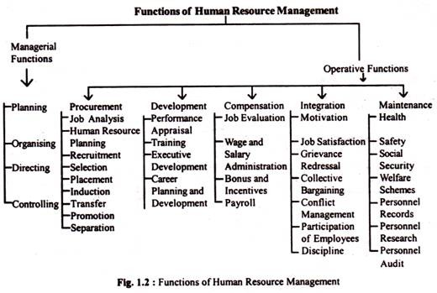

Slide 26
Managerial Function
Planning – This function deals with determination of future course of action to achieve desired results.
Organising – Primarily concerned with proper grouping of personnel activities,assigning of different groups of activites to different individuals and delegation of authority.
Directing – It involves supervising and guiding the personnel
Controlling – It comprises measuring the employee’s performance,correcting deviations assuring effective accomplishments of plans

Slide 27
Operative Functions
Procurement function
- Job analysis
- Human Resource Planning
- Recruitment
- Selection
- Placement
- Induction and orientation
- Internal Mobility

Slide 28
Development
- Training
- Executive development
- Career planning and development
- HRD
Motivation and compensation
- Job design
- Work Scheduling
- Motivation
- Job evaluation
- Performance appraisal
- Compensation administrative
- Incentives and benefits

Slide 29
Maintenance
- Health and safety
- Employee welfare
- Social Security measure
Intergation function
- Grievance redressal
- Discipline
- Collective bargaining
- employee participation and empowerment
- trade unions
- Industrial relations

Slide 30
Emerging issues
-Personnel record
- Human Resource Audit
- Human Resource accounting
- International HRM
- HRIS

Slide 31
Policy
-policy is one which Guide Action to perform an activity
-it is general standards/parameters based on which the decisions are reached where as a procedure is a document written to support a “Policy directive”
Personnel Policy - Derived from personnel objectives of management
Past experience in the form of useful guidelines
As a guide to executive thinking it permits managers to transfer some recurring pbms to subordinates
Achieving coordination
Predict action and decision of others

Slide 32
Categories :
i.Source(originated,appealed,imposed)
1.Originated policy-established by top management
2.Appealed policy – formulated to meet the requirements of certian situations
3.Imposed policy – formed under the pressure from external agencies like govt,unions

Slide 33
ii.Scope –(general,specific)
1.General – reflect the basic philosophy and priorites of top management in mapping out the org growth chart
2.Specific – specific issues such as hiring,rewarding,and bargaining
iii.Form (written,implied)
Implied – inferred from behaviour of members.
Written-managerial thinking on paper,rather than avoiding loose interpretation

Slide 34
Advantages :
Delegation,
uniformity,
better control,
standards of efficiency,
confidence,
speedy decisions,
Coordinating.

Slide 35
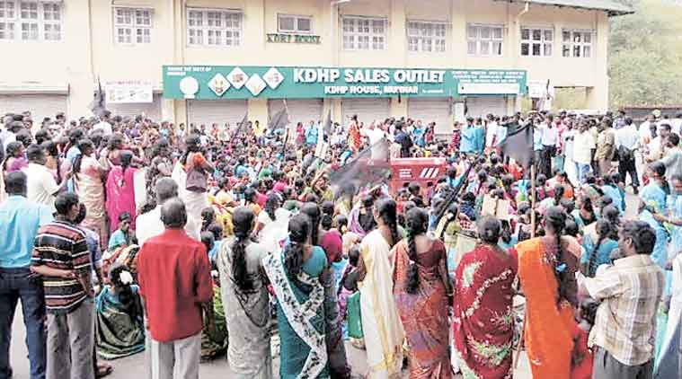
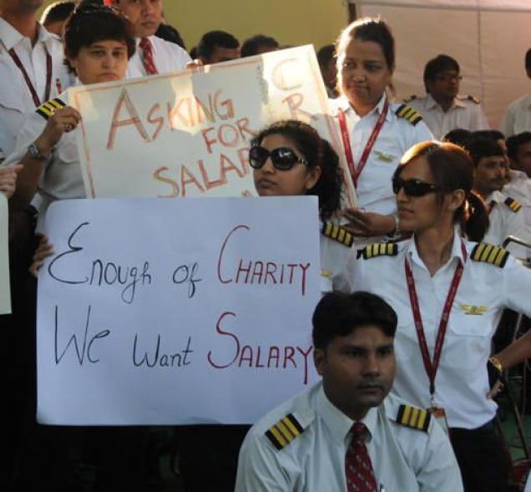
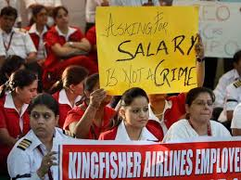
Example

Slide 36
Stages/Growth in HRM
Welfare Stage(before 1947)-Focussed on Welfare management and paternalistic practices
Industrial Relation stage(1947-1960) – Focussed on expanding the role to cover labour,welfare,industrial relations and personnel administation
Personnel administration stage(1970s)
Personnel management stage(1980s) focussed on efficiency and effectiveness of organisation goals and also emphasising on human values,aspiration,dignity,usefulness
HRM Stage (1980 s onwards) – focuses on incremental productivity gains through human assets.

Slide 37
For your reference
Books :
- Human Resource Management – V.S.P.Rao
- Human Resource Management -Dwivedi

Slide 38


CASE STUDY
The Retrenchment Drama,
Jet Airways (India)

Slide 39

•
The case is about the retrenchment
drama that unfolded in one of India’s
leading aviation companies, Jet
Airways (India) Limited in Oct 2008.
•
More than thousand employees
were laid off.
•
It was a part of major Cost-cutting
exercise to tackle Global slowdown
and price hike of Aviation fuel.

Slide 40
The retrenchment
drama unfolds…..
Oct 16, 2008, Jet announced that it would lay off nearly 1,100 of its staffs to streamline operation.
•
•
A day after it had already laid off around 800 of its cabin crew members.
•
Simultaneously announced second phase of lay-off of 1100 employees, mainly from departments like flight attendant, cockpit crew etc.

Slide 41

Ethical issues……
Some most crucial questions
unanswered….
❑
Where would those 1900
employees go?
Why took action only against lower grade staffs?
Senior management was very
less affected.
What would be the future of those students currently taking courses in cabin crew, captain etc?
❑
❑
❑

Slide 42
Some
observations…..
❖
The very existence of any company is because of its
employees.
Company keeps on focusing on customer satisfaction
when its own people are so highly dissatisfied.
Employees are more than just-a-resource.
❖
❖

Slide 43
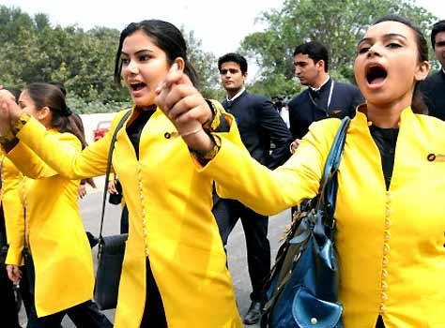

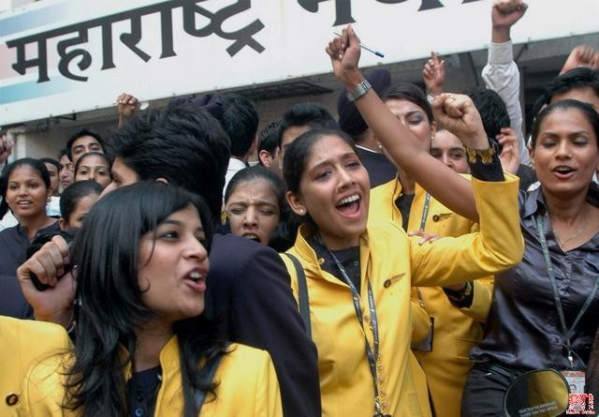
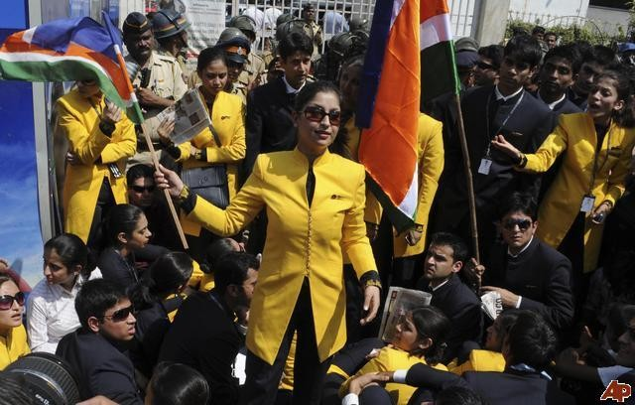
Protest against
Management

